Slide 1
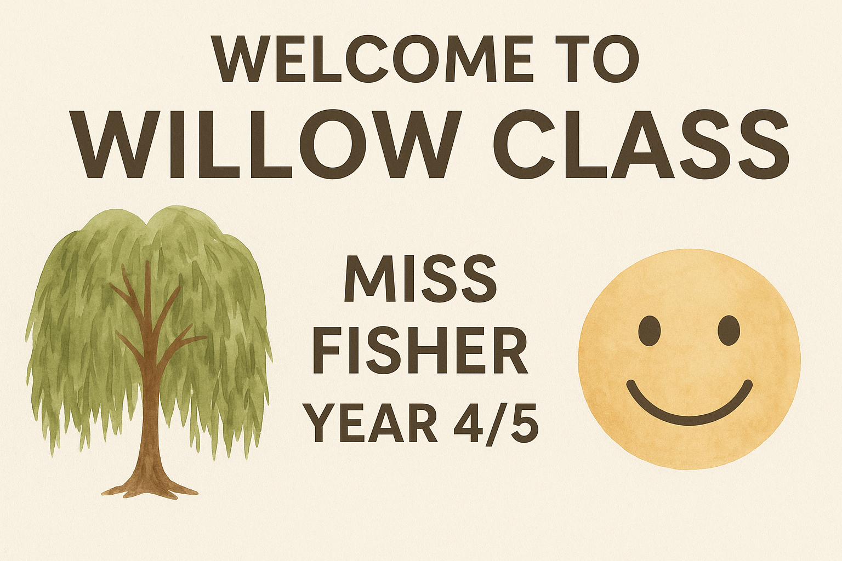
Welcome to Willow Class
Miss Fisher – Year 4/5
2025-2026

Slide 2
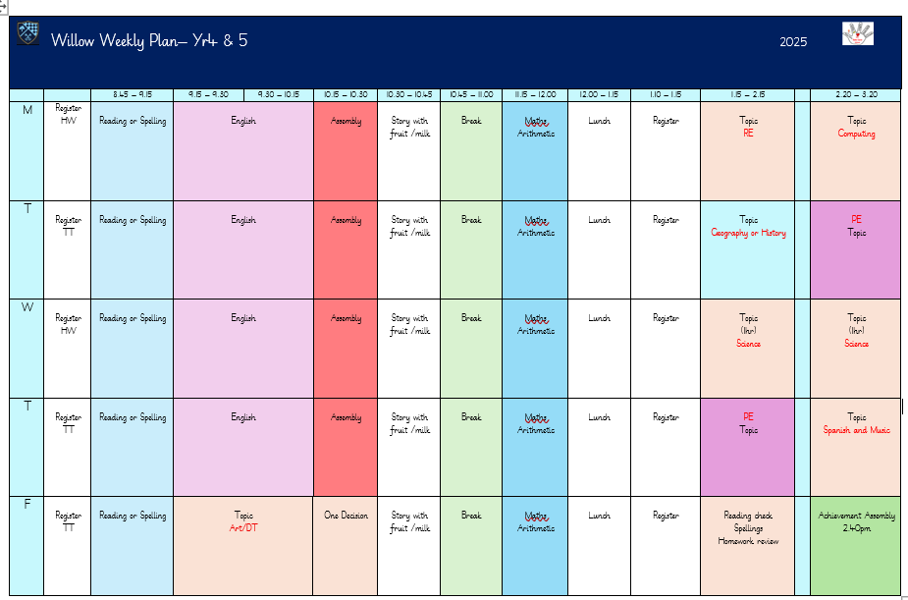

Slide 3

English
Term 1: Fiction: Description & Setting, Non-fiction: Instruction and Poetry
Term 2: Non-fiction: Recounts, Fiction: Character & Dialogue and Non-fiction: Information
Term 3: Fiction: Suspense & Action and Persuasion

Slide 4
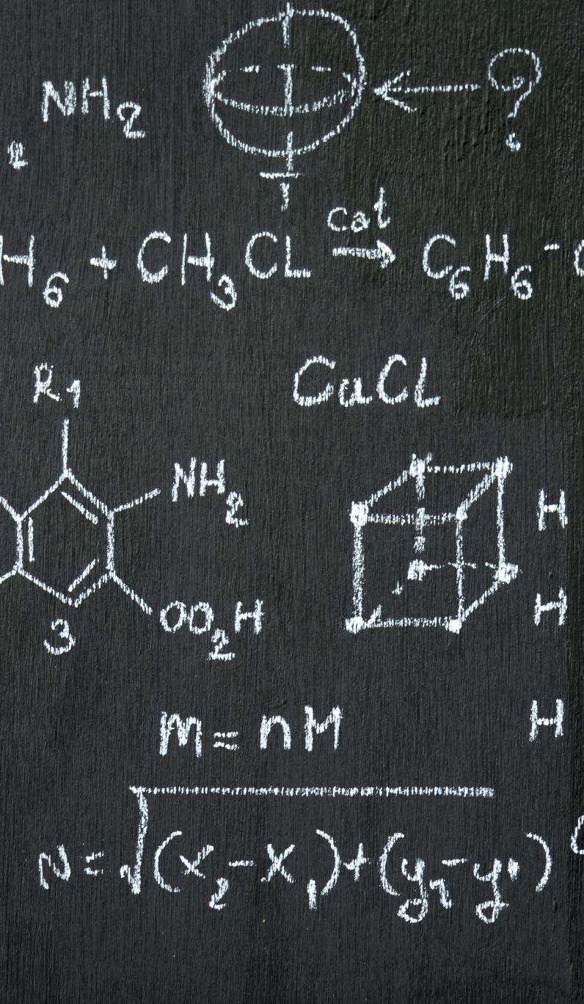
Maths
Term 1: Place Value, Addition and Subtraction, Multiplication and Division A, Measure and Area
Term 2: Multiplication and Division B, Length and Perimeter, Fractions A, Mass and Capacity, Fractions B
Term 3: Time, Decimals, Money, Shape, Position and Direction, Statistics

Slide 5
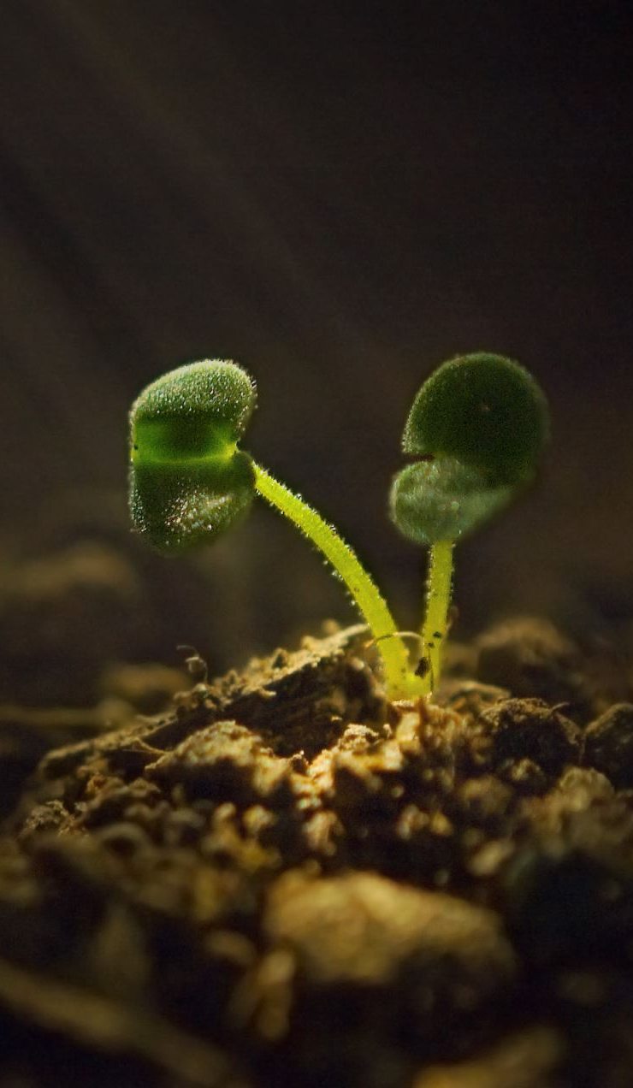
Science
Term 1: How can we slow down the parachute? How many planets are in our Solar System?
Term 2: Can we stop the aging process?
Term 3: Can all properties change their state?

Slide 6

R.E.
Term 1: Gospel: Creation and science: conflicting or complementary?/ Incarnation: Was Jesus the Messiah?
Term 2: Hinduism: How do people’s beliefs about God, the world and others have an impact? / Salvation: What difference does the resurrection make to Christians?
Term 3: People of God: How can following God bring freedom and justice? / Islam: How are religious and spiritual thoughts and beliefs expressed in architecture and in charity and in generosity?

Slide 7
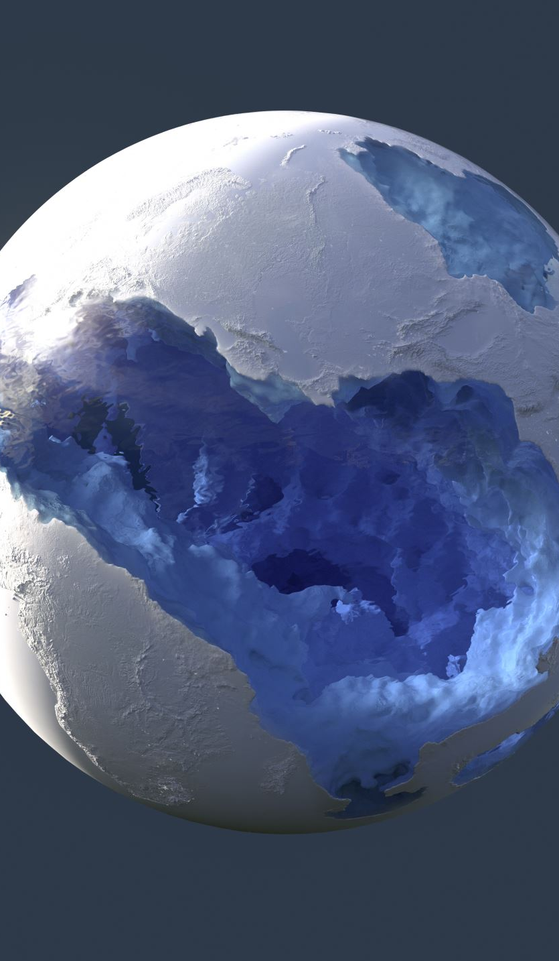
Humanities
Term 1:Which Ancient Chinese dynasties were significant? (History)
Term 2: How do plants, animals and farming shape the way we live and maintain sustainability? (Geography)
Term 3: Why were the Greeks significant? (History)

Slide 8
Art and D&T
Term 1: Why do you think ancient artists used the Taotie face in their art, and what do you think it meant to them? How can air be used to make things move?
Term 2: How did Pablo Picasso use shapes and colours to show emotions in his art? Why is it better to eat fruits and vegetables that are in season?
Term 3: How did Edvard Munch use colour and expression to show feelings in his art? How can we use different images, textures, and materials to tell a story through collage?"

Slide 9
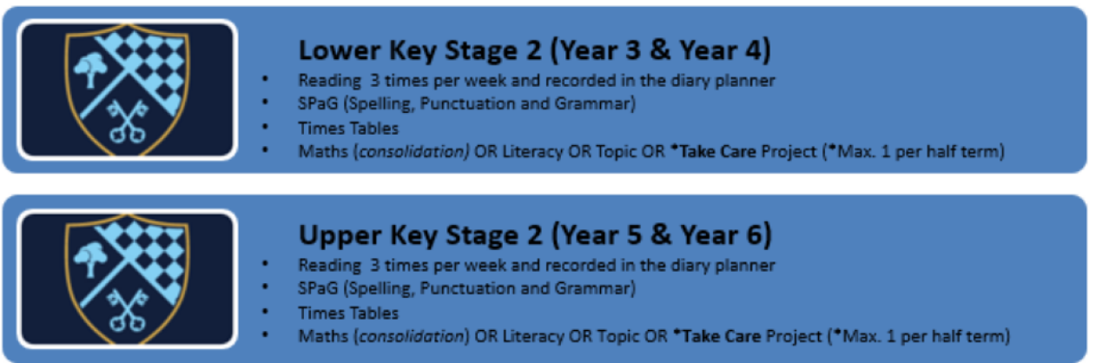
Homework

Slide 10
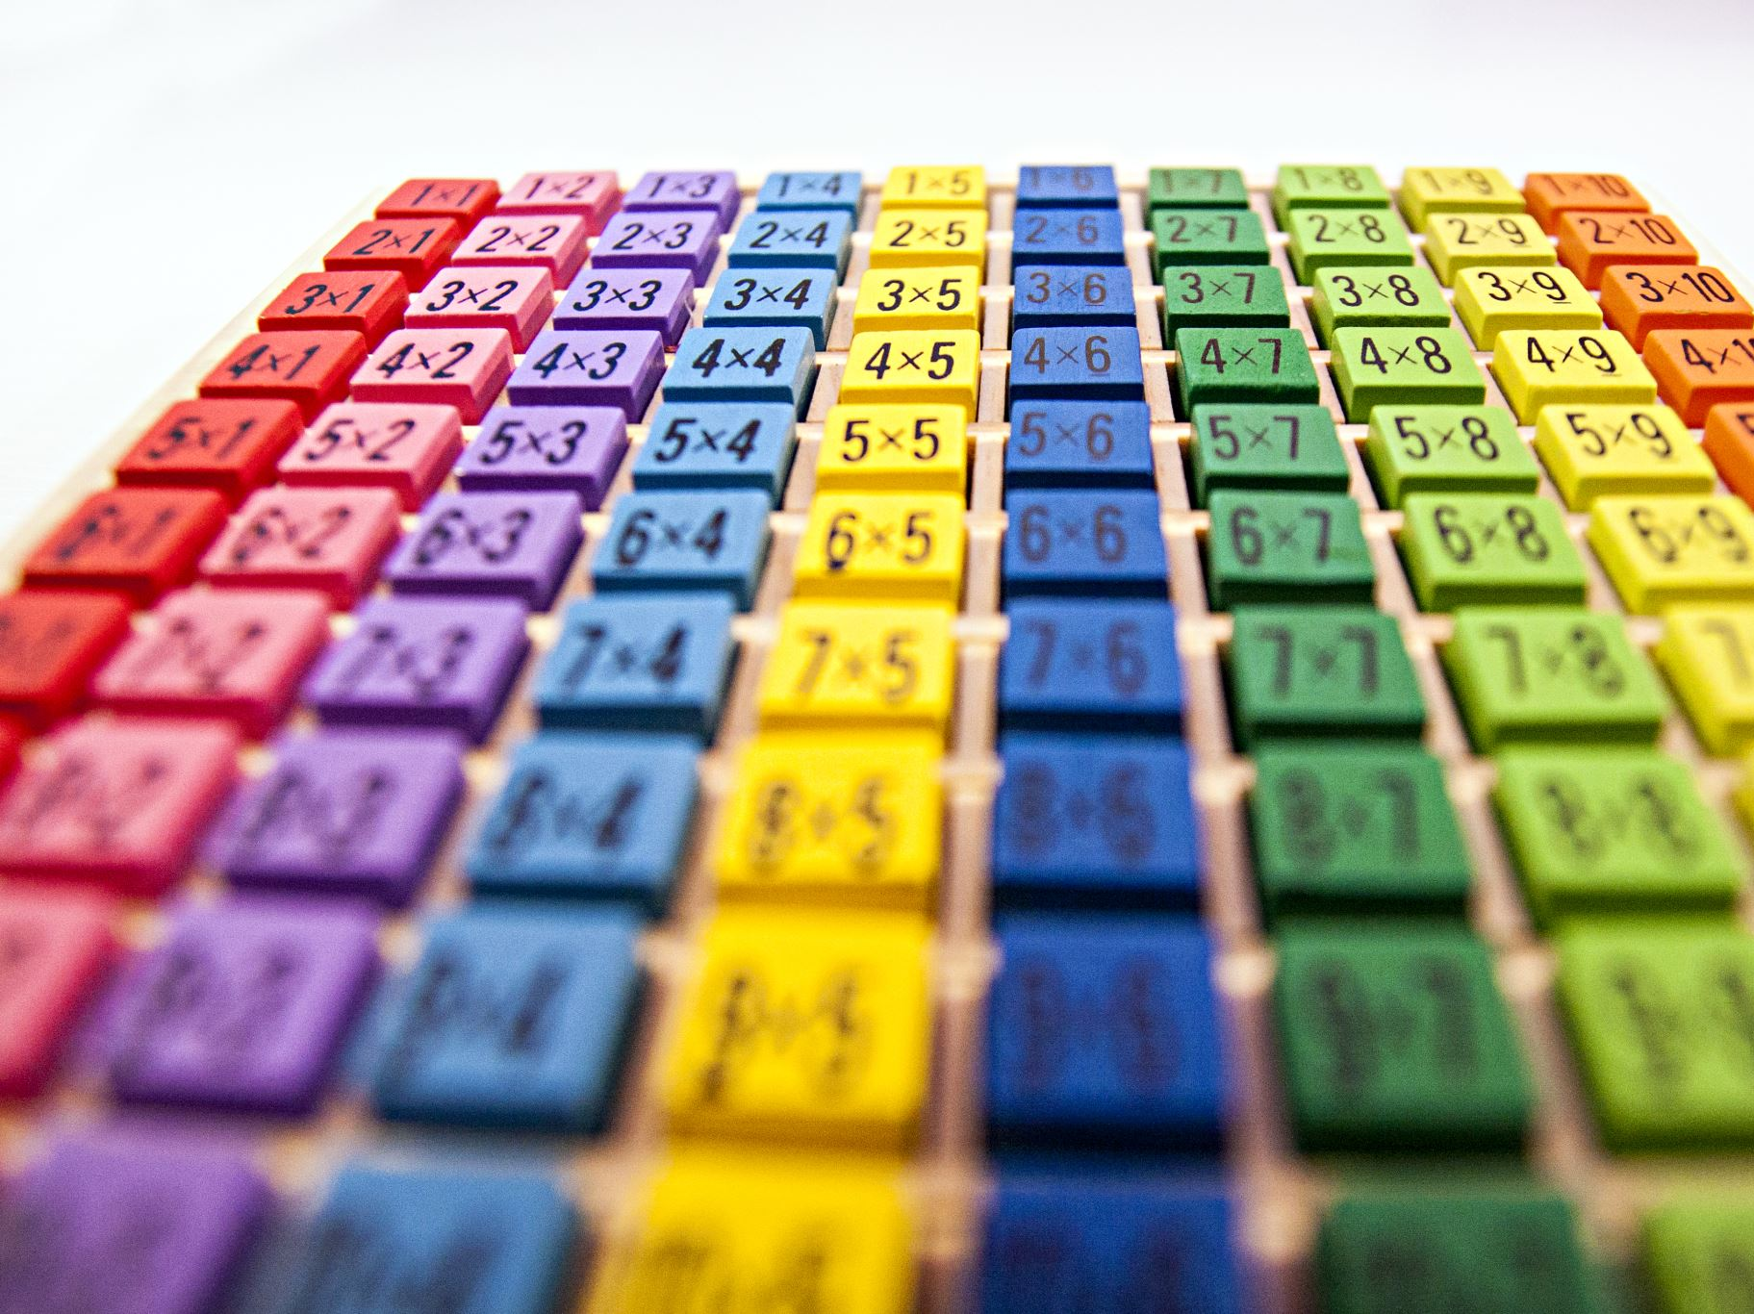
Homework
Children should use Times Tables Rock Stars to practise multiplication.
Usernames and passwords for TT Rockstars and Maths.co.uk will be found in diaries.
Daily reading from a variety of sources is strongly encouraged.
Take Care tokens and bookmarks will be awarded for effort.
Spellings follow the ‘No Nonsense’ scheme, plus statutory word lists.
Weekly homework will be set to support learning.

Slide 11

Rewards and Take Care Tokens
Take Care Tokens are rewarded for good behaviour or outstanding work.
Integrity Awards are given for children who go beyond expectations. Parents can also nominate children.
Midday staff give raffle tickets for good lunchtime behaviour.
Winners can sit at the Top Table the following week.

Slide 12
Trips and Residentials
We will attend day trips throughout the year.
Year 4 Residential: Duke’s Barn: June 2026. More details will follow closer to the date.

Slide 13

Reminders
Fortnightly newsletters will be uploaded to our class page.
Please name all clothing and equipment.
Read at least 3 times a week at home and record in diaries.
Water bottles labelled and brought daily.
PE days: will be confirmed (indoor & outdoor kits).
No pencil cases needed.
Preloved uniform available.
Clubs and dates: see 'Week at a Glance'.

Slide 14
Contact
If you need to get in touch, please email:
parentcorrespondence@st-peters.notts.sch.uk
Or catch Miss Fisher at the end of the day after dismissal.

