Slide 1
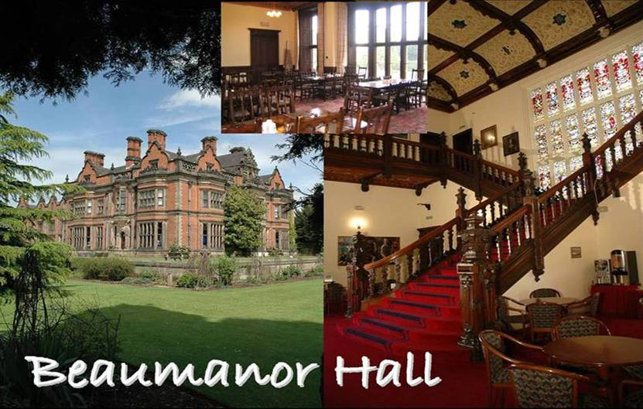
Beaumanor Outdoor Learning Centre

Slide 2
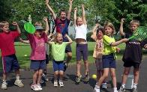
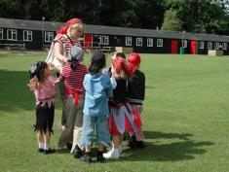
Residential Experience
SOME BENEFITS
Enrich the curriculum
Provide real life learning
Explore own potential
Increase self confidence
Team work and independence
Learn to manage risk
Notes:
The staff at Beaumanor believe passionately in the value of Outdoor Education and the benefits high quality outdoor learning can contribute to a young persons education. We will always try and work with schools to ensure the experiences we deliver to young people make a positive contribution to the school based curriculum.

Slide 3
Staff Members
Mrs Morrell
Mrs Gibbens
Miss McGrory
Mrs Williams
Mrs Adkinson
Miss Dunthorne
Staff are fully first aid trained along with the centre staff.
Split into two smaller groups with staff/1:1

Slide 4
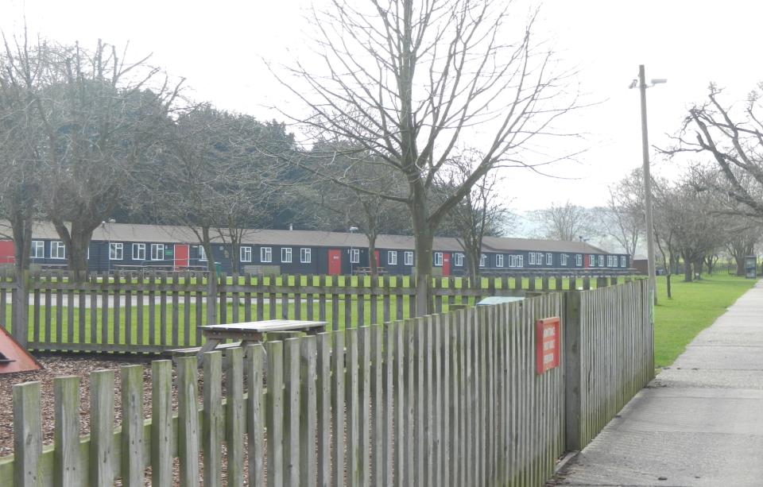
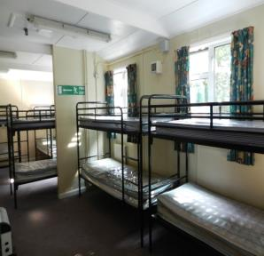
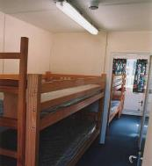
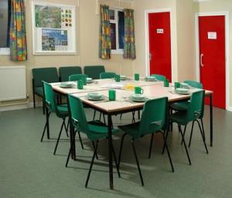
Arrival
Meet and greet off the coach
Escorted to a base room or cabins
Booking in procedures explained
Group settles in
Please send your child to school in appropriate clothes for the day time activities

Slide 5
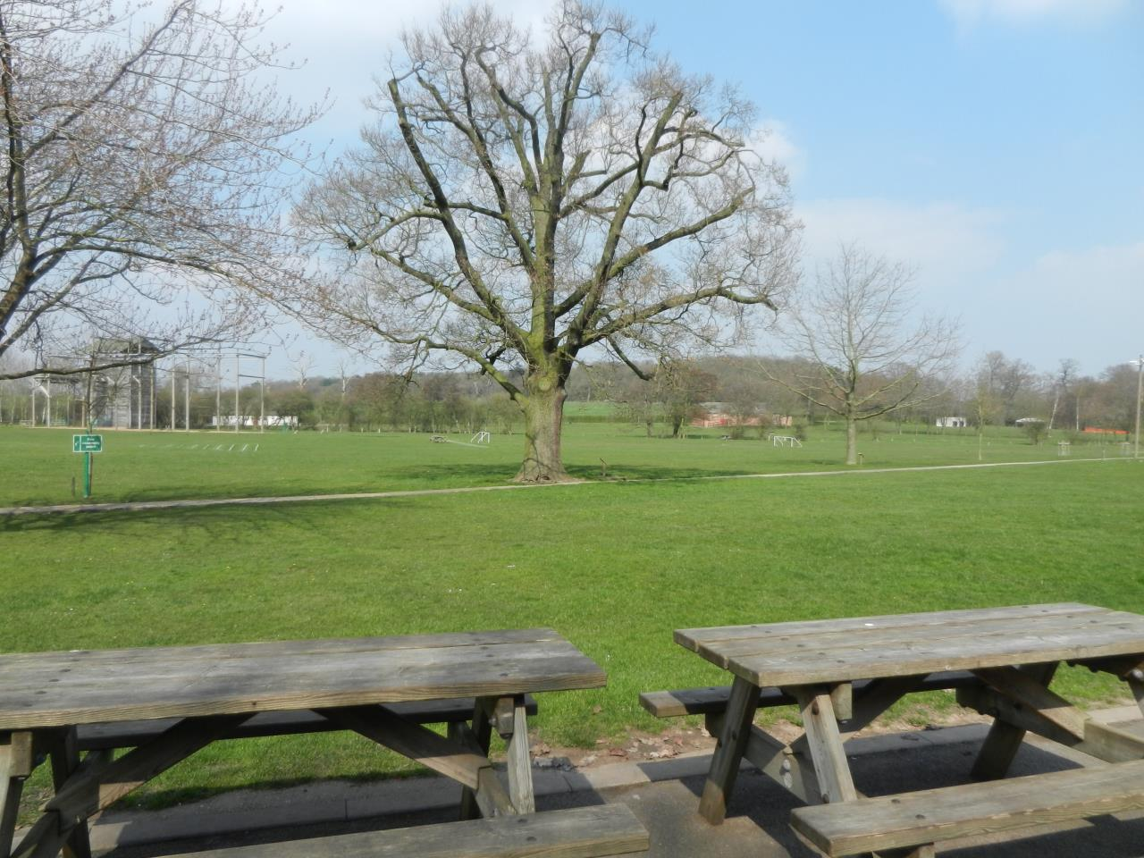
Residential kit
When packing with your child, please include enough clothing for 2 days of outdoor activity plus a comfortable evening outfit.
Sleeping bag- please practise putting this back into the bag!
Pillow
Nightwear
Underwear plus spares
Torch: optional
Toiletry bag; toothpaste, soap, brush/comb
Indoor shoes/slippers
Plastic bags
Waterproof Coat and trousers
Hand towel
Cuddly toy (small enough to fit into suitcase)
Tracksuit bottoms (no jeans as they are difficult to get dry)
Thermal / base layer
Sweatshirt / fleece
Hat, gloves and scarf
Old trainers and or wellies
Suntan lotion for hot weather!!!!

Slide 6

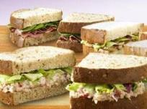

Mealtimes
Breakfast:
Cereals
Toast
Juice
Cooked breakfast
Lunch:
Sandwich
Cake
Fruit
Juice
Notes:
Lunch is a pack up, usually taken in or near the cabin, depending on the weather. There are picnic tables outside the cabins, plus the children are more than welcome to sit on the grassed areas.

Slide 7
All medicines must be given to Mrs Gibbens in the morning.
If your child needs an inhaler for a seasonal wheeze, please ensure you bring one for your child.
Thank you.

Slide 8
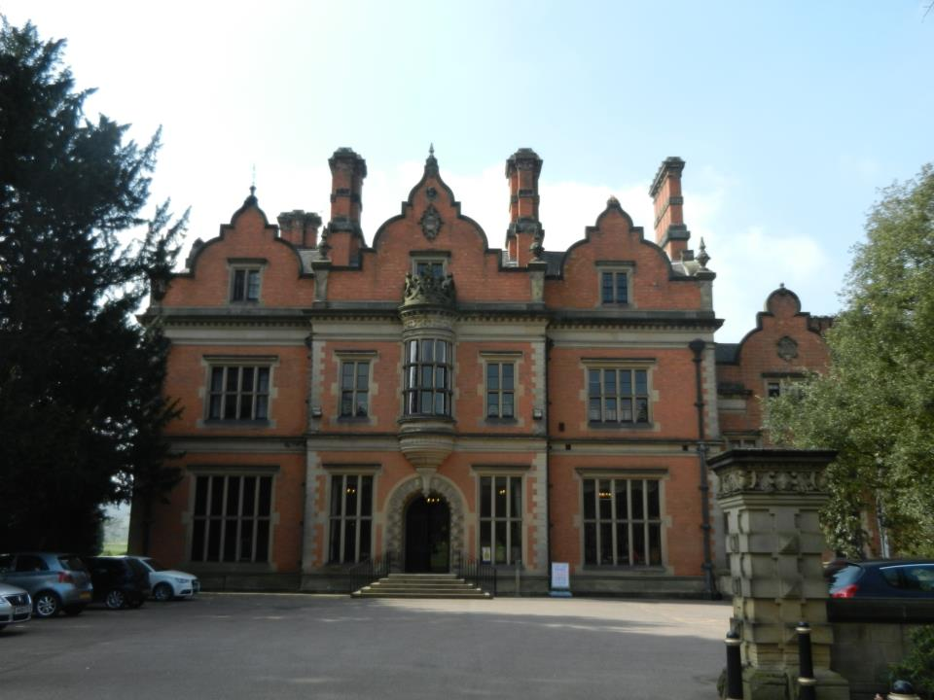
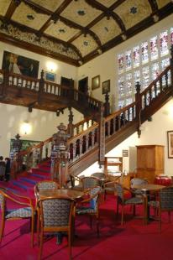
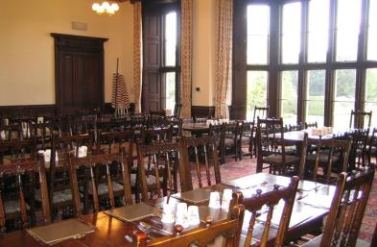
Mealtimes
Evening meal - example
  Chicken Dinner/veggies pasta
  Quorn Dippers/Chips
  Pizza(veggie)
  Pork Meatballs/Macaroni Cheese
  Salad bar
  Sponge/Flapjack/Cookies/Ice Cream
  Jacket Potatoes
  Yoghurts/fruit

Slide 9

Notes:
The day will include literacy and numeracy, themed around Pirates.

Slide 10
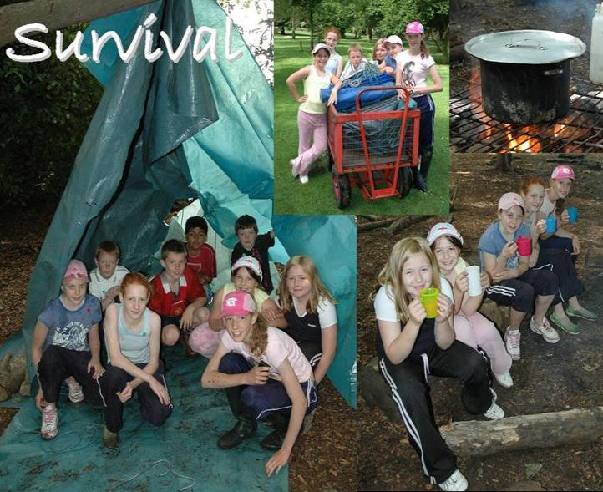
DAY TWO
Problem Solving
Safety
Teamwork
Life skills
Knowledge
Notes:
The children will be given the task of building a water-tight shelter in the woods at Beaumanor. Their instructor will throw a bucket of water on to their shelter to see how successfully the task has been completed. The activity calls upon students design skills and the ability to work as part of a team. The essentials for survival will be explored and how these requirements might be met.
They will then have some soup around a campfire.

Slide 11
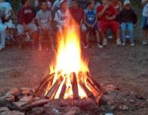
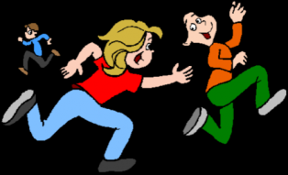
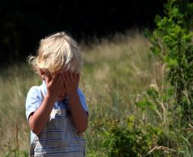
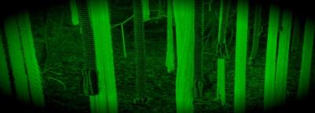
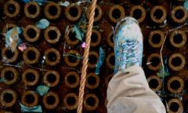
Evening activities
Games, stories and getting dorms ready
Then quiet time ready
for bed
Notes:
There is a small selection of evening activities form which the school will have selected:
Murder Mystery:
The group will do MM around the site, looking for clues to solve a mystery, inspired by the Victorian history of the house.
Cellars:
The group will play ‘Hide and Seek’ in the
Gym Games:
The children will play a selection of sport games in the gym or on the field – light and weather depending!
Campfire:
The children will sit around a campfire and play a few games. Visiting staff are more than welcome to lead singing round the campfire!
Night Line:
The night line is a rope trail running through our beautiful woodlands across numerous man-made obstacles. Participants follow the course blindfolded, meaning that other senses (and perhaps good communication from a sighted helper) must be relied upon to enable a safe and successful circuit of the course.

Slide 12

Itinerary
Monday: Arrive at school at 8.35 am
(All children who need travel sickness tablets to have taken them for a 9 am departure.)
Any medicines etc to be given to an adult. (Clearly labelled with your child’s name)
Luggage to be taken into the classroom.
Depart from school at 9.00 am. Arrive at approximately 10.00 am.
Tuesday: Depart at approximately 2pm.
Arrive back school at approximately 3.15 pm.
(Children to be collected at normal school finishing time)

Slide 13
Useful Information
No mobile phones, watches or electronic games.
No sweets or snacks, there will be a plentiful supply and food is NOT allowed in the dormitories.
Please label ALL clothing and belongings.
Please note that we recommend old, comfortable and warm clothing as the children will be working outside exploring and building shelters. Please come to school in these clothes ready for the activities when we arrive.
When packing, a suitcase or large sports bag is fine. Please try to pack with your child so they know what they have brought!
Children are expected to attempt to pack their own sleeping bags and suitcases (help will be on hand if needed).

Slide 14
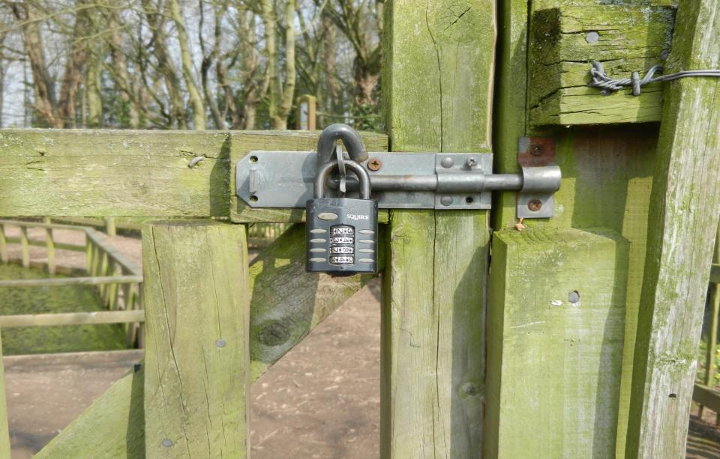

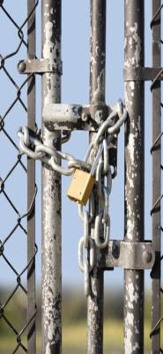
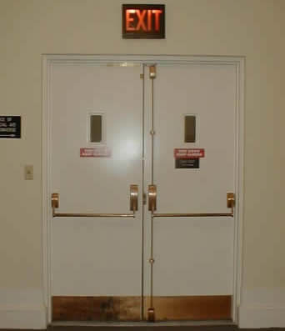
Security
Cabin doors: internal alarms
Fire doors
Windows
Private Site: Boundary fenced
Locked gate
Notes:
Cabin doors – once locked, there is no access from the outside, but those inside can still get out, as there are push bars on the doors.
The cabin doors have alarms which can be set at night-time.
Windows have a safety catch so that they can only be opened a little way.
The main site gate is locked at about 8:30. The group’s leader is issued with the security code, should they need to leave the site or allow someone, eg a parent, in.
They are also given the phone number of the duty person, should they need to call if there are any problems.

Slide 15
Security
Apple air tags or equivalent should not be attached to pupils/their belongings going on school trips or residential trips. This is a safeguarding decision.
Tracking devices undoubtedly offer a layer of security for parents, especially in crowded spaces such as festivals or theme parks. However, school trips and residentials are fully risk assessed and always supervised by an appropriate number of experienced staff. Staff value your trust and support with offering your children these out of school experiences, with staff helping to create safe environments for your children to explore their space with some independence.
Notes:
Cabin doors – once locked, there is no access from the outside, but those inside can still get out, as there are push bars on the doors.
The cabin doors have alarms which can be set at night-time.
Windows have a safety catch so that they can only be opened a little way.
The main site gate is locked at about 8:30. The group’s leader is issued with the security code, should they need to leave the site or allow someone, eg a parent, in.
They are also given the phone number of the duty person, should they need to call if there are any problems.

Slide 16
Please pack with your child
Practise packing sleeping bag and suitcases
Tooth fairy envelopes will be available
Pack layers

Slide 17
Beaumanor Outdoor Learning Centre
Notes:
Beaumanor Outdoor Learning Centre is Leicestershire County Council’s outdoor education provision.
Some views of the hall, showing the Victorian grandeur of the interior staircase. Also, a shot of the dining hall where the pupils will have their evening meals.

