Slide 1

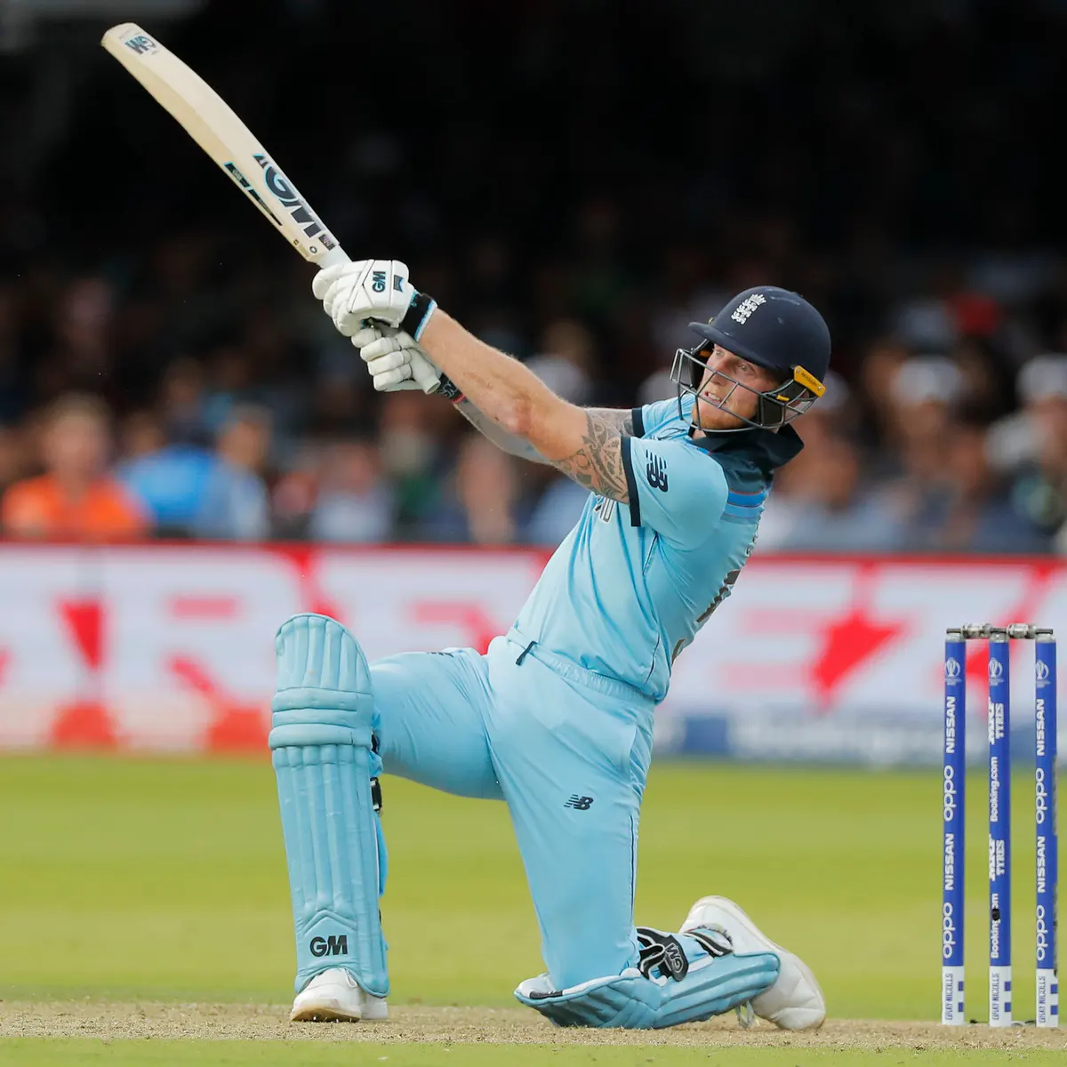
Cricket quiz
By william

Slide 2
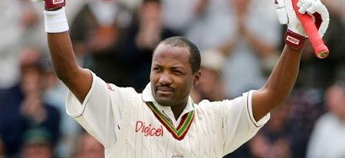
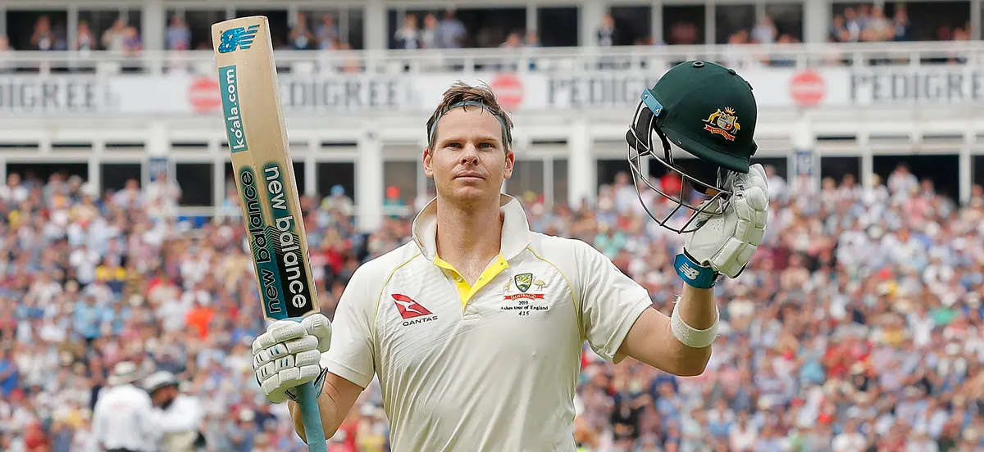
What number does Steve Smith wear is it 29,39 or 49?
Who scored 400 runs is it Brian Lara, Steve Smith or Ben Stokes?

Slide 3
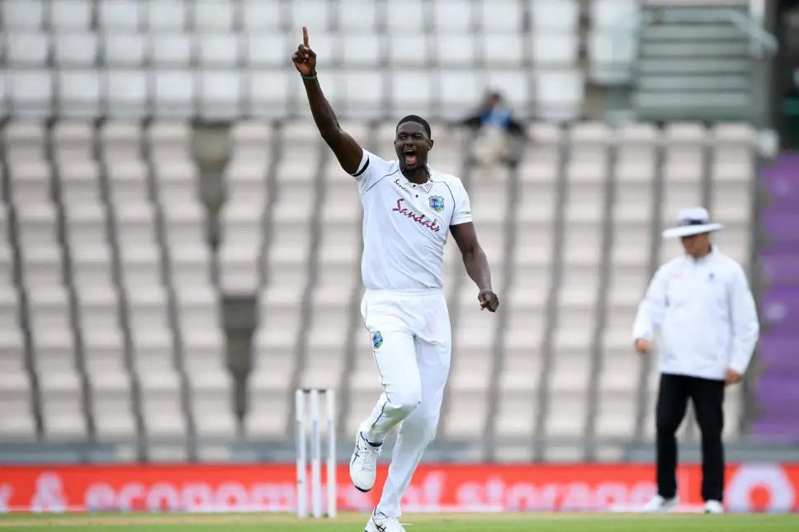
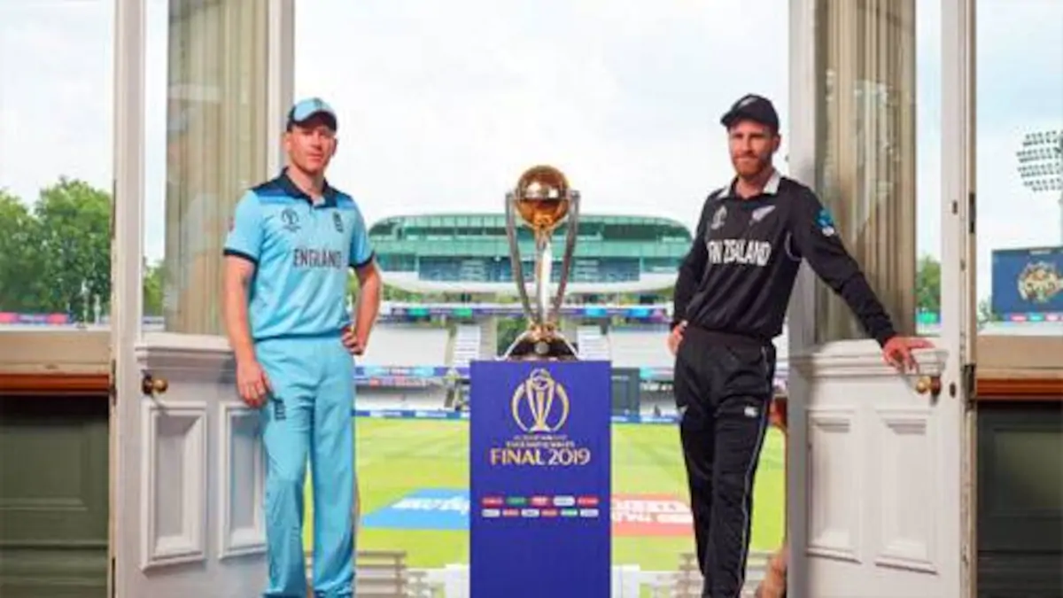
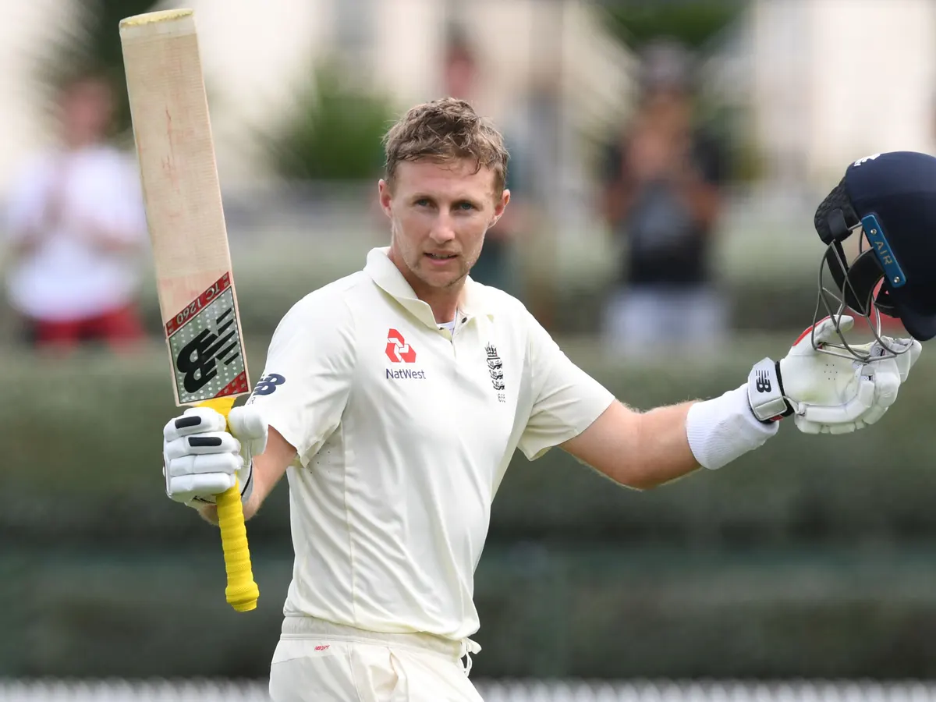
3.Did Jason Holder play for the West Indies in the world cup 2019?
4.What T20 team does Joe Root play for is it Yorkshire, Nottinghamshire or Lancashire?
5.Who won the 2019 cricket world cup England or New Zealand?

Slide 4
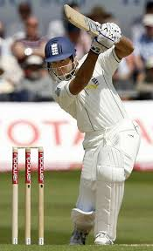
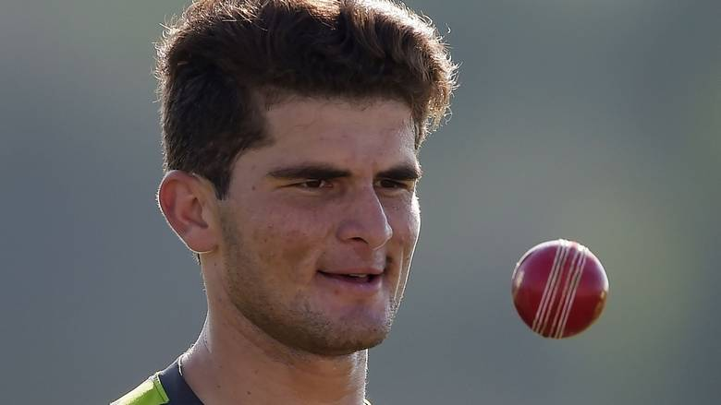
6. Did my dad Play with Micheal Vaughan and Matt Root?
7. What is the mascot for Notts T20 team ?
8.What team does Shaheen Afridi

Slide 5
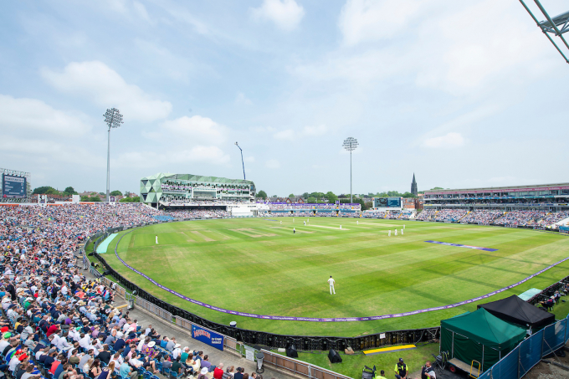
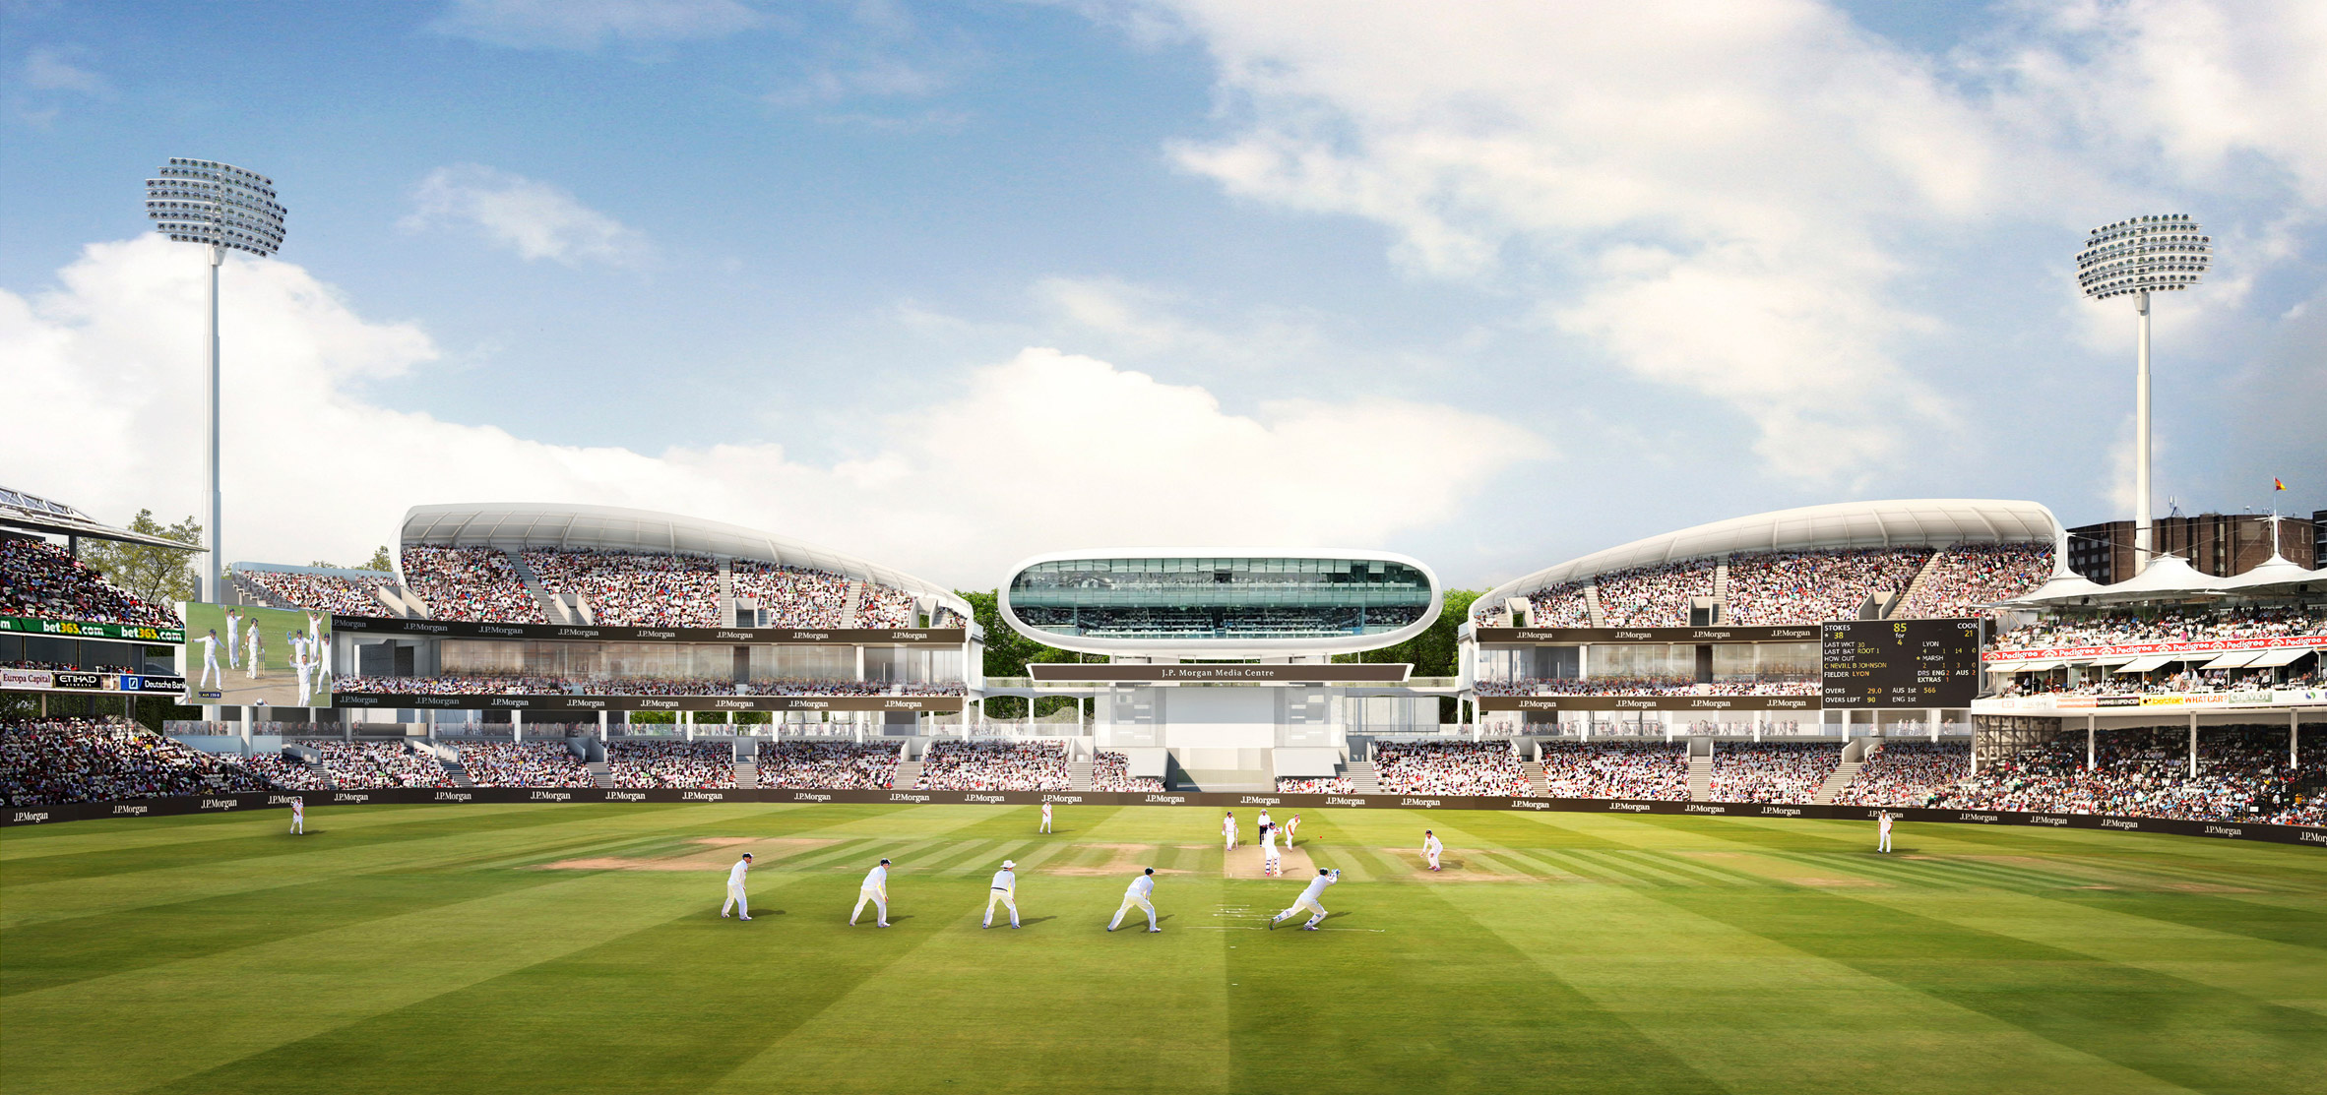
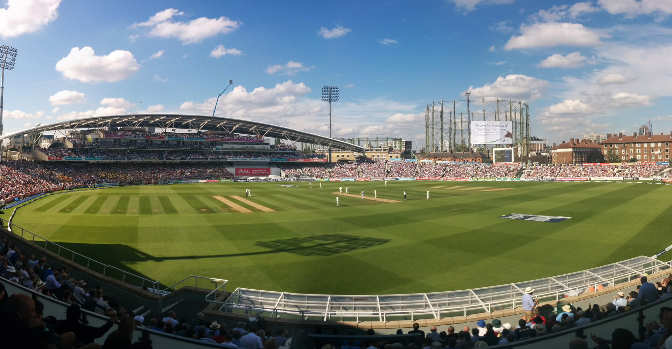

9. Wich cricket ground is nicknamed the home of cricket is it Lords, The Oval or Headingly
10. Does my Dad play for Notts

