Slide 1


Key Stage 2 SATs
Monday 14th May to Thursday 17th May 2018

Slide 2
Assessment and Reporting
Test scores will be reported as ‘scaled scores’.
The new curriculum is more rigorous and sets high expectations.
In July 2018, each pupil will receive:
- A raw score (number of raw marks awarded).
A scaled score in each tested subject.
Confirmation of whether or not they attained the national standard.

Slide 3
Scaled Scores
100 - 109 represents the ‘expected national standard’.
Each pupil’s raw test score will therefore be converted into a score on the scale, either at, above or below 100.
The scale will have a lower end point of 80 and an upper end point of 120.
A child who achieves the ‘expected national standard’ (a score of 100 -109) will be judged to have demonstrated sufficient knowledge in the areas assessed by the tests.
A child who achieves 110 – 120 is considered to have met greater depth of the national standard.

Slide 4
New scaled score system, between 80 to 120
Greater Depth of Expected Standard | 110 to 120
At Expected Standard | 100 to 109
Below Expected Standard | 90 to 99
Significantly below Expected Standard | 80 to 89

Slide 5
The Tests
Statutory tests will be administered in the following subjects:
Spelling (approximately 15 minutes)
Punctuation, Vocabulary and Grammar (45 minutes) (SPAG)
Reading (60 minutes)
Mathematics
- Paper 1: Arithmetic (30 minutes)
- Paper 2: Reasoning (40 minutes)
- Paper 3: Reasoning (40 minutes)
All tests are externally marked (scanned into a computer).
Writing will be ‘Teacher Assessed’ internally, as in recent years.

Slide 6
SATs Week Timetable
Monday 14th | Tuesday 15th | Wednesday 16th | Thursday 17th
Punctuation, Grammar and Vocabulary Paper (45mins) Spelling Paper (15 mins approx.) | Reading Paper (60 mins) | Maths Paper 1 (Arithmetic 30 mins) Maths Paper 2 (Reasoning 40 mins) | Maths Paper 3 (Reasoning 40 mins)

Slide 7
Spelling, Punctuation and Grammar
A Spelling test is administered containing 20 words, lasting approximately 15 minutes.
A separate test is given on Punctuation, Vocabulary and Grammar
This test lasts for 45 minutes and requires short answer questions, including some multiple choice.
Marks for these two tests are added together to give a total for Spelling, Punctuation and Grammar.

Slide 8
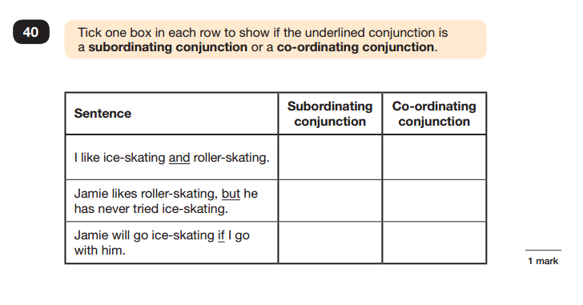
Sample Questions
Grammar, Punctuation and Spelling Paper 1

Slide 9
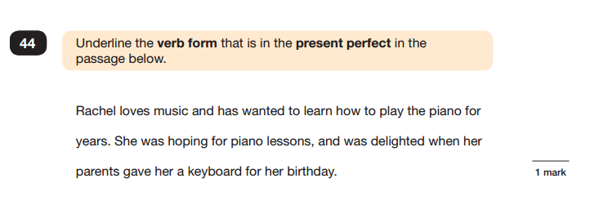
Sample Questions
Grammar, Punctuation and Spelling Paper 1

Slide 10
Reading
The Reading Test consists of a single test paper with three unrelated reading texts.
Children are given 60 minutes in total, which includes reading the texts and answering the questions.
A total of 50 marks are available.
Questions are designed to assess the comprehension and understanding of a child’s reading.
Some questions are multiple choice or selected response, others require short answers and some require an extended response or explanation.

Slide 11
Mathematics
Children will sit three tests: Paper 1, Paper 2 and Paper 3.
Paper 1 is for ‘Arithmetic’ lasting for 30 minutes, covering calculation methods for all operations, including use of fractions, percentages and decimals.
Questions gradually increase in difficulty.
Papers 2 and 3 cover ‘Problem Solving and Reasoning’, each lasting for 40 minutes.
Pupils will still require calculation skills but will need to answer questions in context and decide what is required to find a solution.
No calculator is allowed in all tests.

Slide 12
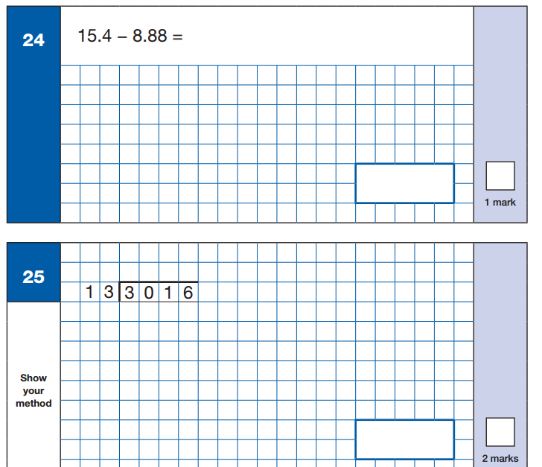
Sample Questions
Maths Paper 1: Arithmetic

Slide 13
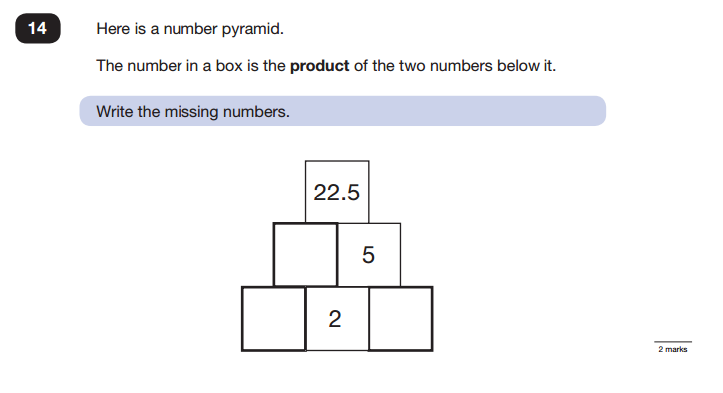
Sample Questions
Maths Paper 2 / Paper 3 : Reasoning

Slide 14
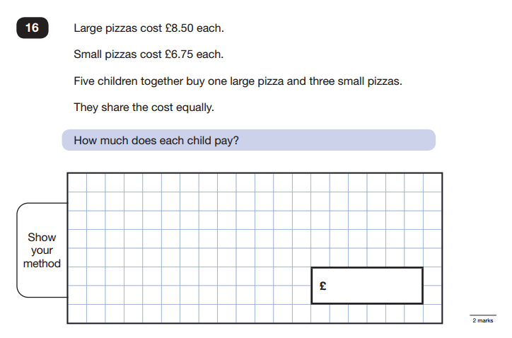
Sample Questions
Maths Paper 2 / Paper 3 : Reasoning

Slide 15
Writing
Pupils’ writing is assessed internally and a sample of pupils’ writing can be moderated by an external moderator from the Local Authority.
A selection of your child’s writing from across the year will be used to assess whether your child has achieved working towards the standard, at the expected standard or greater depth of the standard.
In order to assess the pupils’ writing, an assessment framework is used. All pupils must show evidence of each statement within the standard in order to be awarded that standard.

Slide 16
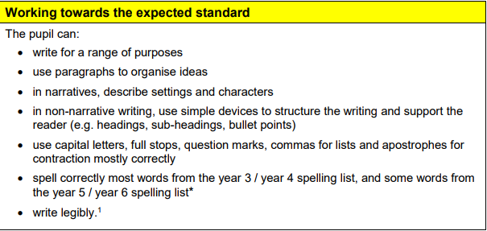
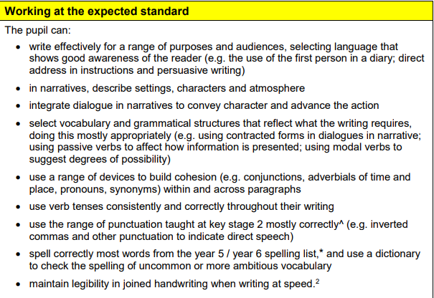

Slide 17
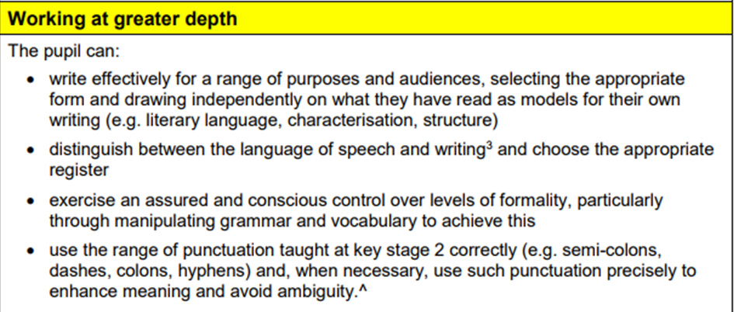

Slide 18
How You Can Help Your Child
First and foremost, support and reassure your child to do their best. Praise and encourage!
Ensure your child has the best possible attendance at school.
Support your child with any homework tasks (routine, time frames).
Support your child with arithmetic practise (e.g. times tables, written methods of addition, subtraction, multiplication, division).
Support your child with learning and practising spellings from the New National Curriculum spelling lists (Years 3/4 and Years 5/6 lists).
Talk to your child about what they have learnt at school and what book(s) they are reading. Listen to your child read.
Encourage your child to work to speed. Try timed recall of timetables. Set mini challenges e.g. – ‘can you find the word on the page that means ‘dangerous?’ you have 1 minute - go!’ ‘What is 10% of 150? You have 10 seconds - go!’
Make sure your child has plenty of sleep and breakfast every morning!

Slide 19
How We Help Your Child
Target reading, maths, writing & SPAG groups.
Maths & English booster sessions in curriculum time (Fridays - 4 rotating groups led by Mr Tomlinson, Miss McHugh, Miss Brownley and Mrs Maddison).
Regular arithmetic practice.
Practise papers (support with approach to test papers) and feedback (whole class and groups).
Booster sessions out of curriculum time.
Targeted intervention groups.
Structured SATs homework, 8 weeks starting after half term (deadline: Fridays). Marked with child/feedback given.

Slide 20

How Your Child Can Help Themselves
Manage time effectively (routine)
Remember deadlines for homework
‘Little and often’ ‘take responsibility for their learning’
Get plenty of sleep
Use revision aids (stick them up on walls, colour code, learn with your child and let them test you…)
Top Tips for Tests:
Read questions carefully
Try not to leave an answer blank
Manage your time effectively
‘Be at your Best’

Slide 21
`
Homework…

Slide 22
`
Any Questions?

