Slide 1
Tom’s animal quiz

Slide 2
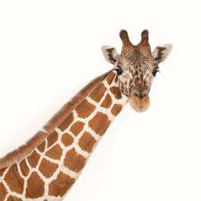
1. What speed can a giraffe run at?
A.20km C.40km
B.55km D.100km
2. How tall are giraffes normally?
A.5.5m C.1m
B.4.5m D.2.5m
3. You can tell a giraffe apart by looking at their hooves.
True False
4. What colour are giraffes tongues ?
A . Blue C . Pink
B . Purple D . black
5. Which of these is not species of giraffe ?
A . South African C . Rothschild
B . North African D . Masai

Slide 3
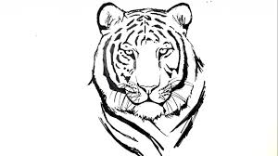
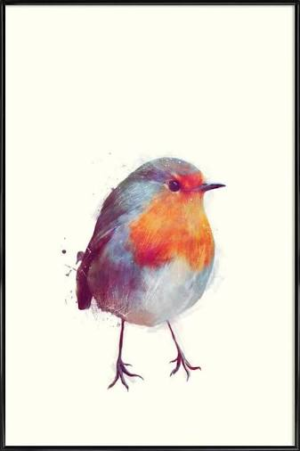
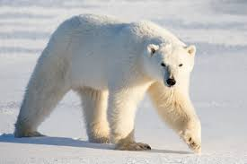
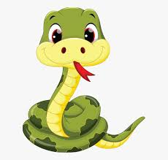
6. What is the name of the tiger in the jungle book?
7. Birds can’t pee?
True False
8. What country do you normally find tigers?
9. What colour is polar bear fur?
10, Grass snakes can’t swim?
True False

Slide 4
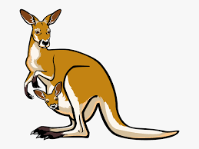
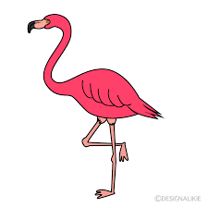
11. The longest snake in the world was a king cobra?
True False
12 . What colour is a goblin shark?
13. Which body part do Burmese pythons use to sniff?
A . Bum C . Tongue
B . Nose D . Eyes
14. Kangaroos carn’t walk backwards
True False
15. Why are flamingos pink?

Slide 5
Answers
1 . B | 2 . A | 3. True
4 . A | 5 . C | 6 . Shear khan
7 . True | 8 . India | 9 . Its translucent
10 . False | 11 . False | 12 . Pink
13 . C | 14 . True | 15 . Because they eat shrimp.

