Slide 1
ST. PETER’S C of E ACADEMY
Together in Achievement
Starting Preschool
Preschool Intake September 2023

Slide 2
ST. PETER’S C of E ACADEMY
Together in Achievement
School Contact Details:
The school office opening hours are 8.15am to 4pm Monday to Friday, during school term time.
Address:
East Bridgford St. Peter’s C of E Academy
Kneeton Road
East Bridgford
Nottinghamshire
NG13 8PG
Telephone:
01949 20226
Website:
https://www.eastbridgfordstpeters.co.uk
Email:
office@st-peters.notts.sch.uk

Slide 3
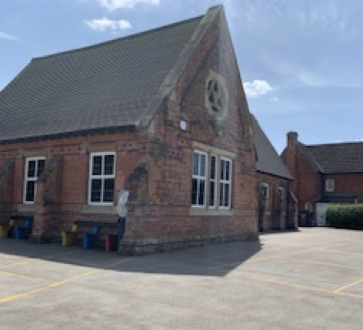
ST. PETER’S C of E ACADEMY
Together in Achievement
Tonight:
• To help your child make the best possible start to preschool
• To help you understand the curriculum and how we teach it
• Housekeeping information

Slide 4
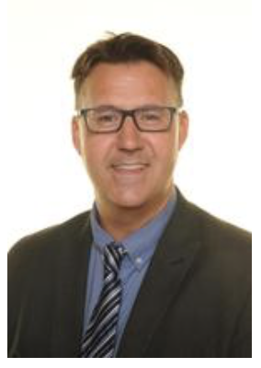
ST. PETER’S C of E ACADEMY
Together in Achievement
Mr Richard Tomlinson
Head Teacher

Slide 5
ST. PETER’S C of E ACADEMY
Together in Achievement
Please visit our website to look at more information about us, our values and ethos.
• We pride ourselves on our Take Care Values which is core to the school’s whole curriculum and our children’s personal development.
• This slide includes our School Prayer that the children will learn with signs.
• Be the best version of yourself that you can be…

Slide 6
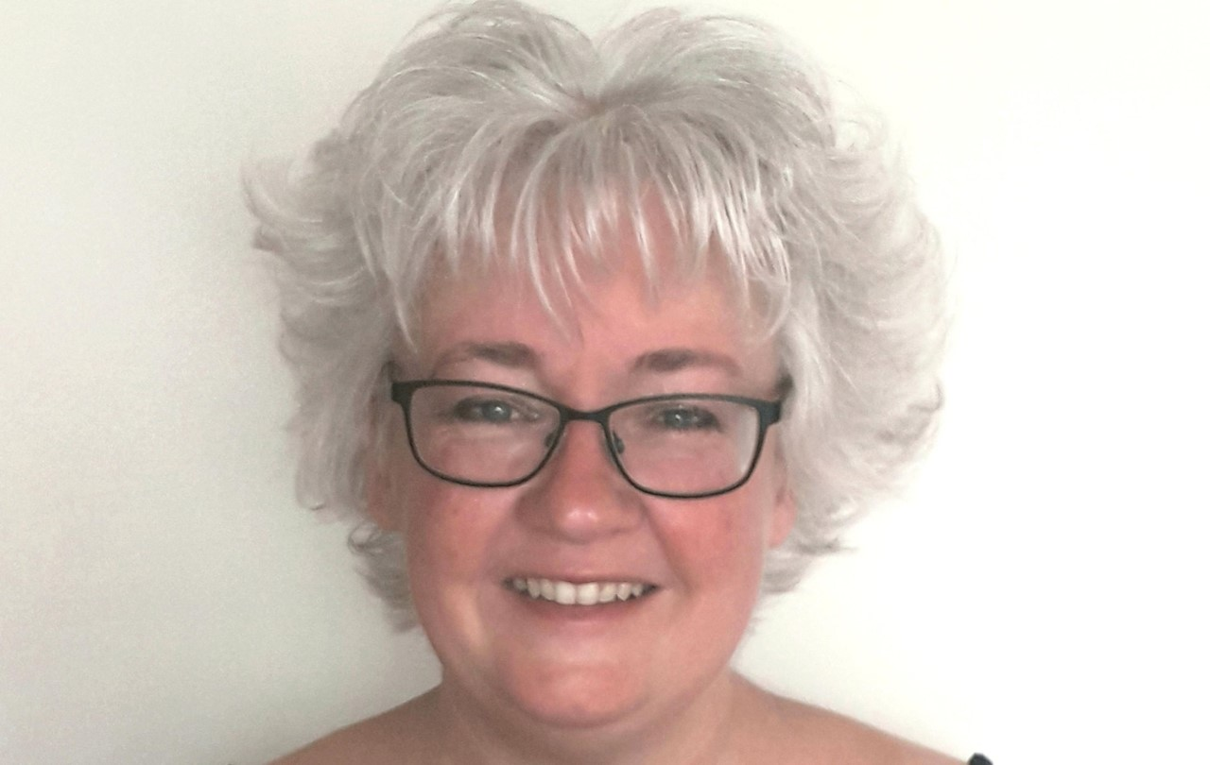
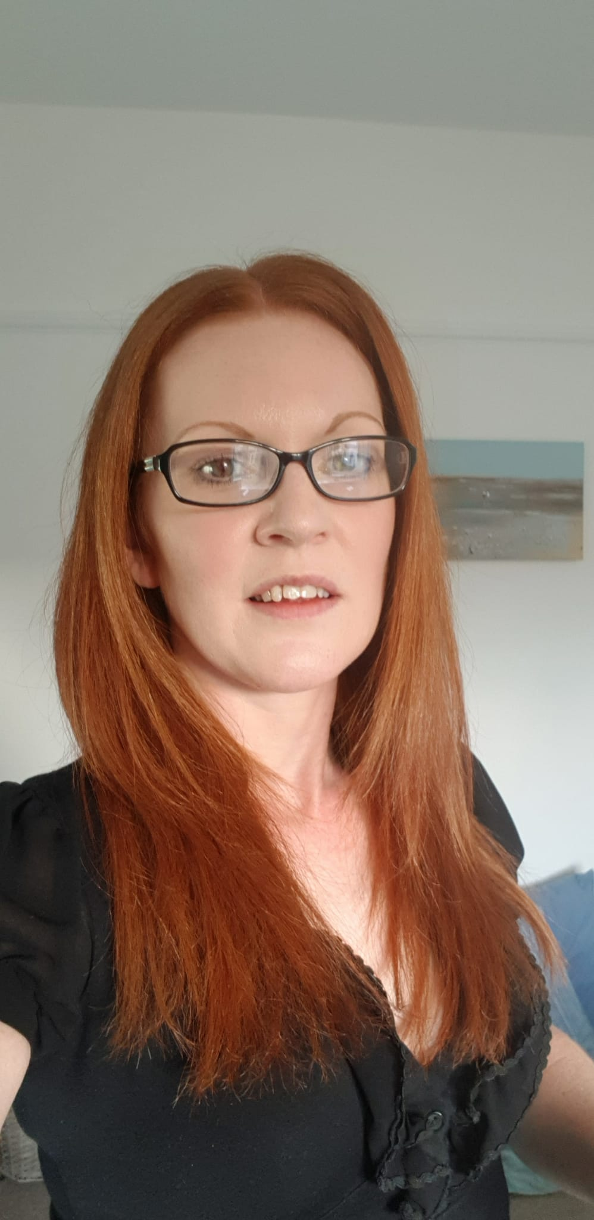
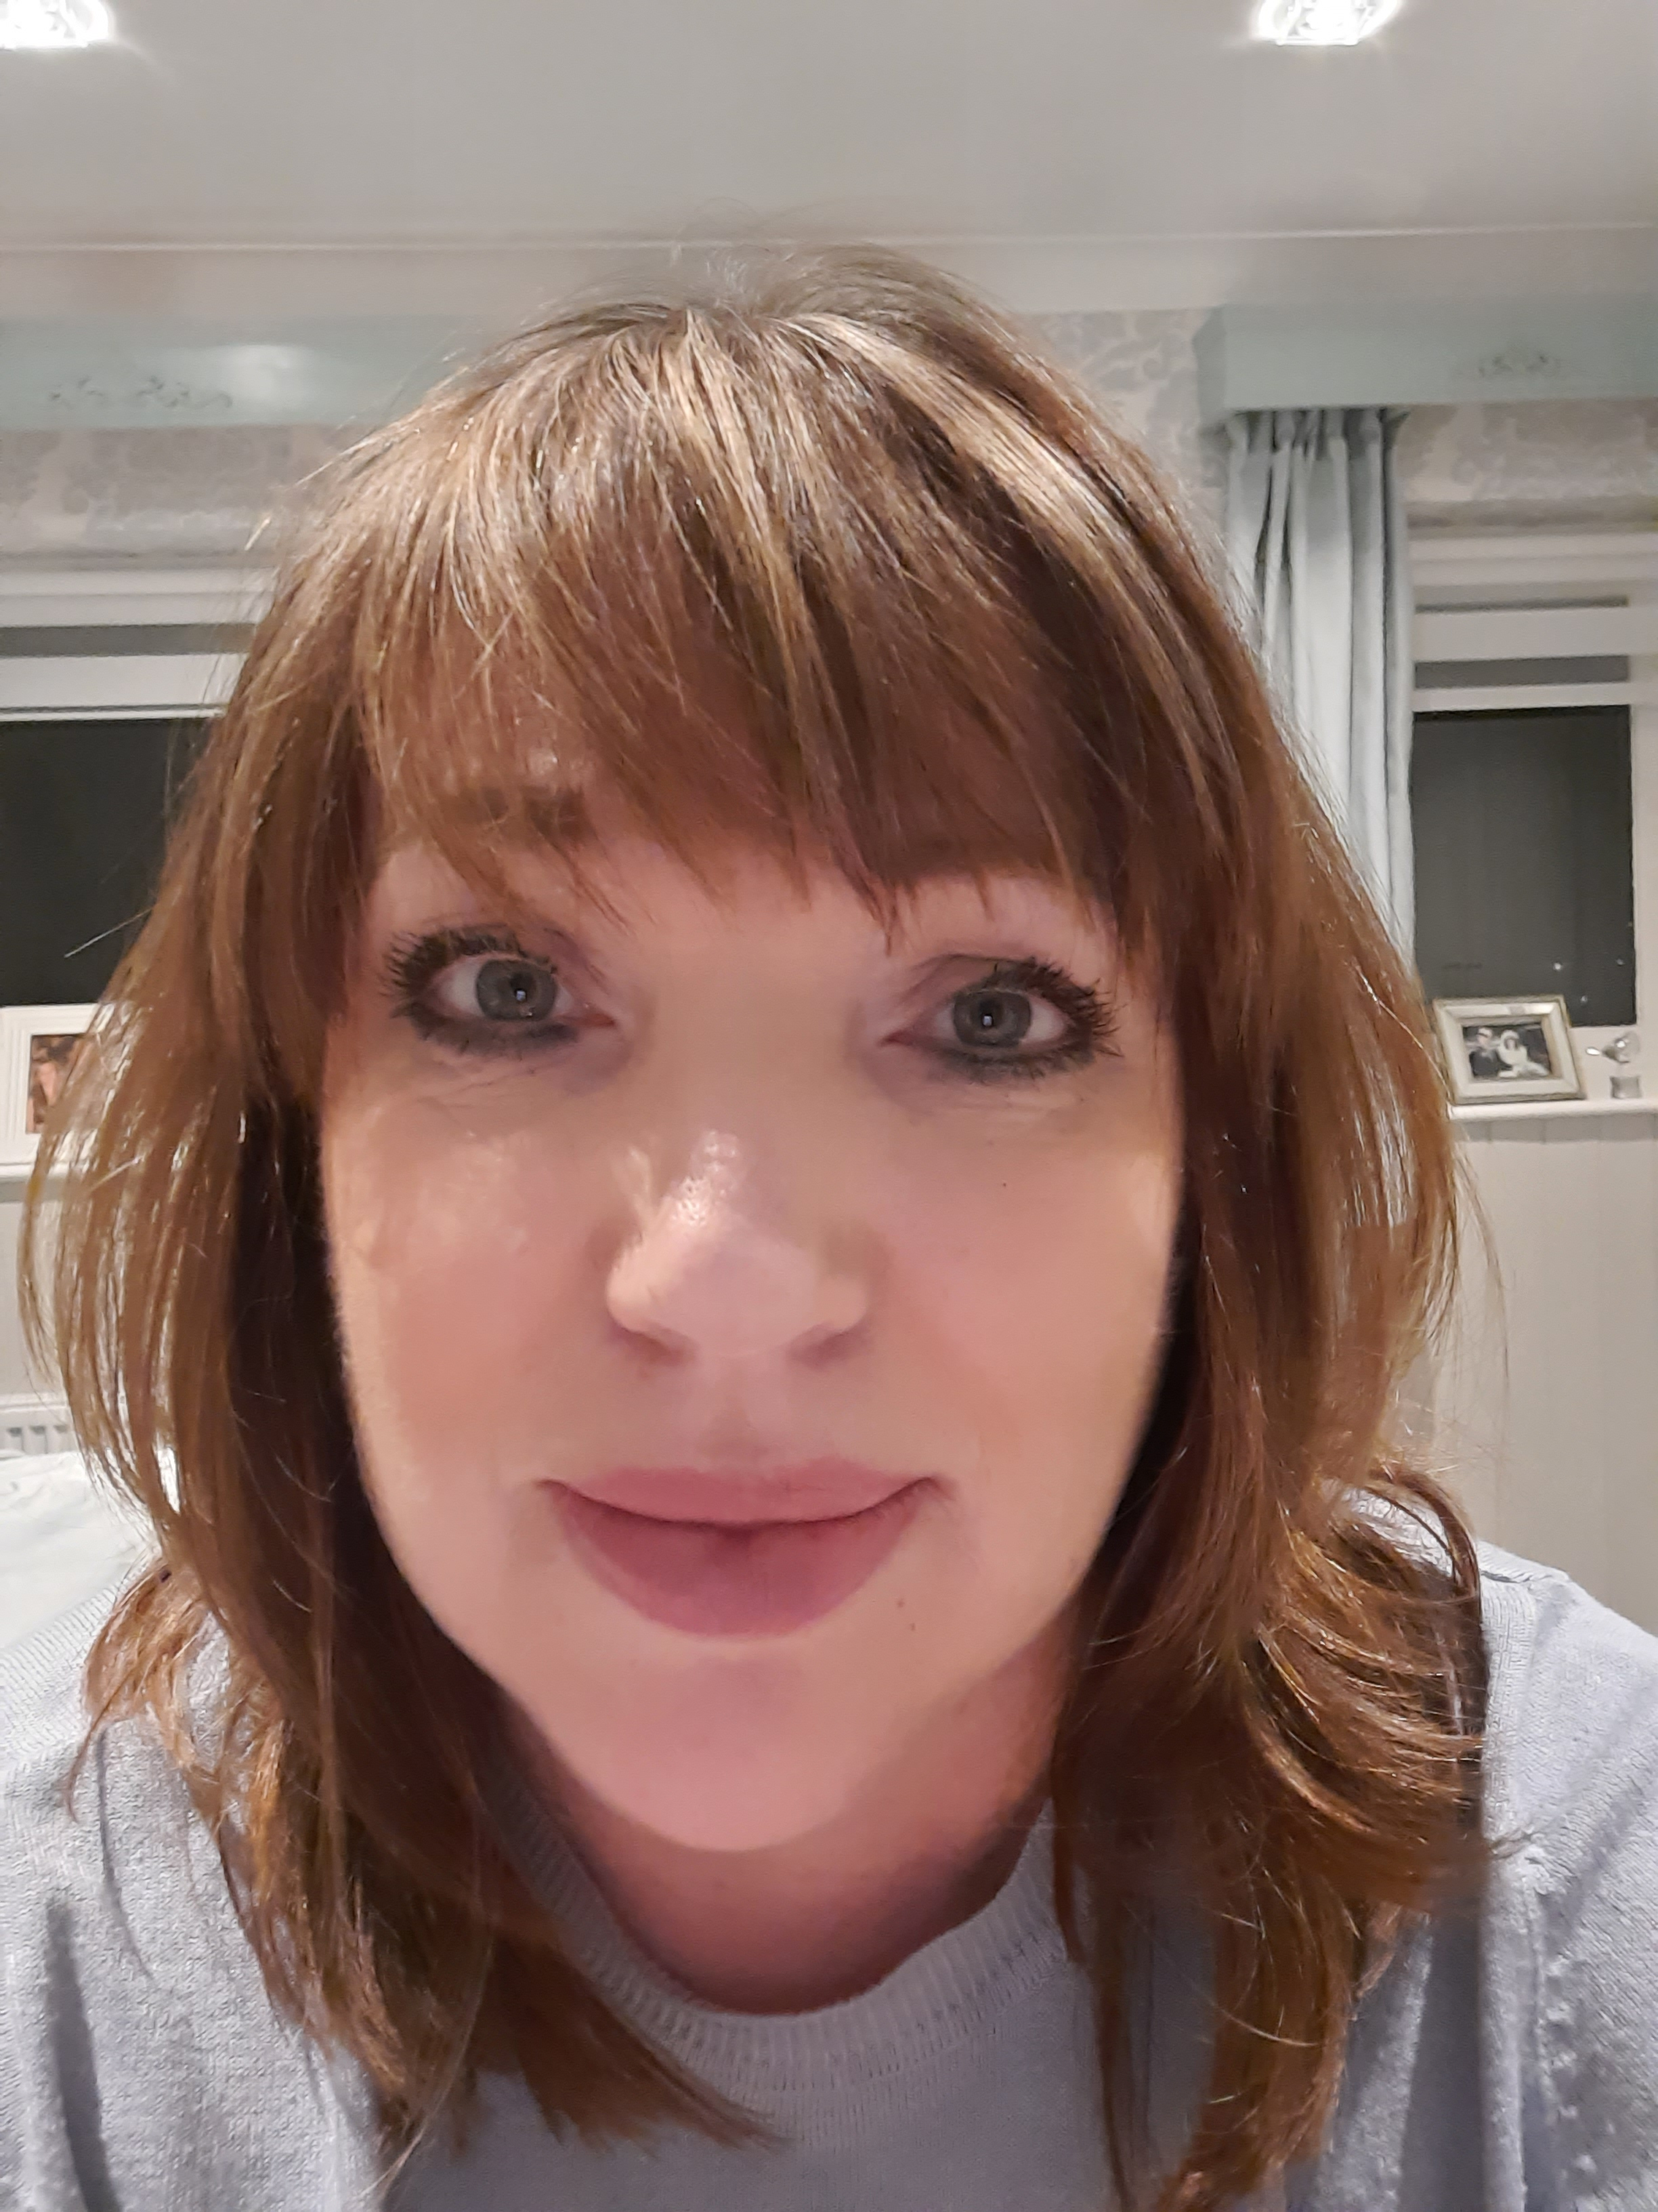
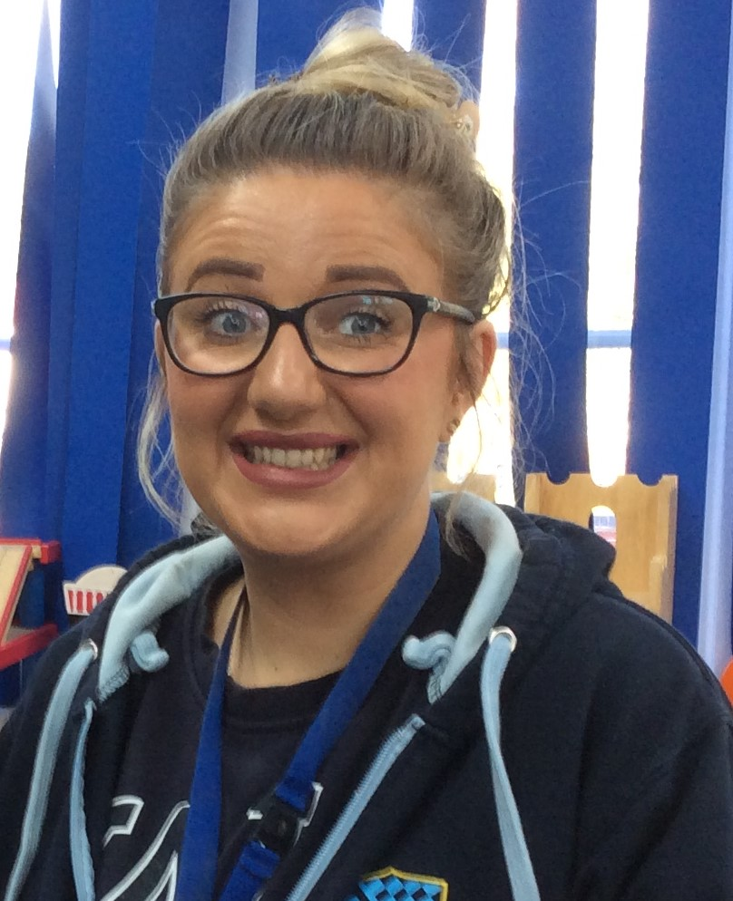
ST. PETER’S C of E ACADEMY
Together in Achievement
Preschool Teachers
Mrs Gibbens
Deputy Head
EYFS Lead
Mrs Cruse
(Foundation)F1 Deputy
(Mon- Wed)
Mrs Morrell
Class teacher
(Foundation)F1 lead
Mrs Spence
F1 Assistant
(Wed – Fri)
Miss Smith
F1 Assistant
(Mon,- Fri am)
Miss Smith
F1 Assistant
(Mon, Tue, Thu, Fri)

Slide 7
ST. PETER’S C of E ACADEMY
Together in Achievement
Class Visits
6, 7 & 8 Sept (Wed, Thurs & Fri)
These will be either a morning or afternoon slot for each of the 3 days, even if your child is not due to attend on a Wed, Thur or Fri.
These sessions will either be
9 am – 11am or
1.30 pm – 3.30 pm
Normal sessions from Monday 11 Sept.
• These are just taster sessions to start building relationships and meet the staff.
• Everyone can recognise each other.
• Children can see some activities, the classroom and meet the other children.

Slide 8
ST. PETER’S C of E ACADEMY
Together in Achievement
9am/1.30 pm We will open the bottom blue gates and let you in. All the children will enter through the preschool door. (There is a picture in the general information).
11.00am/3.30 pm We will let you in through the bottom blue gates and you will be able to collect your child from the same preschool door.
They will only need a coat or a hat depending on the weather. We will provide them with a snack and a drink of water during the visit. We need contact forms before this visit.

Slide 9
ST. PETER’S C of E ACADEMY
Together in Achievement
Paperwork reminders
• Preschool registration form
• Medical form
• EYPP form
• Parent consent form
• All about me Booklet
• Parent funding declaration form
• Remember to register for Cool Milk

Slide 10
ST. PETER’S C of E ACADEMY
Together in Achievement
Funding and Fees
30 hrs
15 hrs
Code – keep it valid!
Fees
Childcare vouchers
Invoices – every term
Parentpay

Slide 11
ST. PETER’S C of E ACADEMY
Together in Achievement
What is the Early Years Foundation Stage?
The Early Years Foundation Stage (EYFS) is the stage of education for children from birth to the end of the Reception year.
It is based on the recognition that children learn best through play and active learning.
As we follow one curriculum, your child will be continuing with the same style of learning if they have come from a different setting.

Slide 12
ST. PETER’S C of E ACADEMY
Together in Achievement
Three prime areas of learning and development
Communication and Language
Physical Development
Personal, Social and Emotional Development
Four specific areas of learning and development
Literacy
Mathematics
Understanding the World
Expressive Arts and Design

Slide 13
ST. PETER’S C of E ACADEMY
Together in Achievement
The prime areas
Theses are essential in underpinning the learning that happens in the Specific areas.
If you can’t talk about it, you will be unable to write about it.
If you can’t control large movements, you will be unable to do fine motor movements with your fingers.
If you are worried/anxious/falling out with friends, you will be unable to learn.

Slide 14
ST. PETER’S C of E ACADEMY
Together in Achievement
The three characteristics of effective learning
1 Playing and exploring
2 Active learning
3 Creating and thinking critically
These characteristics are important as they look at how your child learns and not just what they learn. This helps us to plan effectively for them when they are learning and playing and help them become lifelong learners.
e.g do they challenge themselves, are they resilient, can they persevere, do they get frustrated?

Slide 15
ST. PETER’S C of E ACADEMY
Together in Achievement
A typical day in Preschool
• Register
• Dough disco, Squiggle while you Wiggle
• “Busy Bee” time (Child-initiated or Adult-led activities) – free play inside/outside e.g funky fingers, creative, home corner, construction, sand, water, dough
• Snack
• Outside play
• PE (Thursday)
• Circle time – phonics, maths, topic or T4W (Talk for Writing)
• Song time
• Story time

Slide 16
ST. PETER’S C of E ACADEMY
Together in Achievement
The first few weeks
• Playing and talking
• Routines of the classroom and school
• Observations
• Getting to know each other
Parent’s evening will be an opportunity to discuss what we will be learning and your child’s strengths and areas for development.

Slide 17
ST. PETER’S C of E ACADEMY
Together in Achievement
School Readiness
To be ready for school means that your child is ready emotionally and physically for the new challenges that going to school will present. If your child can dress themselves, they won’t worry about who to ask for help. If your child is able to ask for help or talk to an adult, they will start to build relationships and trust staff to help them when they find things hard or can’t do something. If your child has the following skills, they will be much more confident in the classroom.

Slide 18
ST. PETER’S C of E ACADEMY
Together in Achievement
General Information
The main school gates will be opened at 8.30 am and Preschool starts at this time (not when the bell goes for school.)
Preschool entrance is through the door, next to the netball court. A member of staff will be there waiting and waving.
We encourage the children to enter the classroom by themselves using our drop off, kiss and go technique!
Children being collected at 11.30/12.30 will be brought to the main blue gate at the bottom of the playground.
At the end of the day please collect your child from the same door that you dropped off at. Your child will leave their classroom and come out to you.
Please let us know if someone different is collecting your child.
Breakfast /After school club children are collected by staff and taken to preschool/club.
School club register is sent to us every day.

Slide 19
ST. PETER’S C of E ACADEMY
Together in Achievement
What your child will need
Uniform/ own clothes (plus spares for those little accidents!)
Waterproof coat (even when sunny)
Hat and gloves/sun hat
PE kit and PE bag
Sun cream (named and to be left at Preschool)
Please label everything with your child’s name.

Slide 20
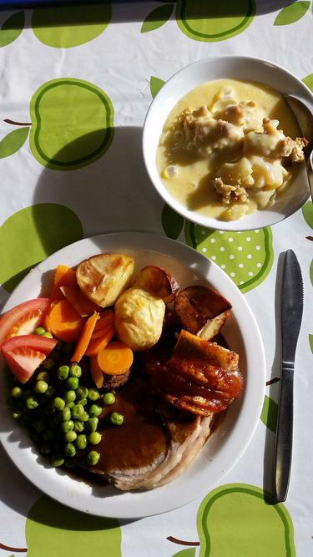
Snack time
We have milk in the morning along with a piece of fruit (sometimes carrots/tomatoes), in the afternoon the children have water with another piece of fruit. The fruit will be given whole and is not cut up.
We encourage the children to have water throughout day. We have a water station where each child has a named cup and they fill these independently. If we notice they do not drink very much during the day, we will encourage them to drink more and have a chat with you. Children do not have bottles of juice in the classroom.
Dinner time
Our school dinners are cooked on site by Mrs Plumb and her catering team and our menu is put on the website weekly for you to see what they are eating each day. The children are seated and their food is served to them at the table by the teaching staff. If you have any concerns about your child eating please do talk to us, as we have a very experienced team that can talk to you about your worries.
Packed lunch
We are a nut free school. Please no peanut butter or chocolate spread (containing nuts) sandwiches. We ask if grapes can be quartered.
For more information on our school dinners please take a look at our website here.

Slide 21
ST. PETER’S C of E ACADEMY
Together in Achievement
Medical Matters
• Any sickness, diarrhoea, we ask is followed by 48 hours absence.
• Please phone the office to report any illness as early as possible.
• Head lice happen! Please check regularly and treat as recommended.
• Any medicines can only be administered by prior arrangement and by filling in the form at the school office. This is normally given at lunch time.

Slide 22
ST. PETER’S C of E ACADEMY
Together in Achievement
Communication
Parents eve (twice per year)
School office will pass on messages
Give us a quick update/ask a question at drop off/collection
For more in depth conversations a meeting can be arranged
Our class page on the website (find out what the children have been up to!)

