Slide 1
Ways to stop pollution
By Lily Reece

Slide 2
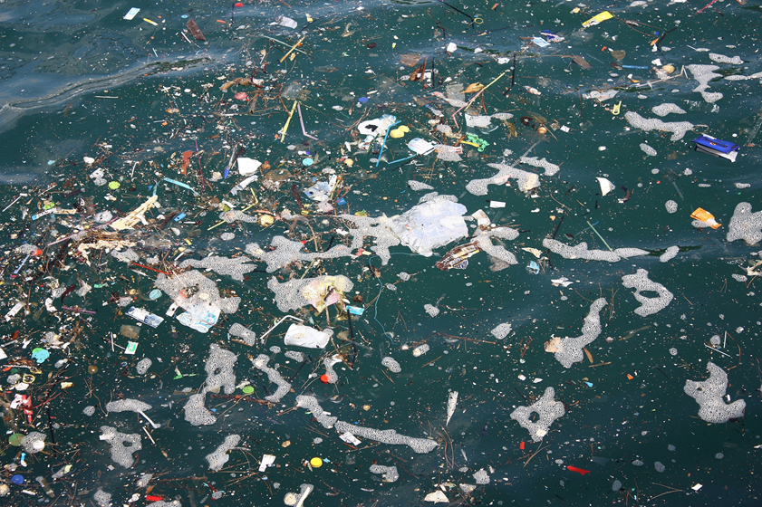
Pollution
This is pollution!

Slide 3
Pollution Facts
These are some of the items that have been found in the sea:
Cigarettes
Food wrappers
Drink bottles
Plastic bags
Bottle lids
Straws
Drink cans

Slide 4
Recycling
There are lots of ways to stop pollution.
One of the main ways is recycling.
This is a way to stop plastic and clothes from going into the ocean or into landfill by reusing these products to make new things.

Slide 5
Ways to recycle
You can recycle bottle lids, milk bottles, yoghurt pots, plastic packaging and other plastic resources.
You can also put clothes that don’t fit any more in clothes bins that can be found in some car parks or you can give them to charity.

Slide 6
Recycling in school
You can help the environment too by recycling as well. Here are some ideas.
Next to the year one classroom there are some recycling bins. In the morning when you come in you can bring any items to recycle, into school.
Make sure you don’t put any items that can’t be recycled in the recycling bin.

Slide 7
Recycling at home
You can also recycle at home by:
1. Putting all the plastic you find in your house in the recycling bin.
2. Using recyclable bags instead of plastic bags.
3. Trying not to use plastic cups, plates and cutlery. Instead use paper plates and cups and wooden cutlery.
4. Not buying as many plastic toys or games.

Slide 8
Polluters
One of the main polluters of our rivers and seas are wet wipes. People flush them down toilets and they end up in rivers and seas.
Do not flush anything down the toilet apart from toilet roll and human waste.

