Slide 1
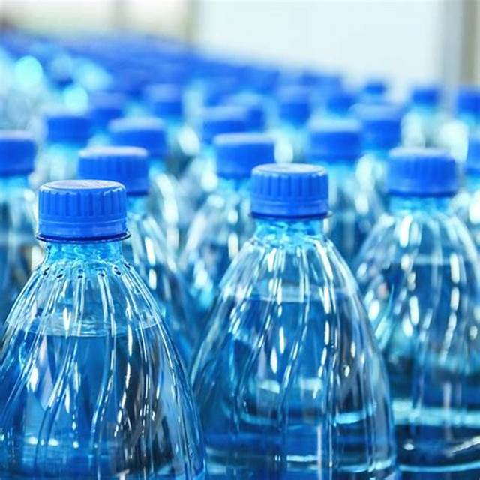
Recycling
BY ESME, SEB AND TILLY

Slide 2
Intro
In this power point we will be showing you about plastic waste and recycling. Our goal is to inform, shock and persuade. We would like to get more recycling bins for school.

Slide 3
Why we need the recycling bins?
We want the recycling bins because we do not reuse enough in the UK. Here are some facts.
It is estimated about 4.9 million tons of plastic is sold and ¾ of it is single use.
About 75% of plastic isn’t recycled.
Nearly 300 million tons of plastic is produced each year.
Plastic waste has become worse by 9%.
The US produces the most plastic waste.
Around 70,000 micro plastics (which is plastic so small you can’t see it) is consumed by each person per year.

Slide 4
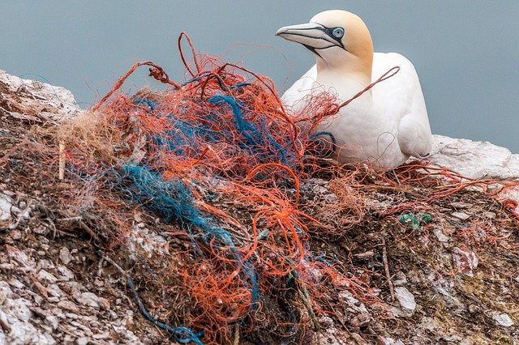
It takes around 500 and 1000 years for plastic to decompose.
73% of litter on beaches is plastic waste.
About 455,000 tons of plastic bottles are thrown away.
Each household produces over 1 ton of waste per year.
If the world carries on doing all of this we will seriously damage so much of the oceans, forests and all of the of the other places you love like nature trails.
This is a bird that is sitting on some plastic waste.

Slide 5
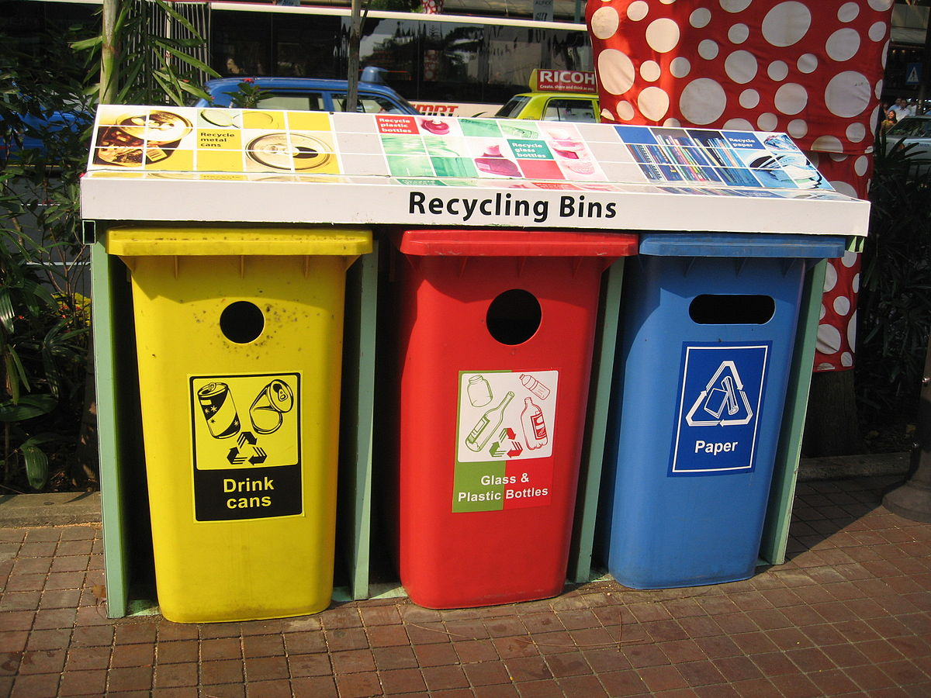
Recycling saves the world!
Recycling means less trees will be cut down, fewer animals are harmed and less pollution in the air, soil and water.

Slide 6
How much do we recycle?
In the UK we create 260 large cruise ships of waste each year.
On average each person creates 7 times their body weight in plastic.
Of this waste 45% is recycled and 55% goes to landfill.
Germany, Austria and South Korea recycle between 60-70%.
In England we are a long way behind, we only recycle 3% more than we did in 2010.
Our government want to get to 50%.

Slide 7
How to use recycling bins?
Recycling bins may be easy to use but not many people use them.
Most places only let you recycle paper, cardboard and some plastics.
You should always check with your bin company though.

Slide 8
QUIZ TIME!!!

Slide 9
What fraction of 4.9 tons is single use in the UK?
¾ or
3 quarters

Slide 10
How much plastic is produced in the UK?
300 million tons

Slide 11
What percentage of waste on beaches is plastic?
73%

Slide 12
How many micro plastics are consumed by each person a year?
70,000

Slide 13
How many Cruise Ships do the UK fill of plastic?
260 Cruise ships

Slide 14
Thanks for watching!!!

