Slide 1
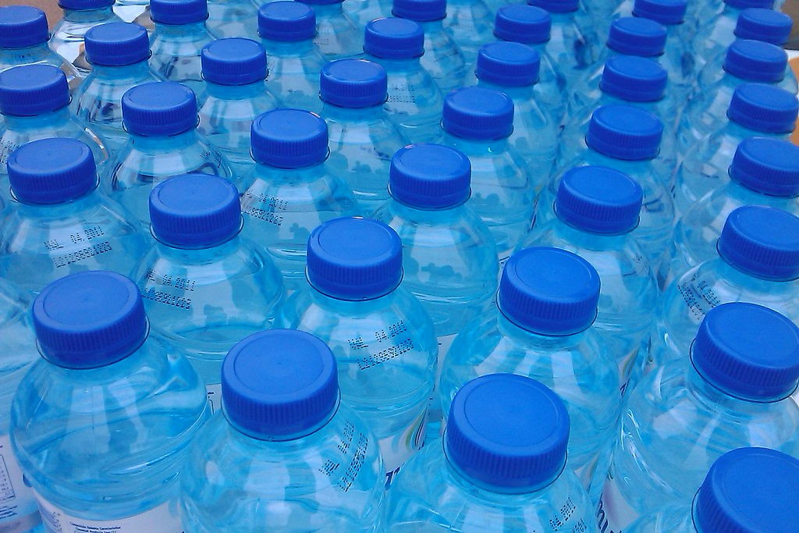
Recycling
By Seb Ferrar
This Photo by Unknown Author is licensed under CC BY-ND

Slide 2
Intro
In this power point we will be showing you about plastic waste and recycling. Our goal in this power point is to show you why we would like to get some plastic ins for the school.

Slide 3
Why we need the recycling bins.
We want the recycling bins because the UK does not recycle enough. Here are some facts.
It is estimated about 4.9 million tons of plastic is sold and 3 quarters of it is single use.
About 75% of plastic isn’t recycled.
Nearly 300 million tons of plastic is produced each year.
Plastic waste is becoming worse by 9%.
The US has the most plastic waste.
Around 70,000 microplastics (which is plastic so small you can’t see it) is consumed by each person per year.
This Photo by Unknown Author is licensed under CC BY-NC

Slide 4
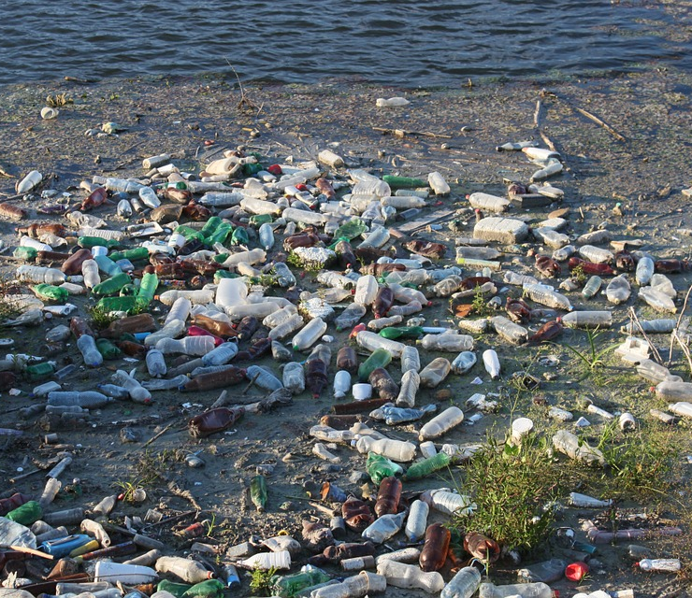
It takes between 500 and 1000 years for plastic to decompose.
73% of litter on beaches is plastic waste.
About 455,000 tons of plastic bottles are thrown away.
Each household produces over 1 ton of waste per year.
If the world carries on doing all of this we will seriously damage so much of the oceans, forests and all other nature.

Slide 6
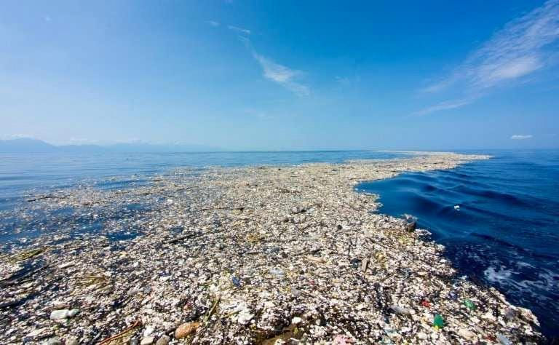
Plastic in the ocean

Slide 7
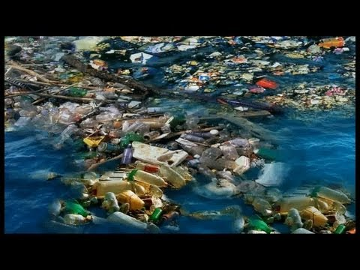
We use lots plastic.
We create lots of plastic waste.
Some of this plastic waste has ended up in the sea.
In the Pacific Ocean, there are 2 large patches of plastic waste, known as the Eastern and Western Garbage Patches.
Most commonly used plastics do not ever fully “go away,” but rather break down into smaller and smaller pieces.

Slide 8
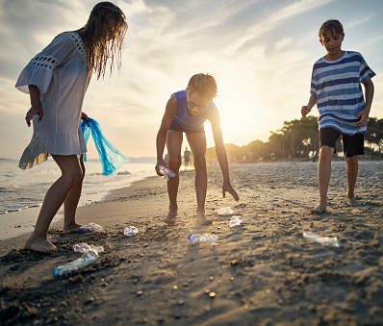
What can we do?
Be responsible for all your rubbish on land and on the water.
Dispose of items properly.
Get involved! Participate in local clean ups in your area. Remember that the land and sea, no matter where you are, are connected.
Reduce the amount of waste you produce.
Reuse items whenever possible.
Choose reusable items over disposable ones.
Recycle as much as possible.

Slide 10
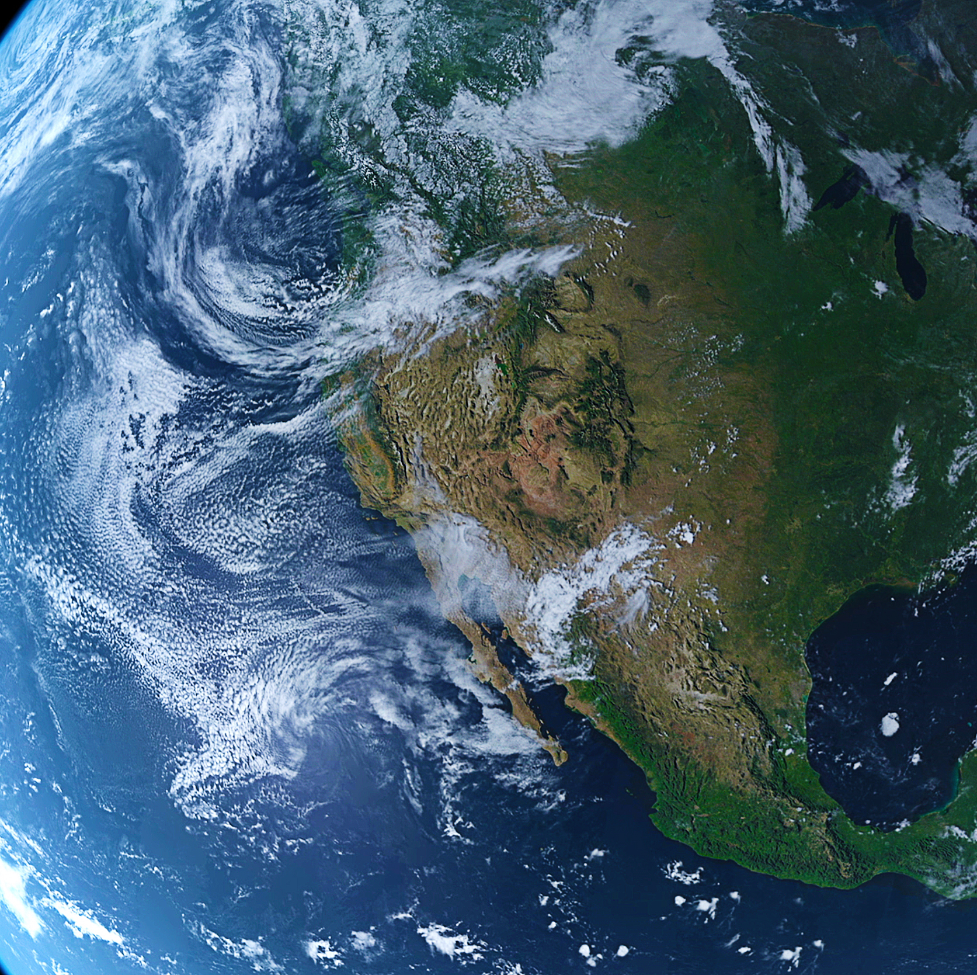
Climate Change
By Noah Smith

Slide 11
Impact of Climate Change on the world
Climate change impacts on weather conditions
Rising maximum temperatures
Rising minimum temperatures
Rising sea levels
Higher ocean temperatures
An increase in precipitation (lots of rain and hail)
Shrinking glaciers (big blocks of ice)
Thawing permafrost (big lumps of frozen soil under the earth’s surface)

Slide 12
What can we do to help
More electric cars
Change your light bulbs
Switch of your tv
Ride a bike or walk
Use less gas
Eat more locally produced vegetables
Reduce, reuse, repair and recycle

Slide 13
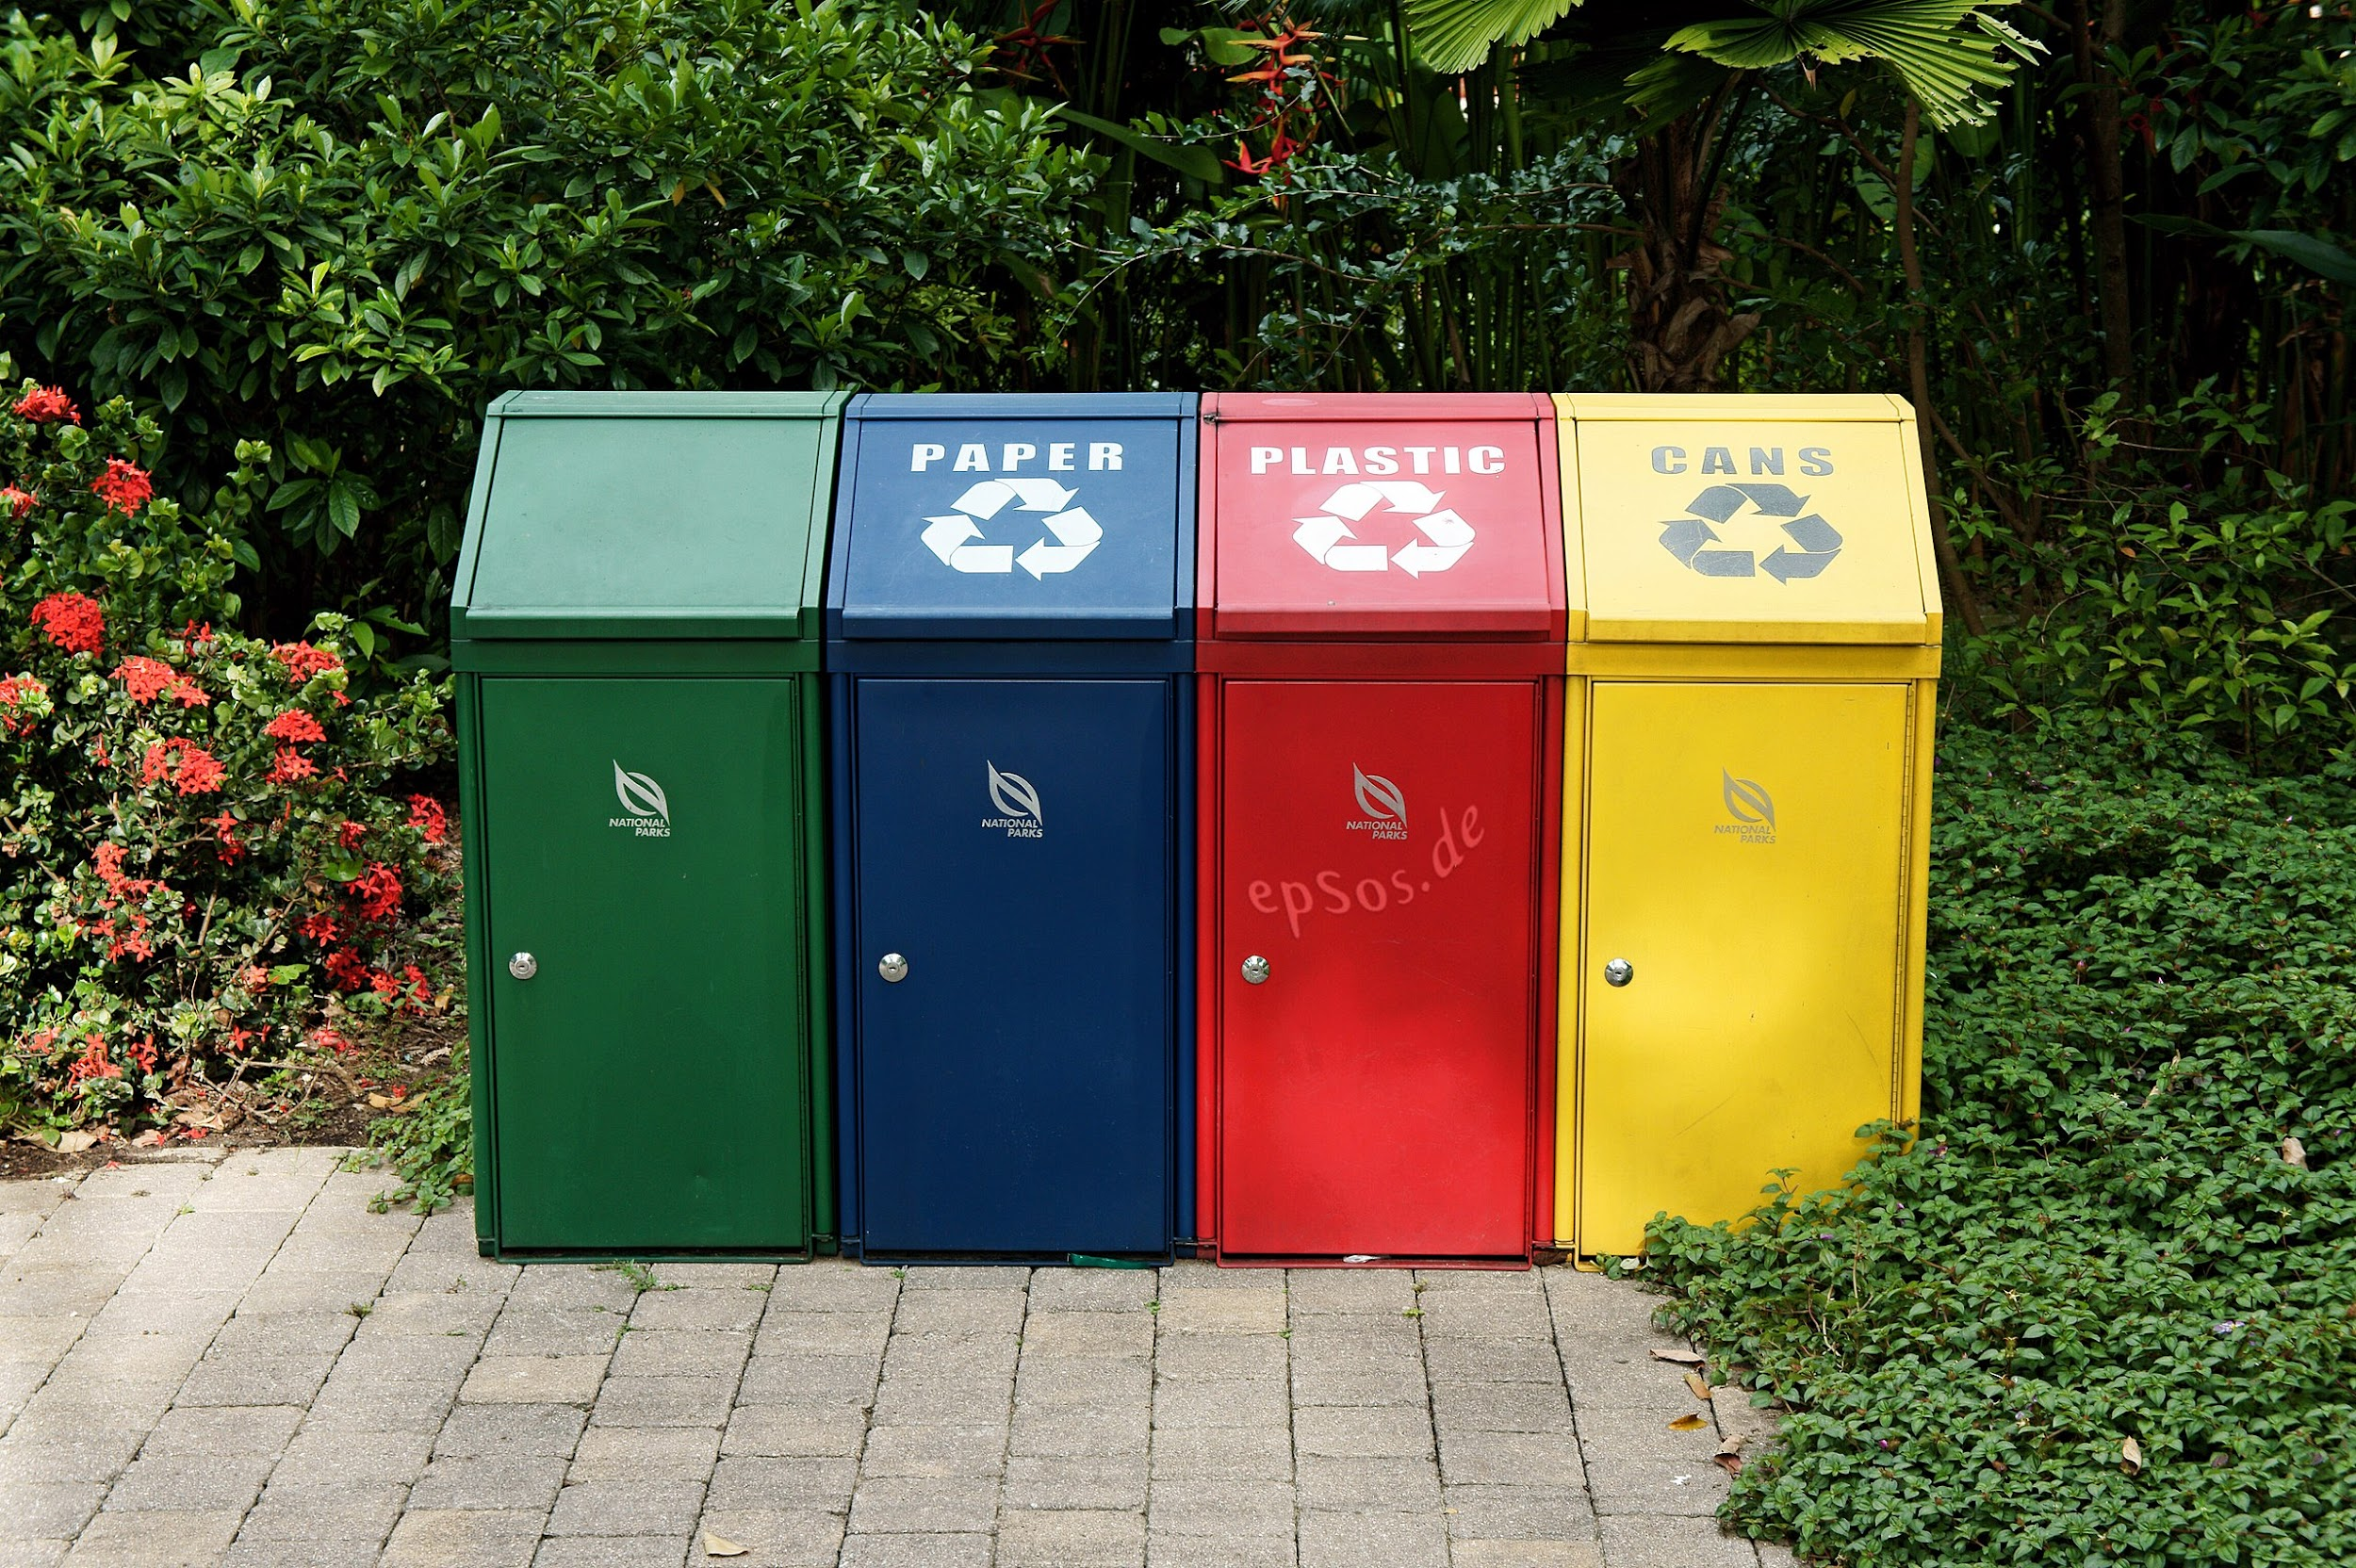
Recycling
Bin

Slide 14
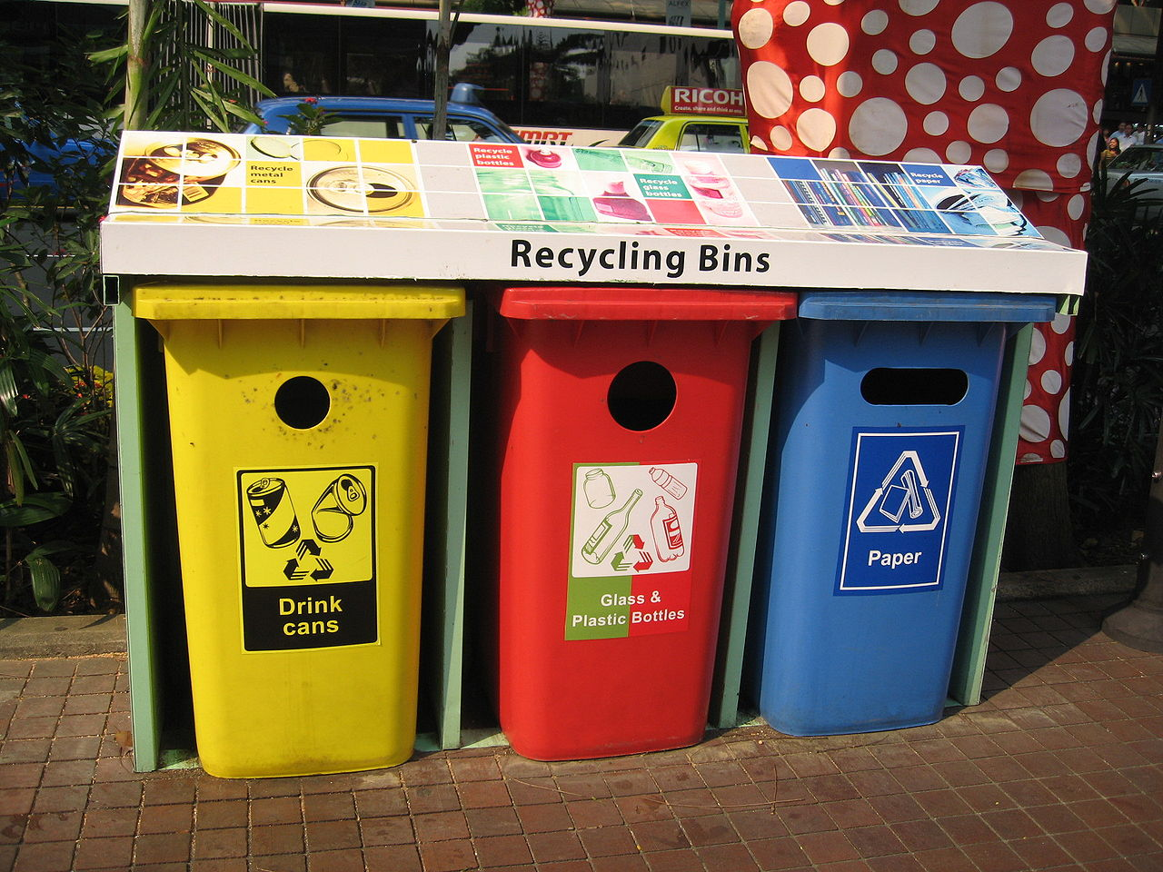
Recycling saves the world!!!
It means less forest are cut down, fewer animals are harmed and less pollution in the air, soil and water.

Slide 15
How much do we recycle?
In the UK we create 260 large cruise ships of waste each year
On average each person creates 7 times their body weight
Of this waste 45% is recycled and 55% goes to landfill
Germany, Austria and south Korea recycle between 60-70%
In england we are a long way behind, we only recycle 3% more than we did 2010
Our government target is 50%

Slide 16
How to use recycling bins?
Recycling bins may be easy to use but not many people use them. You only put plastic, paper and cardboard in recycling bins. You put the recycling bins out on Friday.

Slide 18
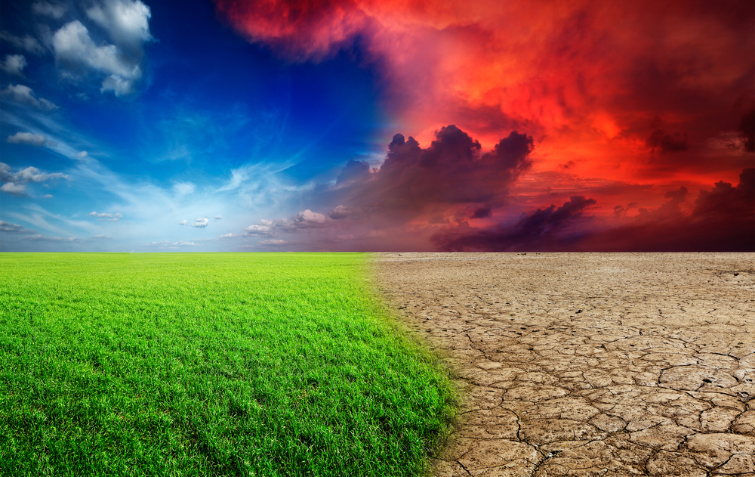
Climate Change Facts
By Ewen

Slide 19
1. The last decade was the hottest in 125,000
years.
2. The ocean absorbs most off the heat we
produce.
3. In the next 20 years, global temperatures are
likely to rise by 1.5 degrees.
4. More than one million species are at risk of
extinction.
5. 800 to 600 million years ago the earth was so
cold that it was covered with ice.

Slide 20
6. Glaciers and ice sheets in the arctic and Antarctic
are melting quickly. Water from the melting ice falls
into the oceans and causes the sea levels to rise
7 .CO2 is at its highest in two million years.
8. It could become too hot to live in many places by
the end of the century.
9. We are losing 1.2 trillion tons of ice each year.
10. Global warming is partially reversible.

Slide 21
Climate Change
The effects of climate change on the world
Made by Noah M

Slide 22
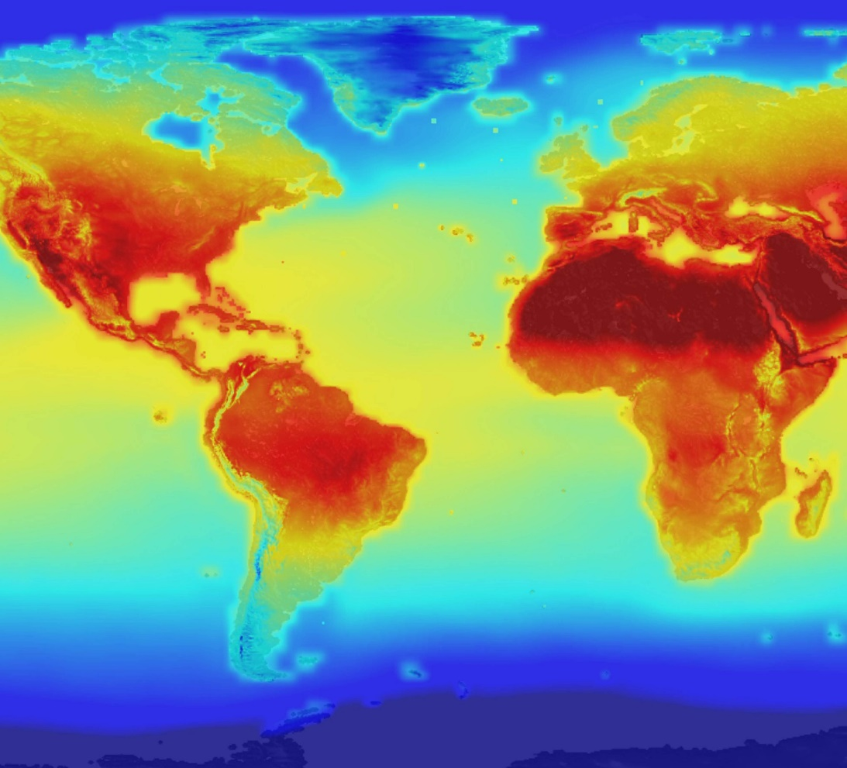
What is climate change?
Climate change describes a change in the average conditions such as temperature and rainfall.
Global climate change refers to the average long term changes over the entire Earth like hotter temperatures and changes in rain it also has other effects such as higher sea levels and shrinking glaciers.

Slide 23
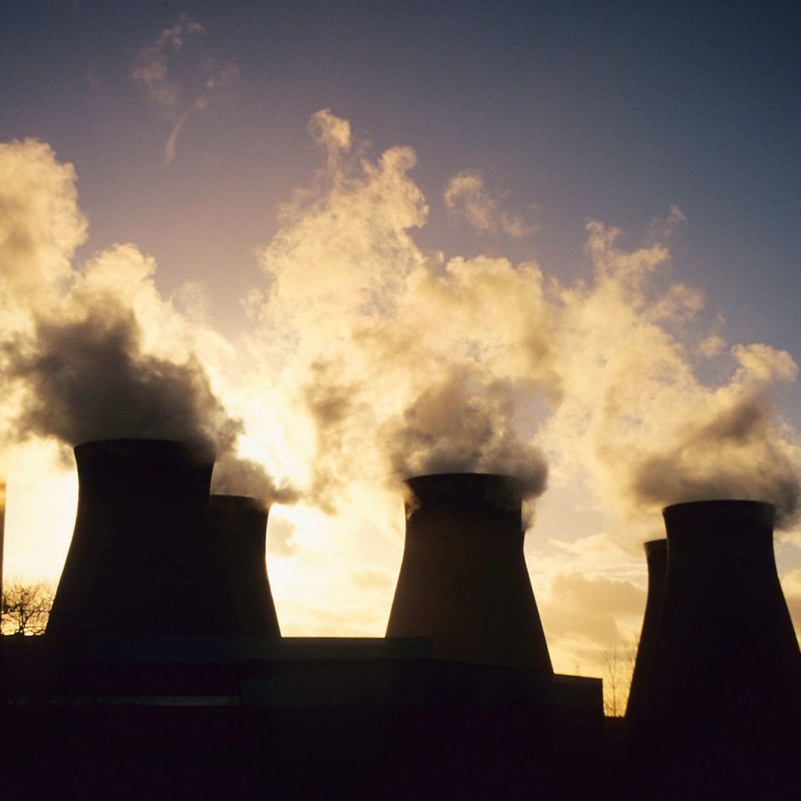
What is a green house gas?
When heat goes into the Earth’s atmosphere it can’t escape from the atmosphere because the greenhouse gases are creating a wall that the heat can enter but can’t leave and because of this the world heats up. This is called ‘global warming’.
Some green house gases includes water vapor, carbon dioxide, Methane, Ozone, Nitrous oxide and Chlorofluorocarbons.

Slide 24
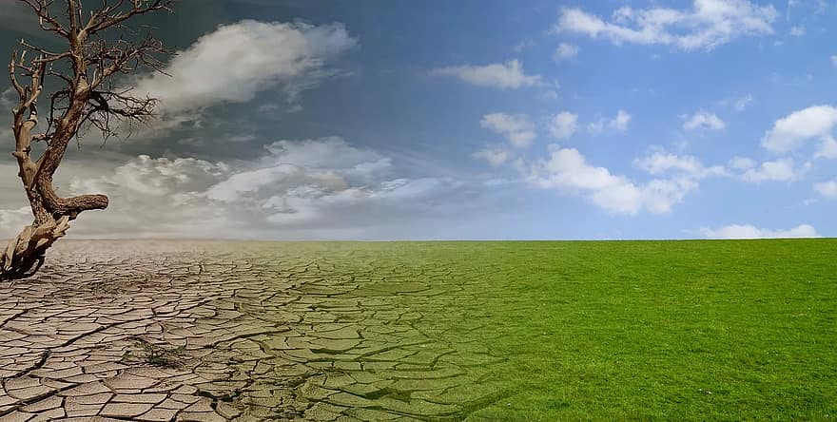
Examples of climate change
Climate change has made storms more frequent and intense.
Between 1991 and 2019 in the United Kingdom the northern part had averages of 15 to 19 degrees the southern part had highs of 25 degrees and middle part had averages of 21 to 23

Slide 25
What can you do?
Humans need to do a lot more to slow down climate change, but Planting trees can help slow climate change.
Walking ,cycling and more exercises. Cars give out a greenhouse gas that blocks the sunlight from getting out.

Slide 27
Climate Change
By Joe Ball

Slide 28
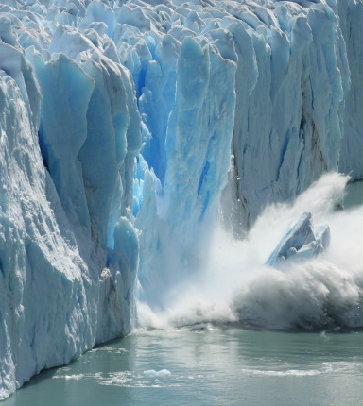
Understanding the causes of climate change is crucial.
Many animals are harmed because of temperatures rising.
Icebergs are melting and killing off polar bears and other animals in both the artic and Antarctic.
Here is a clip of an iceberg splitting.

Slide 29
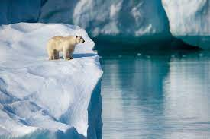
Temperatures rising are caused by the burning of fossil fuel such as coal and the production of methane.

Slide 30
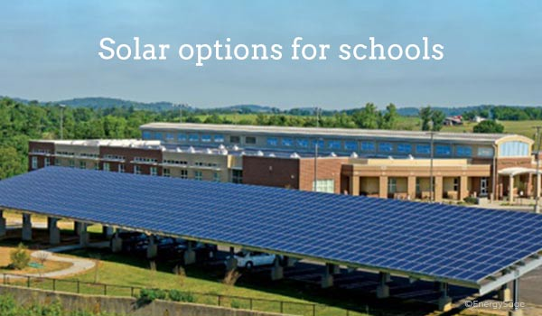
what we can do
We can use renewable energy such as solar panels, electric cars and wind farms.
We could eat less meat – the meat industry is a big producer of methane gas.
In school we could do the following:
Have a meat free Monday
Solar panels fitted to the school roofs
Make sure all the lights are turned off at the end of the day
The school bus could run on green energy

