Slide 1
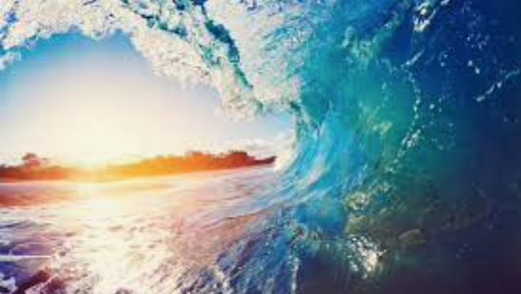
Ocean life
By Rota Kids

Slide 2
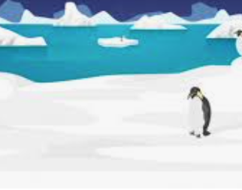
Animals Endangered by Ocean Pollution

Slide 3
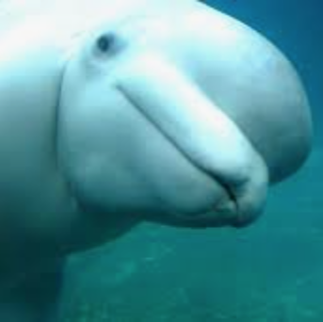
Beluga Whale
Toxic chemicals found inside them – pesticides, herbicides, etc
Increased risk of cancer due to chemicals
Often found with bellies full of plastic, fishing nets and other debris

Slide 4
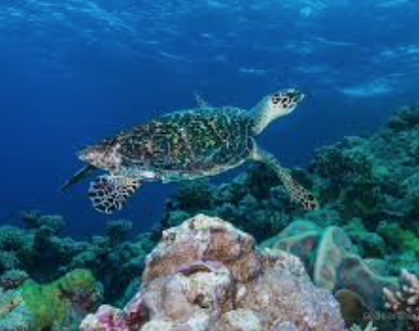
Hawksbill Turtle
Overfishing can lead to danger - they are killed for their meat and shells
Poison fishing contributes to the degradation of coral reefs which these turtles survive on

Slide 5
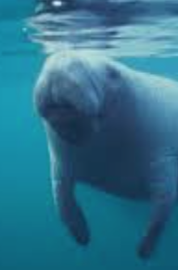
Florida Manatee
Pesticides and herbicides cause deaths to these creatures
Toxic algae blooms destroys the grass which is the Manatee’s main source of food

Slide 6
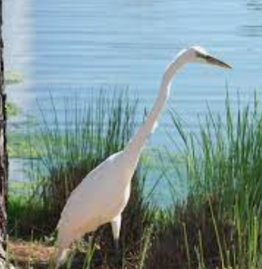
Seabirds
Seabirds are often found with bellies full of plastic which they cannot digest, leading to their death
They are also found tangled in debris

Slide 7
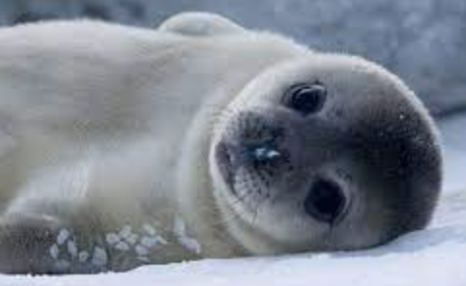
Sealions and seals
Sealions and seals are often found strangled by plastic
Young seals and sealions play with marine debris, not knowing what harm it may cause

Slide 8
Coral Bleaching

Slide 9
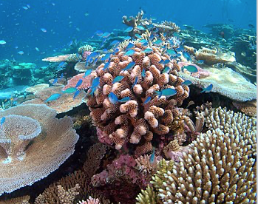
What is Coral Bleaching?
Coral bleaching is when reefs start dying, get stressed and turn white.
Bleaching occurs when the sea heats up and the coral gets stressed. When the coral gets stressed, it expels chemicals, which are toxic to the coral, and the tissue becomes transparent and reveals the hard, white skeleton.

Slide 10
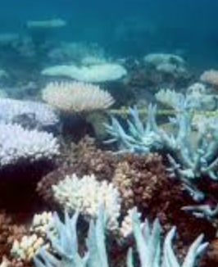
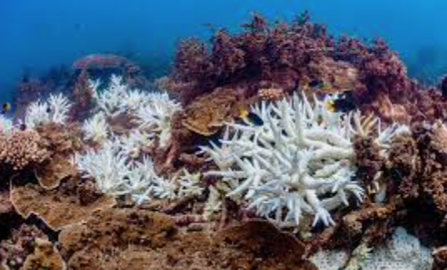
The great barrier reef
The great barrier reef is dying due to climate change. Over 90% of the coral in the great barrier reef has been bleached at least once.

Slide 11
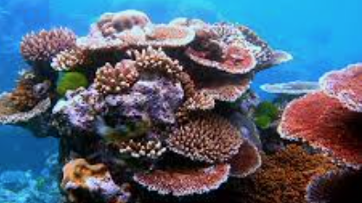
Why are coral reefs important?
Coral is not actually a plant. It is an animal.
Like sponges, they clean the water around them.
Most marine life live on coral reefs. When storms come, they act as a barrier, protecting the inhabitants of it.

Slide 12
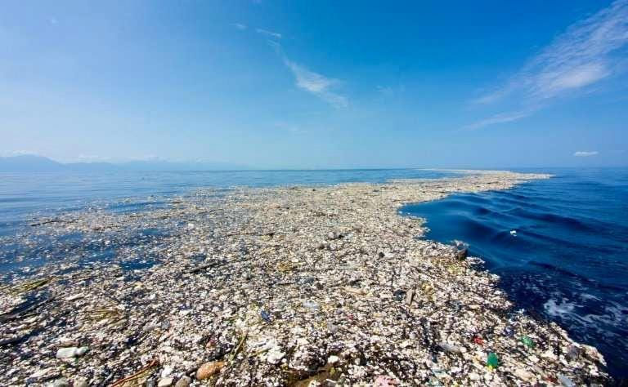
Plastic in the ocean

Slide 13
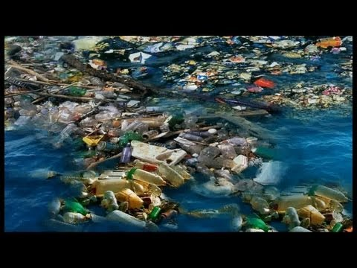
We use lots plastic.
We create lots of plastic waste.
Some of this plastic waste has ended up in the sea.
In the Pacific Ocean, there are 2 large patches of plastic waste, known as the Eastern and Western Garbage Patches.
Most commonly used plastics do not ever fully “go away,” but rather break down into smaller and smaller pieces.

Slide 14
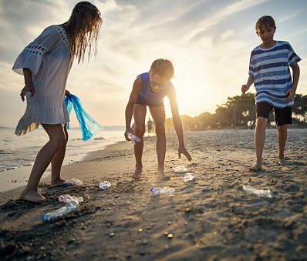
What can we do?
Be responsible for all your rubbish on land and on the water.
Dispose of items properly.
Get involved! Participate in local clean ups in your area. Remember that the land and sea, no matter where you are, are connected.
Reduce the amount of waste you produce.
Reuse items whenever possible.
Choose reusable items over disposable ones.
Recycle as much as possible.

Slide 15
Ways to stop pollution
By Lily Reece

Slide 16
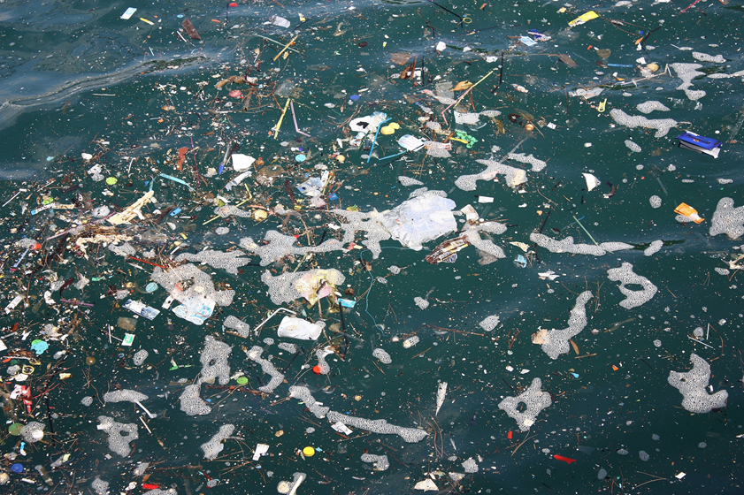
Pollution
This is pollution!

Slide 17
Pollution Facts
These are some of the items that have been found in the sea:
Cigarettes
Food wrappers
Drink bottles
Plastic bags
Bottle lids
Straws
Drink cans

Slide 18
Recycling
There are lots of ways to stop pollution.
One of the main ways is recycling.
This is a way to stop plastic and clothes from going into the ocean or into landfill by reusing these products to make new things.

Slide 19
Ways to recycle
You can recycle bottle lids, milk bottles, yoghurt pots, plastic packaging and other plastic resources.
You can also put clothes that don’t fit any more in clothes bins that can be found in some car parks or you can give them to charity.

Slide 20
Recycling in school
You can help the environment too by recycling as well. Here are some ideas.
Next to the year one classroom there are some recycling bins. In the morning when you come in you can bring any items to recycle, into school.
Make sure you don’t put any items that can’t be recycled in the recycling bin.

Slide 21
Recycling at home
You can also recycle at home by:
1. Putting all the plastic you find in your house in the recycling bin.
2. Using recyclable bags instead of plastic bags.
3. Trying not to use plastic cups, plates and cutlery. Instead use paper plates and cups and wooden cutlery.
4. Not buying as many plastic toys or games.

Slide 22
Polluters
One of the main polluters of our rivers and seas are wet wipes. People flush them down toilets and they end up in rivers and seas.
Do not flush anything down the toilet apart from toilet roll and human waste.

Slide 23
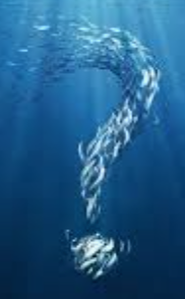
Quiz

Slide 24
What animals are dying or endangered?
Hawksbill turtle, Florida manatee,
Seals, Seabirds and Beluga whales.

Slide 25
Why is coral getting bleached?
The climate is causing the
coral to get stressed

Slide 26
What is the waste in the sea?
Cigarettes, Food wrappers, Drink bottles,
Plastic bottles, Bottle lids,
Drink cans and straws.

Slide 27
What can we do to prevent raising ocean climates?
Reduce, reuse and recycle

