Slide 1
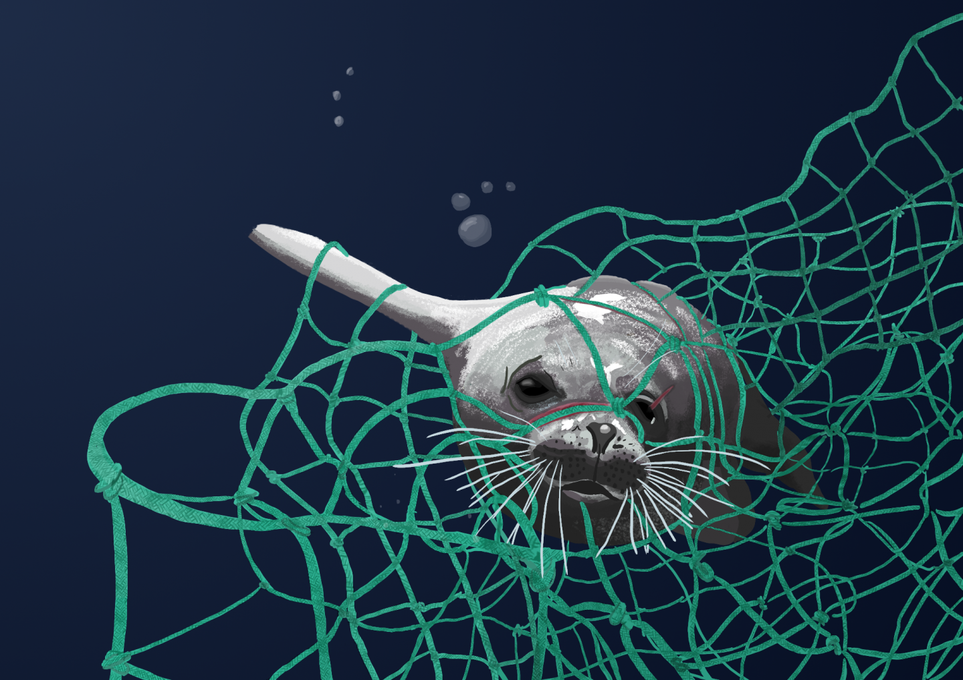
Plastic is destroying habitats

Slide 2
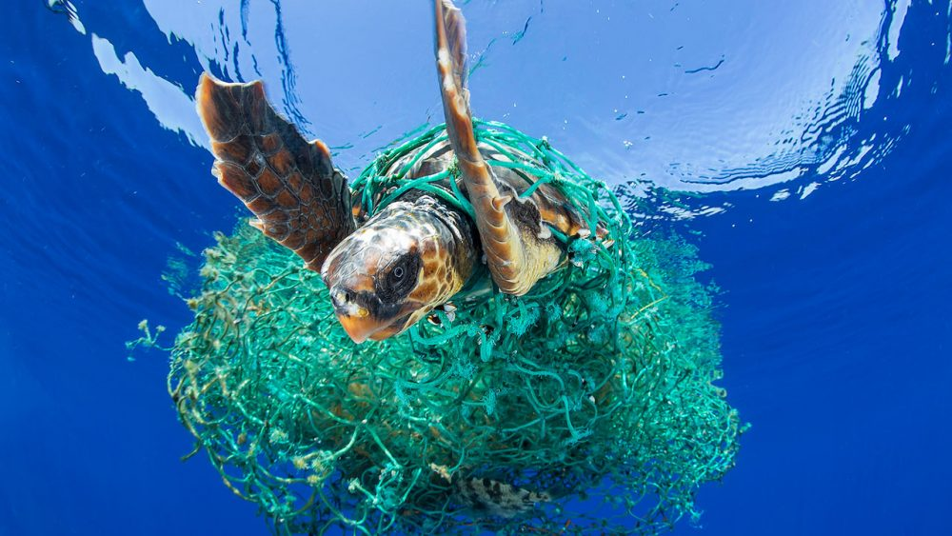
Fish are not very smart so what they see they will eat.
8 Million tonnes of plastic end up in the sea, ocean, lakes, rivers and ponds.
If we eat fish we end up eating the plastic and that wouldn`t be good for us.

Slide 3
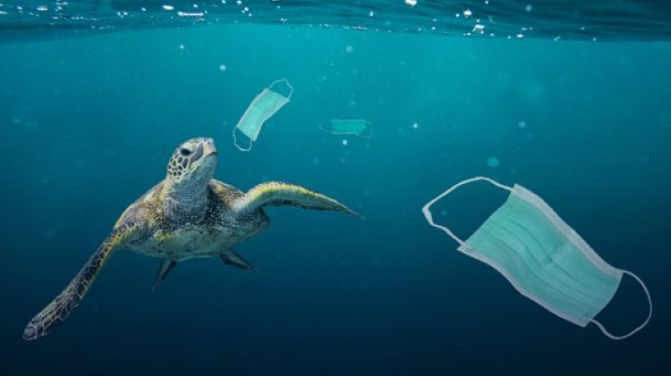
What is poisoning ocean creatures ?
Plastic waste includes straws, hangers , fishing nets, cup holders and facemasks. The wind pushes all the plastic towards the coral reefs where all the wild life is. Sharks, fish, turtles, whales, dolphins, crabs, jellyfish, seahorses and eels.
It’s their ocean too but we
are poisoning it.

