Slide 1
Climate Change
The effects of climate change on the world
Made by Noah M

Slide 2
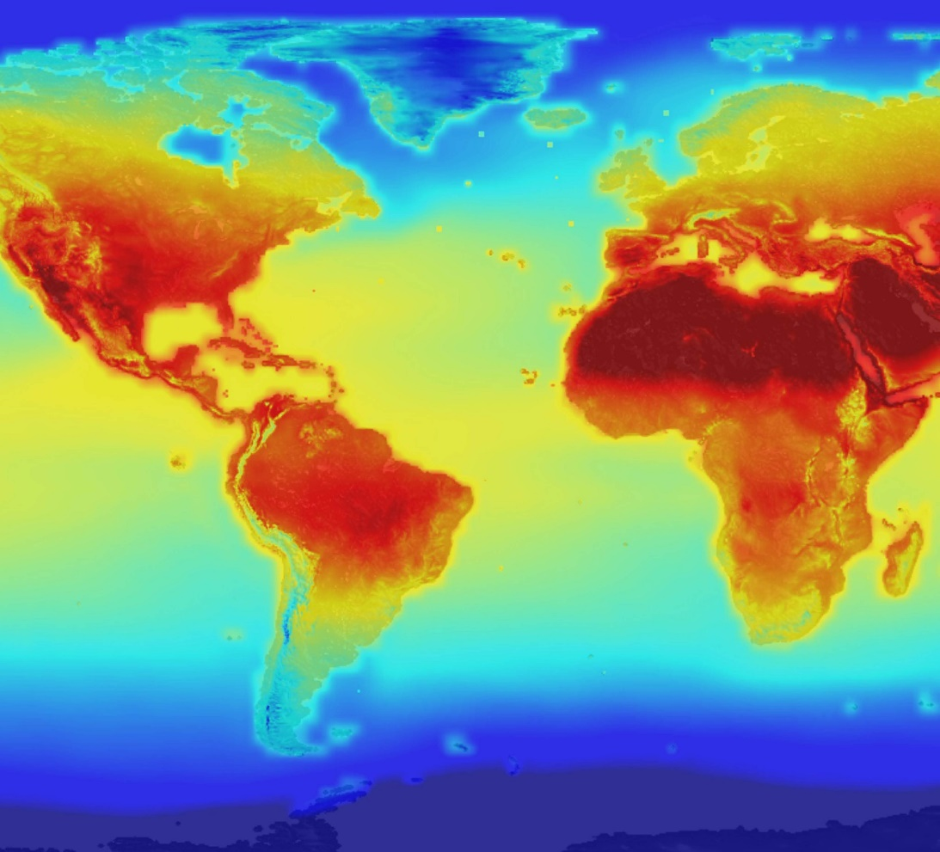
What is climate change?
Climate change describes a change in the average conditions such as temperature and rainfall.
Global climate change refers to the average long term changes over the entire Earth like hotter temperatures and changes in rain it also has other effects such as higher sea levels and shrinking glaciers.

Slide 3
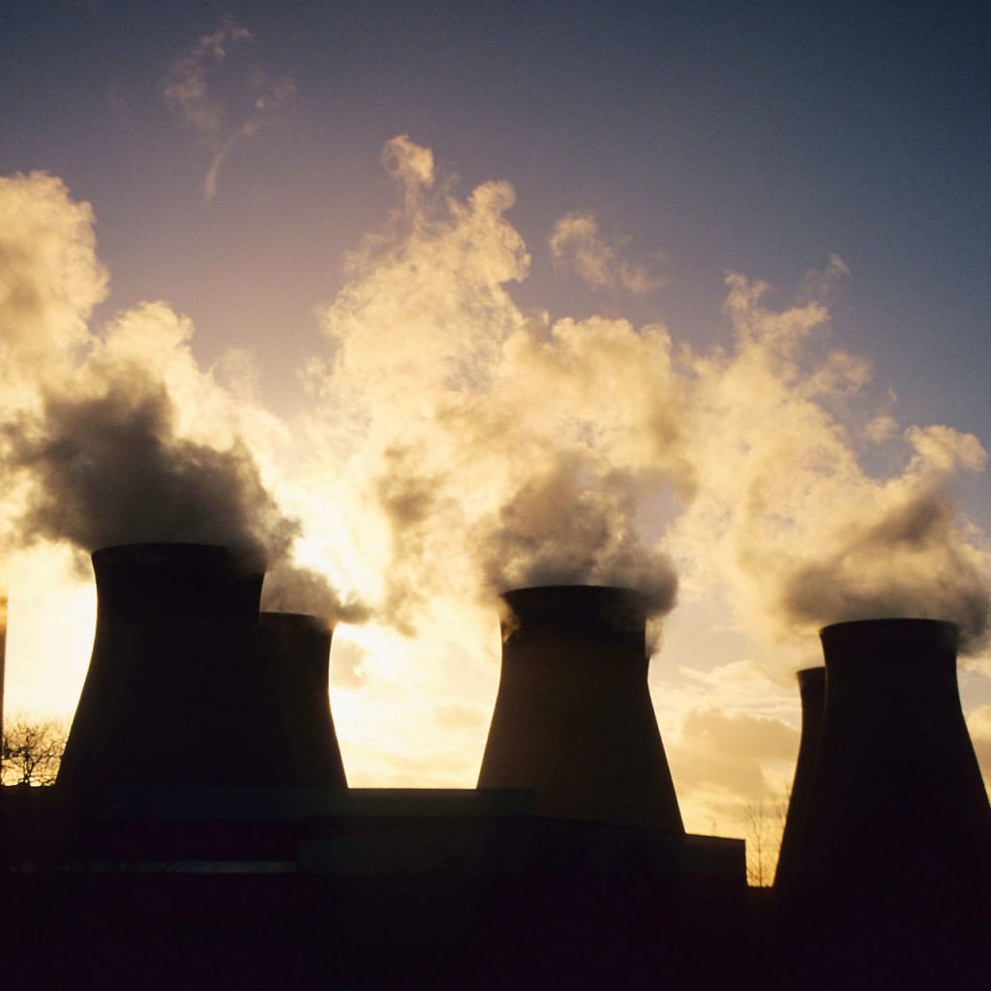
What is a green house gas?
When heat goes into the Earth’s atmosphere it can’t escape from the atmosphere because the greenhouse gases are creating a wall that the heat can enter but can’t leave and because of this the world heats up. This is called ‘global warming’.
Some green house gases includes water vapor, carbon dioxide, Methane, Ozone, Nitrous oxide and Chlorofluorocarbons.

Slide 4
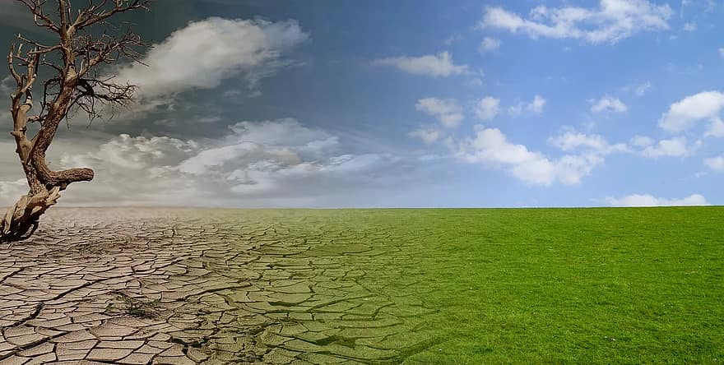
Examples of climate change
Climate change has made storms more frequent and intense.
Between 1991 and 2019 in the United Kingdom the northern part had averages of 15 to 19 degrees the southern part had highs of 25 degrees and middle part had averages of 21 to 23

Slide 5
What can you do?
Humans need to do a lot more to slow down climate change, but Planting trees can help slow climate change.
Walking ,cycling and more exercises. Cars give out a greenhouse gas that blocks the sunlight from getting out.

