Slide 1
Climate Change
By Joe Ball

Slide 2
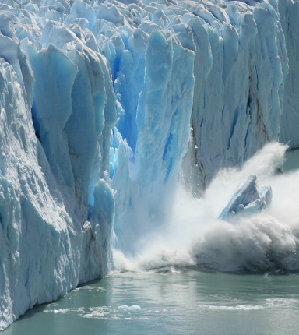
Understanding the causes of climate change is crucial.
Many animals are harmed because of temperatures rising.
Icebergs are melting and killing off polar bears and other animals in both the artic and Antarctic.
Here is a clip of an iceberg splitting.

Slide 3
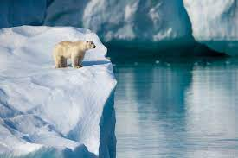
Temperatures rising are caused by the burning of fossil fuel such as coal and the production of methane.

Slide 4
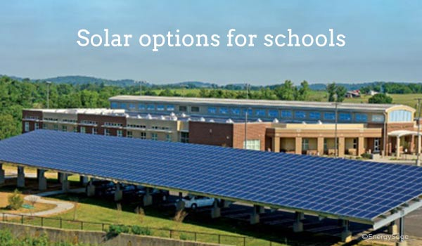
what we can do
We can use renewable energy such as solar panels, electric cars and wind farms.
We could eat less meat – the meat industry is a big producer of methane gas.
In school we could do the following:
Have a meat free Monday
Solar panels fitted to the school roofs
Make sure all the lights are turned off at the end of the day
The school bus could run on green energy

