Slide 1
Phonics and Early Reading Skills in EYFS

Slide 2
Did you know…?
The English language is one of the most complex languages to read and write.
It has:
26 letters
44 sounds
And over 100 ways to spell those sounds

Slide 3
The Jargon – A Quick Guide
phonics (also known as ‘synthetic phonics’) – The teaching of reading by developing awareness of the sounds in words and the corresponding letters used to represent those sounds.
phoneme - Any one of the 44 sounds which make up words in the English language.
grapheme – How a phoneme is written down. There can be more than one way to spell a phoneme. For example, the phoneme ‘ay’ is spelt differently in each of the words ‘way’, ‘make’, ‘fail’, ‘great’, ‘sleigh’ and ‘lady’.
blending – Putting together the sounds in a word in order to read it, e.g. ‘f – r – o – g, frog’
segmenting – Breaking a word into its constituent sounds in order to spell them,
e.g. ‘frog, f – r – o – g’’

Slide 4
What is phonics?
Phonics is a method for teaching reading and writing.
It develops phonemic awareness – the ability to hear, recognise and use the sounds within words.
Learners are also taught the correspondence between sounds and the graphemes (spelling patterns) that represent them.
Phonics is currently the main way in which children in British primary schools are taught to read in their earliest years.
Children will also be taught other skills, such as whole-word recognition (see ‘tricky words’), book skills and a love and enjoyment of reading.

Slide 5
Why Are Children Taught Phonics?
Phonics, taught in a structured way, is generally accepted to be the most effective way to teach reading and writing.
Children learn to hear and recognise sounds in words and spell them correctly.
This assists with their confidence, accuracy and fluency.
Phonics should not be taught in isolation — children also need to learn other reading and comprehension skills alongside phonic knowledge.

Slide 6
In July 2021, the government asked all schools to revise their phonic provision.
At St. Peter’s we have chosen to buy into a new scheme called Little Wandle Revised Letters and Sounds. As much of the content and format of this scheme is very familiar to the staff and children, we are confident that this scheme will help us to deliver a robust phonic programme that enables children to learn the code quickly and efficiently.

Slide 7
Phase One Phase 1 has seven aspects, with a focus on listening skills.
Environmental sounds
Instrumental sounds
Body percussion
Rhythm and rhyme
Alliteration
Voice sounds
Oral blending and segmenting

Slide 8
Phase Two
Learning 19 letters of the alphabet and one sound for each.
Blending sounds together to make words.
Segmenting words into their separate sounds.
Beginning to read simple captions.
Tricky words – the, I, no, go, to
Set 1: s, a, t, p
Set 2: i, n, m, d
Set 3: g, o, c, k
Set 4: ck, e, u, r
Set 5: h, b, f, ff, l, ll, ss

Slide 9
Phase 3
The remaining 7 letters of the alphabet, one sound for each and graphemes such as ch, oo, th representing the remaining phonemes not covered by single letters.
Set 6: j, v, w, x
Set 7: y, z, zz, qu
Consonant digraphs: ch, sh, th, ng
Vowel digraphs & trigraphs: ai, ee, igh, oa, oo, ar, or, ur, ow, oi, ear, air, ure, er
Tricky words which cannot be decoded are also introduced. He, she, we , me, be, was, you, they, all, are, my, her

Slide 10
Phase Four
By Phase 4, children are able to represent each of 42 phonemes with a grapheme. Children will be able to read CVC words and begin to segment them to spell them.
Phase 4 is consolidation of children’s knowledge. Children also move on to blending and segmenting using adjacent consonants, e.g. st, sp, tr, br, spr, str in words such as string, blow, train.
Phonics teaching continues to be regular and structured and children play games to consolidate their learning.

Slide 11
Phase Five
Children will broaden their knowledge of graphemes and phonemes.
They will learn alternative ways of spelling the phonemes they have already learnt.
They will learn strategies to help them choose the correct grapheme for spelling.
Children will be reading with more and more fluency, no longer needing to ‘sound out’ most familiar words.

Slide 12
There is a daily 10 – 20 minute phonic lesson

Slide 13
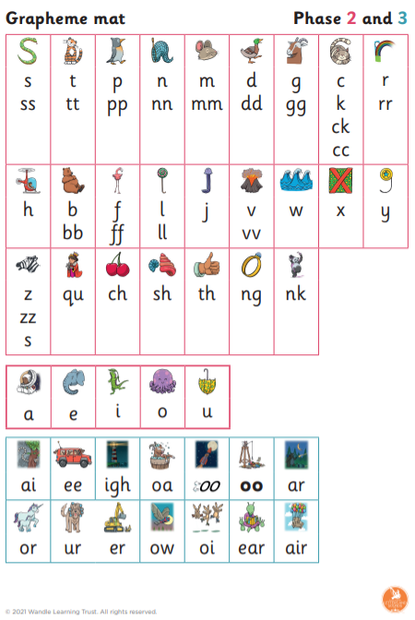
The children will have this to support the children when they are reading and writing in the classroom.

Slide 15
Reading
In school smaller groups are used to help the children practise the skills needed to become fluent readers.
Each group will read 3 times a week and will practise different skills:
Decoding the text
Prosody of the text. Intonation and expression.
Comprehension of the text

Slide 16
Reading
Picture books without words
Books with CVC words
Books with digraphs
Books with tricky and high frequency words
The type of book your child brings home will change as your child gains confidence with their phonic knowledge. The books will support the teaching of reading in the classroom.

Slide 17
What should I do with the reading book at home?
Support your child to sound–talk the words in the book.
Encourage them to point at the words as they read.
Point out tricky words before they try to sound them out.
Talk to them and ask questions to aid their comprehension.
Ask them for their opinion of the book and reasons why.

Slide 18
Information
https://www.littlewandlelettersandsounds.org.uk/resources/for-parents/
https://www.eastbridgfordstpeters.co.uk/phonics-and-reading/

