Slide 1
Samson’s life in lockdown
by Samson Marshall

Slide 2
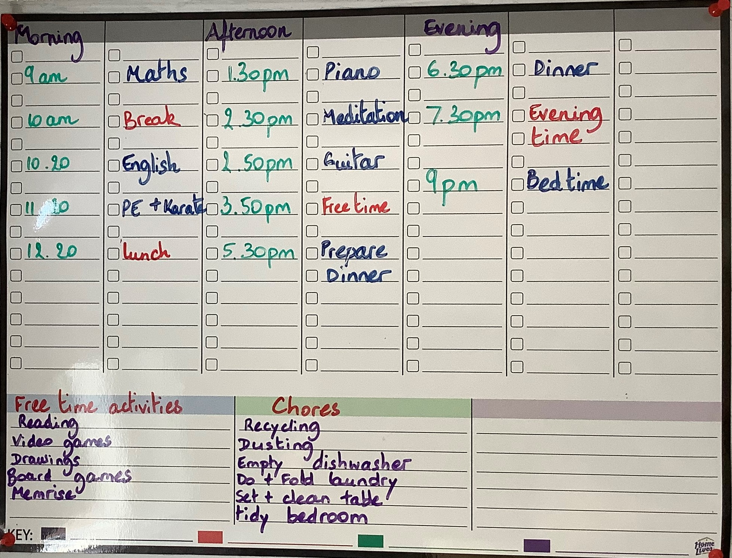
This is what my typical lockdown home learning day looks like. I particularly enjoy ticking them all off but my favourite time is PE with Joe wicks because I found it so active and enjoyable to do the incredible exercises. During my free time, I usually read my books (I read so many that I can’t even count them). I also enjoy walking to the shop on my own to get any food or drink that we need. I also have chores which I found fair because it makes me feel helpful especially cleaning the table.

Slide 3
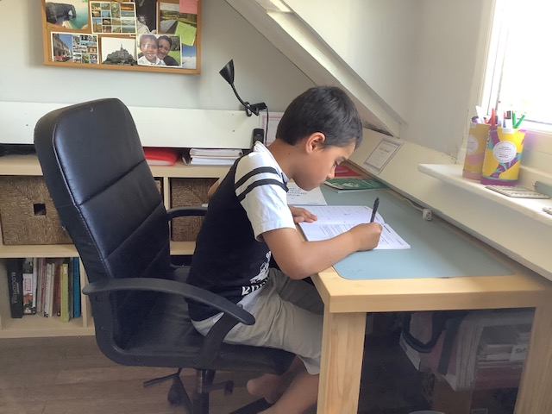
Here I am focusing on grammar in English. On that day, I completed four tasks and I scored 12/23. I really need to work on my adverbials but I have done quite well on synonyms.

Slide 4
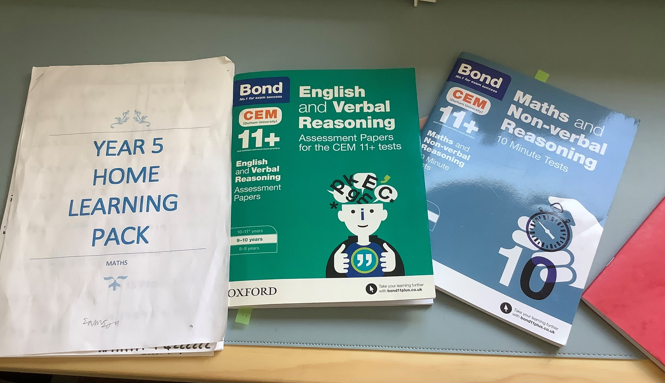
These are the main books I used to keep me going in English and in Maths. What I like the most about them, is that they help me practice what I have learned at school.

Slide 5
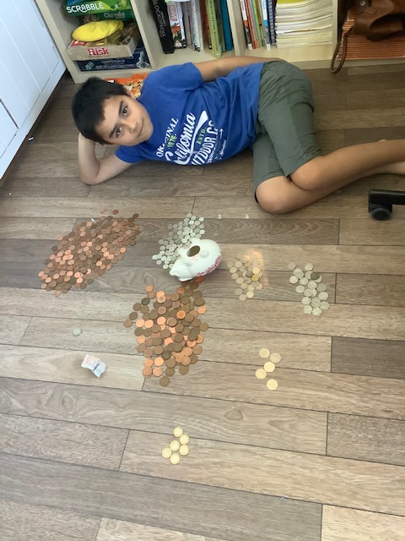
I have also been practising my maths skills to count my own money. That was really fun!

Slide 6
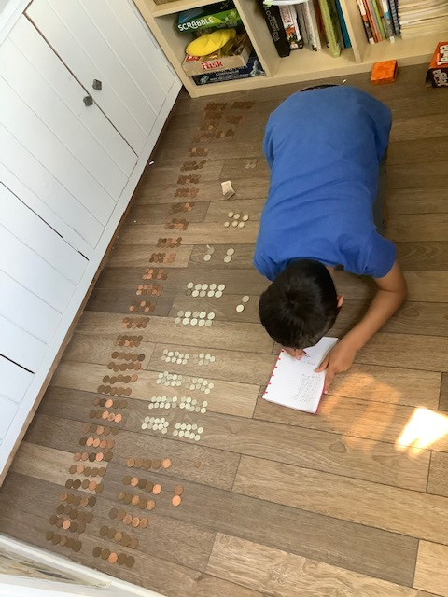
I found that sorting out the coins into tens made it a lot easier to add them all up.

Slide 7
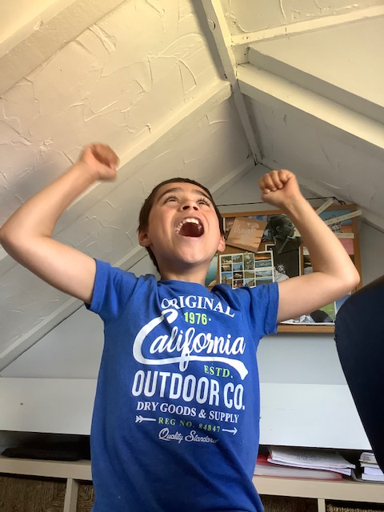
This is the result of counting up my coins but me and my mum made a deal that if I guessed the number right she would double the amount for me. I guessed the number right!

Slide 8
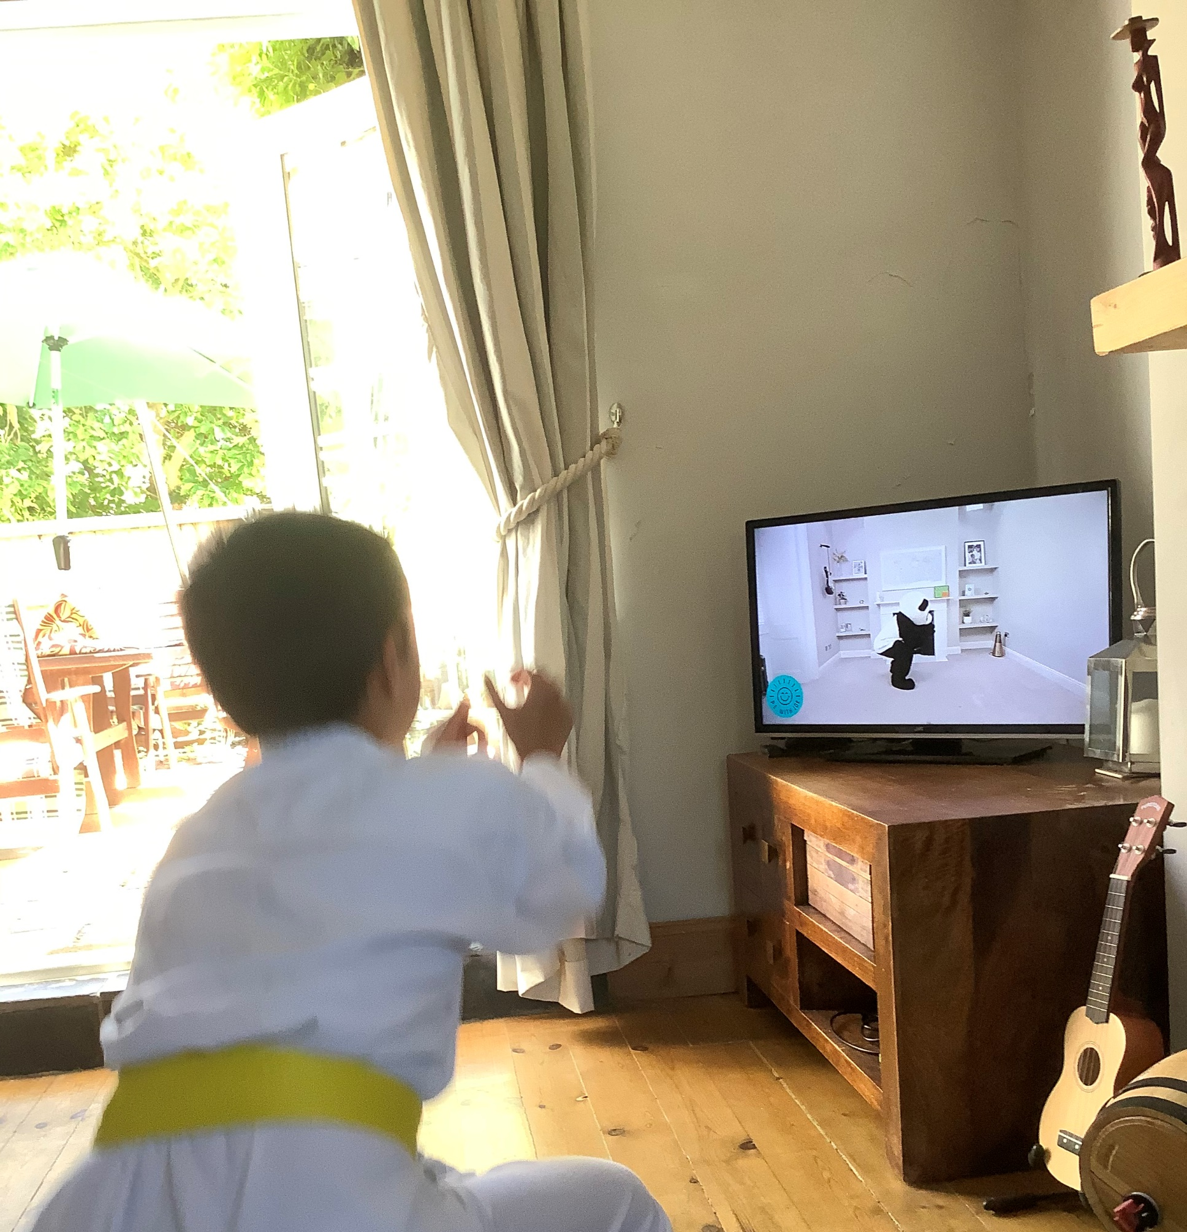
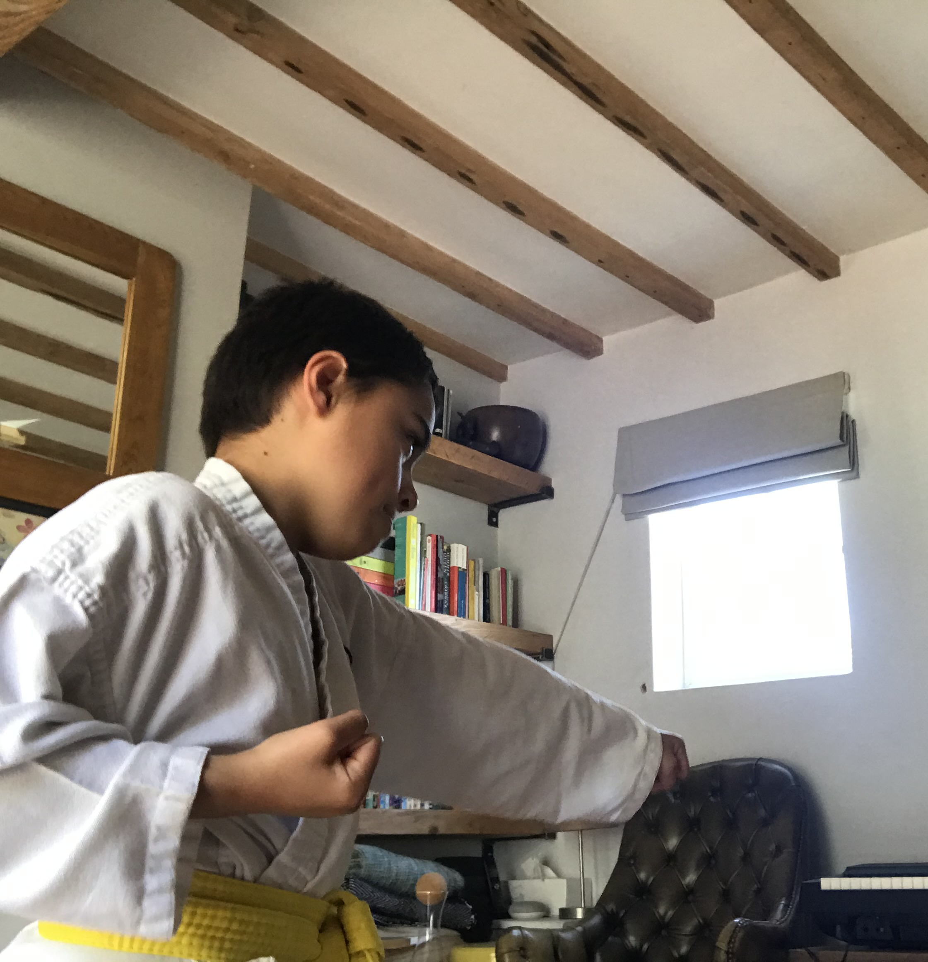
And here I am doing my PE and Karate using Youtube and Zoom. Does any one else follow Joe Wicks?

Slide 9
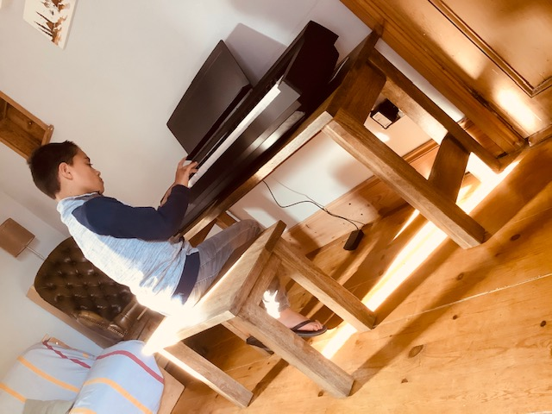
Playing the piano is a new skill that I have been enjoying during the lockdown. I definitely recommend using the Simply Piano
app, it is amazing! The song that I have enjoyed playing lately is ‘Up town funk’ by Bruno Mars.

Slide 10
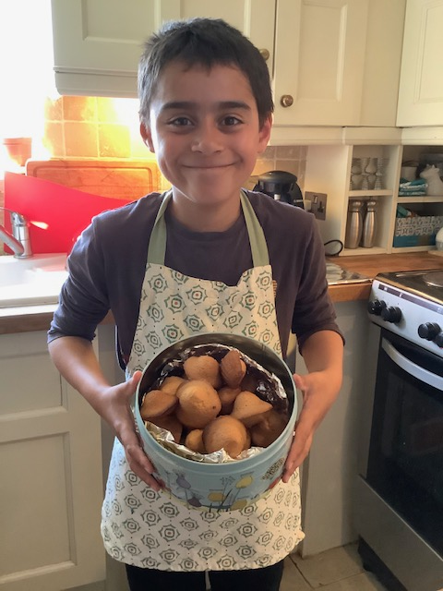
I have also been baking a lot but making those delicious madeleines was definitely something I really enjoyed.

Slide 11
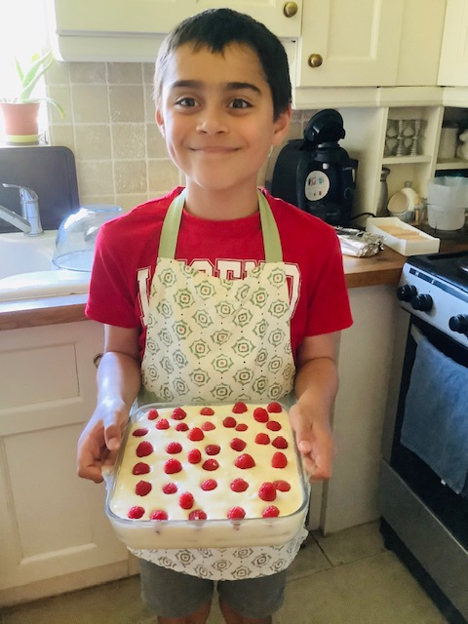
Another of my favourite to make (and EAT) is raspberry tiramisu which is equally mouth-watering!

Slide 12
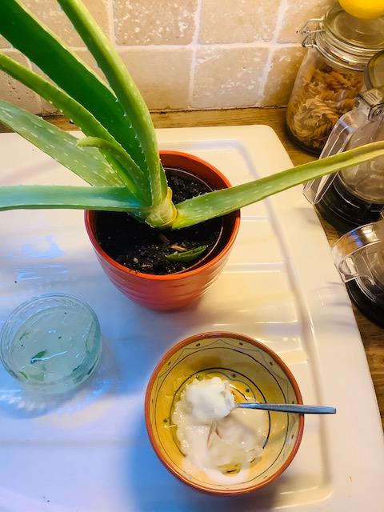
As a science project, I research the benefits of Aloe Vera. I then made some cream based on this plant. Et voila!

Slide 13
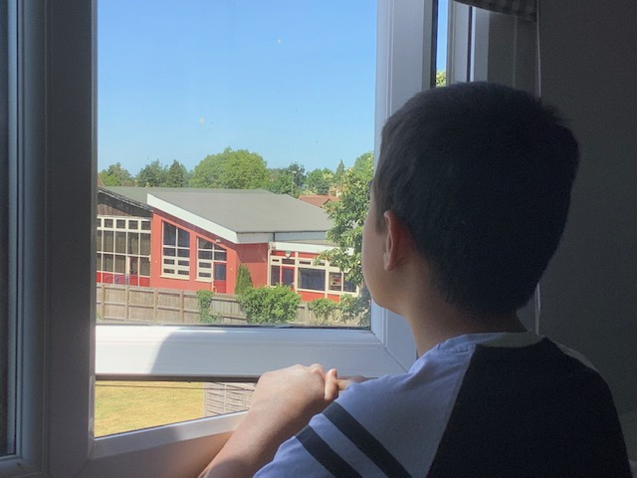
I miss school but I see it from my bedroom window and I hope that I will see you all soon. Take care.

