Slide 1
World war 2
By Leo Goodman

Slide 2
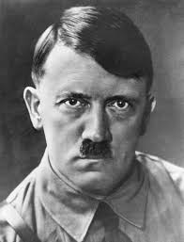
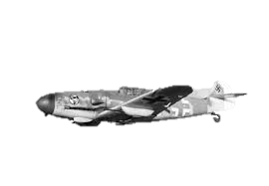
Nazi
1 what was the most famous Nazi fighter plane?
2 who was the leader of the Nazis?
3 what country was the Nazis?

Slide 3
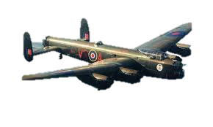
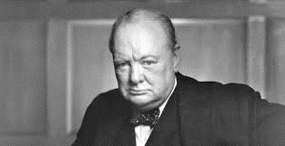
r.a.f
1 who was the prime minister of England during ww2?
2 what does r.a.f stand for?
3 what was a famous bomber during ww2 that is named after a place near here?

Slide 4
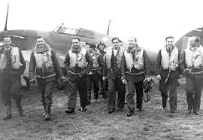
Squadron 303
1 what country was squadron 303 fighting for?
2 where was the squadron formed?
3 how many pilots were in the squadron?
4 was the squadron on the allies or the axes ?

Slide 5
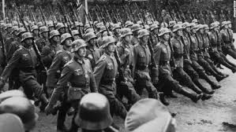
ww2
1 how many countries fought in ww2?
2 How many people died in ww2?
3 When did ww2 end?
4 When did ww2 start?

Slide 6
Answers!!!
Nazi- 1 Messerschmitt, 2 Adolf hitler, 3 Germany
R.a.f- 1 Winston Churchill, 2 royal air force, 3 Lancaster bomber
Squadron 303- 1 Poland, 2 Blackpool, 3 148, 4 allies
ww2- 1 30, 2 85 million, 3 2nd September 1945, 4 1st September 1939.

