Slide 1
MINECRAFT QUIZ
By Lily Barrett
Class 5/6

Slide 2
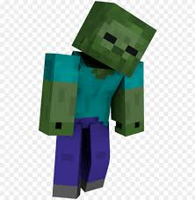
Question 1:
How much health does a zombie have?

Slide 3
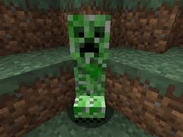
Question 2:
How does a creeper kill you?

Slide 4
Question 3:
How many hearts do you have in Minecraft?

Slide 5
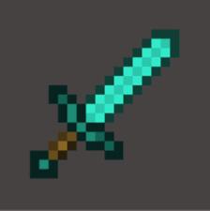
Question 4:
What do you need to craft a diamond sword?

Slide 6
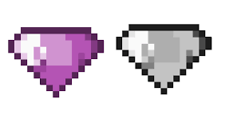
Question 5:
What is the rarest gem in Minecraft?

Slide 7
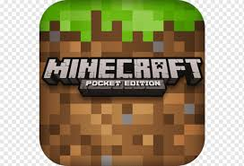
Question 6:
Who was the inventor of Minecraft?

Slide 8
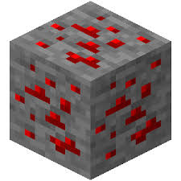
Question 7:
Name one of the places you can find Redstone ore?

Slide 9
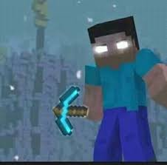
Question 8:
What is the name of the ghost that some people claim to have seen in Minecraft?
A: Zerowine
B: Herobrine
C: Spectral Gary

Slide 10
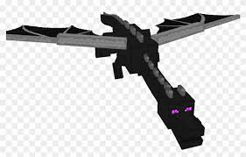
Question 9:
Which of these is the best weapon to use against the Ender Dragon?
A: Bow and arrows
B: Sword
C: Axe

Slide 11
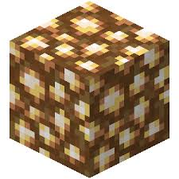
Question 10:
What is the name of this type of block?
A: Redstone
B: Glowstone
C: Cobblestone

Slide 12
Answers:
1. How much health does a zombie have?
10 health
2. How does a creeper kill you?
It explodes near you
3. How many hearts do you have in minecraft?
Ten
4. What do you need to craft a diamond sword?
One stick and two diamonds
5. What is the rarest gem in Minecraft?
Emerald
6. Who invented Minecraft?
Markus ‘Notch’ Persson
7. Name one of the places you can find Redstone ore?
In a cave or near lava (both answers correct)
8. What is the name of the ghost that some people claim to have seen in the game?
Herobrine
9. Which is the best weapon to use against the Ender Dragon?
Bow and Arrows
10. What is the name of the block in question 10?
Glowstone
How many questions did you get right? Are you a Minecraft Expert?!

