Slide 1

KS1 Meet and Greet 2023
Mrs Gilbey, Miss Fisher, Miss Evans and Mrs Lewis

Slide 2
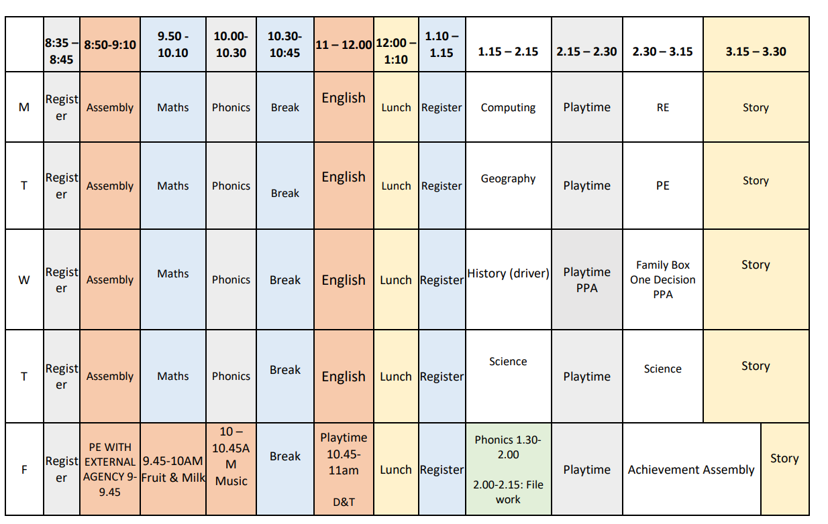
Example KS1 Timetable

Slide 3

Spelling, Phonics and Reading
Reading
  Prediction
  Decode
  Prosody
  Comprehension
Spellings
  Year 1 – lists can be found on class pages (not tested)
  Year 2 – Tested weekly on a Thursday

Slide 4

How can you help at home?
Reading and sharing books with your child. Please read with your child at least three times a week and sign in the calendar section of their diary. Reading certificates are awarded termly for regular reading.
Spellings: High frequency words for year one and two can be found in their diary.
Homework
Number facts and counting
Speaking and listening opportunities are individual to each class (Family Box, Baker’s Basket and Moonbeam the Bear)
PurpleMash – passwords in their diaries

Slide 5

Extra information
Please label all clothing and equipment that is in school
Water bottle
Independence
Clubs, educational visits and residential
Sandwiches and jacket potatoes
Uniform and jewelry (no smart watches)
Communication via the office or catch us at the end of the day

Slide 6

Forest School
Forest School: linked to our topics through the year. Our first topic is all about habitats so we’ll be out looking for what we can see, building some homes for the animals and playing lots of games.
Letter to follow but please send them in long sleeved tops, trousers & wellies or walking boots. Make sure to check the weather in case they need waterproofs/warmer coats too!

Slide 7
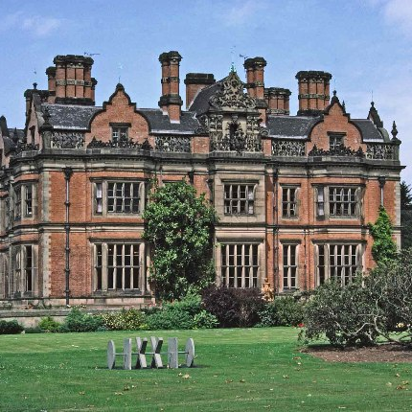
Things to look forward to this year….
Harvest
Christmas
Easter celebrations
Beaumanor (Y1 day trip and Year 2 residential)
Trips linking to topics (if and when appropriate)

Slide 8
Thank you
Mrs Gilbey, Miss Fisher, Miss Evans and Mrs Lewis

