Slide 1
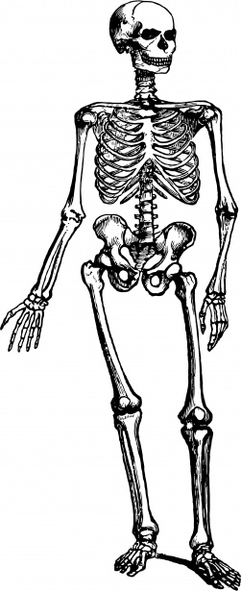
QUIZ
Human Body

Slide 2
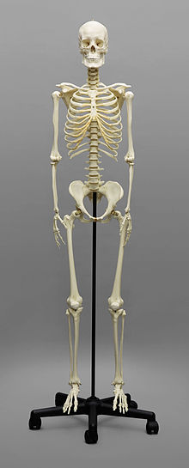
NAME THOSE BONES
6
PELVIS
HUMERUS
FEMUR
CLAVICLE
MANDIBLE
F. TIBIA
5
1
4
3
2

Slide 3
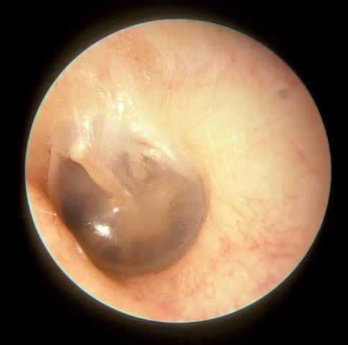
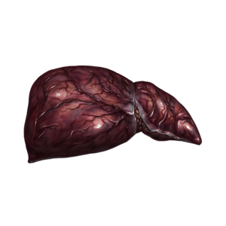
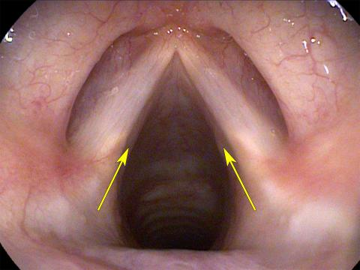
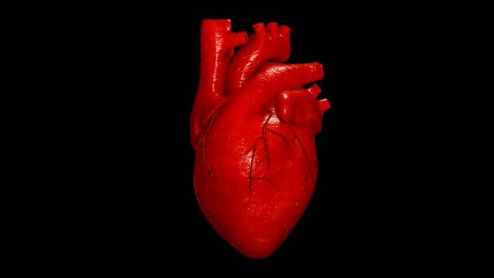
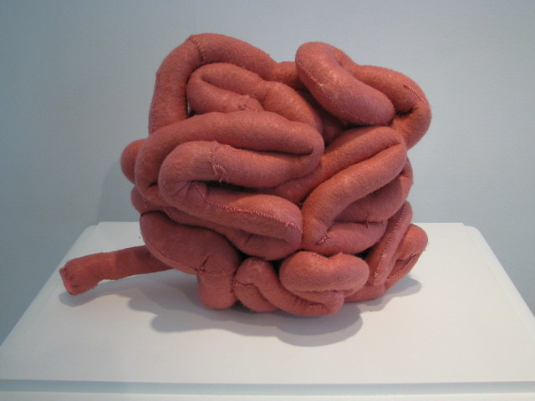
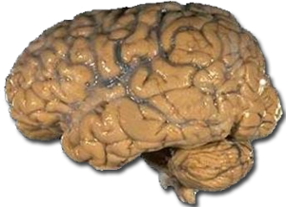
WHAT ON EARTH IS THAT?
This Photo by Unknown Author is licensed under CC BY

Slide 4
TRUE OR FLASE
IS THE SMALL INTESTINE AS LONG AS A TWO STORY HOUSE FROM THE FLOOR TO THE ROOF?
ARE THEIR SIX BONES IN THE HUMAN HAND?
DOES THE NOSE HAVE A BONE?
DO THE VEINS CARRY BLOOD TO THE HEART?
DOES THE LIVER MAKE YOUR URINE?

Slide 5
LARGEST ORGAN IN THE HUMAN BODY .
THE BREATHING ORGAN.
MAKE URINE .
MADE OF THE SAME THING AS YOUR TOE NAILS.
CLEANS YOUR BLOOD
FIGHTS GERMS
WORKS OUT THE ANSWERS TO JOKES
1
2
3
4
5
6
7
LUNGS
LIVER
SKIN
KIDNEYS
BRAIN
SPLEEN
HAIR

Slide 6

THANK YOU FOR LISTENING
HOPE YOU ENJOYED IT
This Photo by Unknown Author is licensed under CC BY-SA

Slide 7
ANSWERS
1A
2F
3C
4B
5D
6E
3
1
T
F (27)
BOTH
T
F (KIDNEYS)
4
1 ORANGE 2 LIGHT BLUE
3 RED 4 YELLOW 5 BLACK
6 DARK BLUE 7 GREEN
2
EAR DRUM VOICE BOX LIVER HEART INTESTIENS BRAIN

