Slide 1

Animals Take Control
TAKE THAT HUMANS!!!
Come into the lions den and answer the questions to my monkey puzzle…

Slide 2
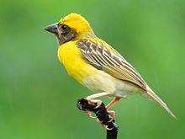
Birds
There are many ranges of birds, but where would you find a Yellow Baya bird?
How tall is an average Ostrich?

Slide 3
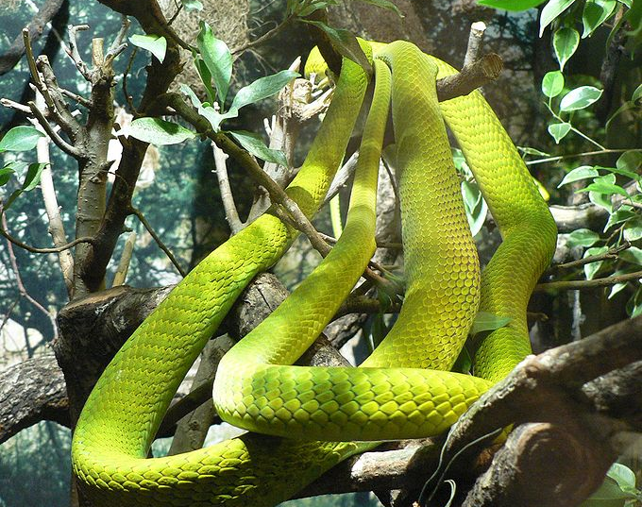
Reptiles
These are cold-blooded animals with scales, so answer this, how many vertebrae do large snakes have?
What are snakes’ scales made out of?

Slide 4
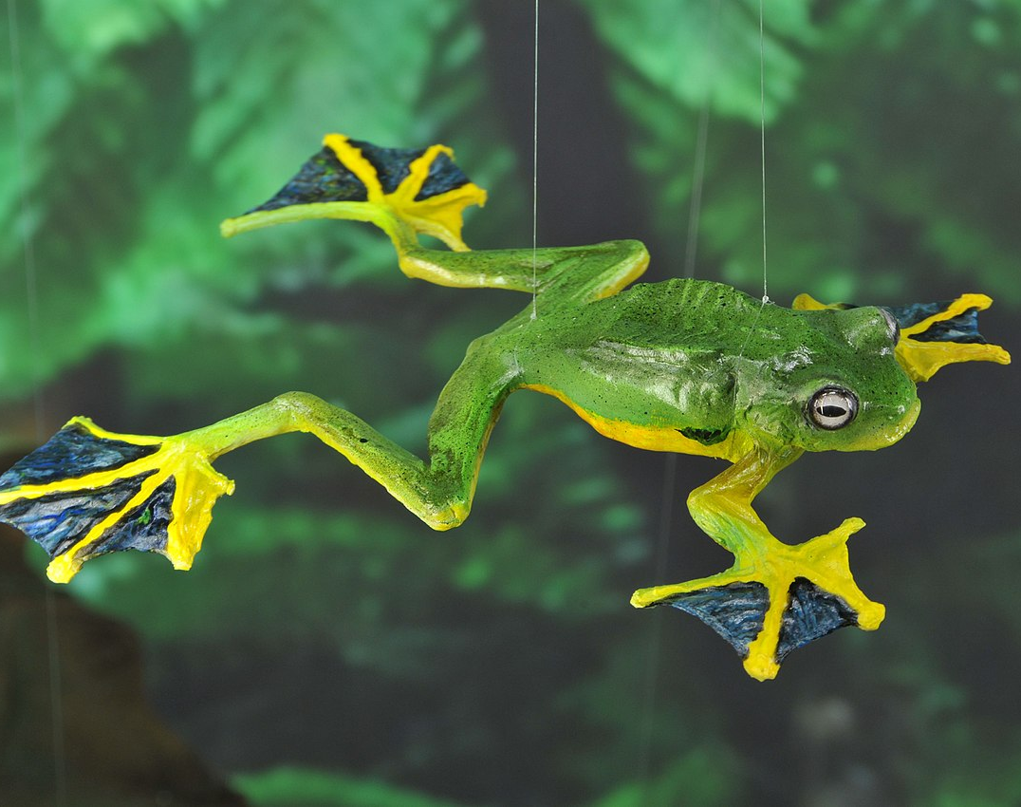
Amphibians
Reptiles are cold-blooded but so are Amphibians. If you know enough about Amphibians and what they eat, you probably will get this one.
What frog eats dragonflies?
What percentage of amphibians are born in rainforests?

Slide 5
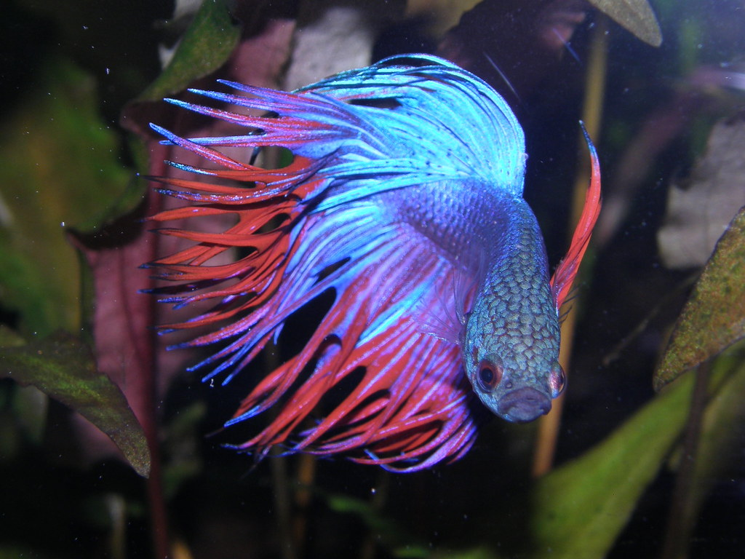
Fish
True or False?
Tuna can swim at speeds of up to 70kph(43mph).
There are over 40724 species known to mankind.

Slide 6

Insects
Fun Fact:
Insects have three parts to their bodies, the thorax, abdomen and the head.
True or False:
Insects have three pairs of legs.
The number of insect species are between six and what million?

Slide 7
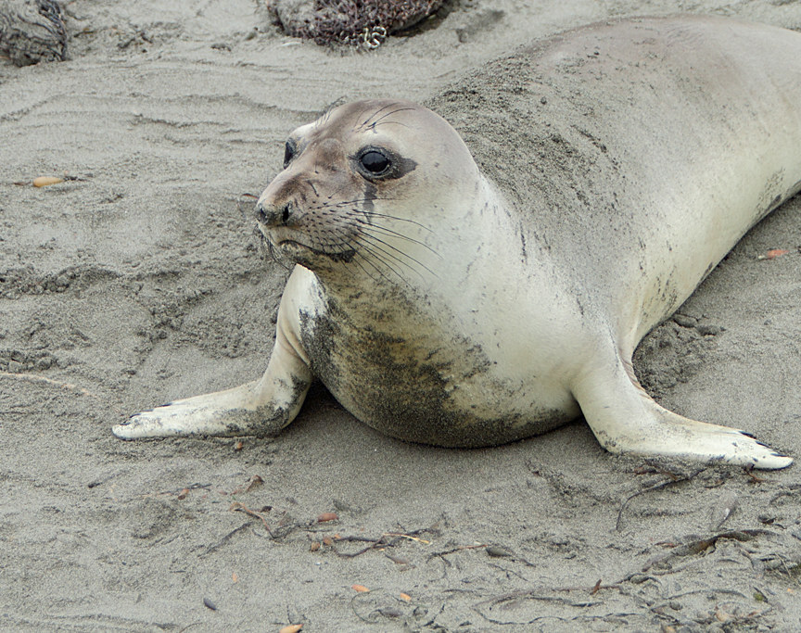
Mammals
Humans are mammals, and just like any over mammal they are warm-blooded animals. Tell me the answer to this.
How fast can a killer whale swim?
How far can a Red Kangaroo leap in one bound?

Slide 8
Answers
Birds- 1. South and Southeast Asia
2. 2.75 metres
Reptiles- 1. 400
2. Thick pieces of keratin
Amphibians- 1. Northern Leopard Frog
2. 75%

Slide 9
Answers
Fish- 1. True
2. False
Insects- 1. True
2. 10
Mammals- 1. 3.55 kilometres an hour
2. 9 or 10 metres

