Slide 1
SPORTS QUIZ
By Jack

Slide 2
Question 1
What year was Maradonna’s “hand of God”?

Slide 3
Question 2
When was the last time London hosted the Olympics?

Slide 4
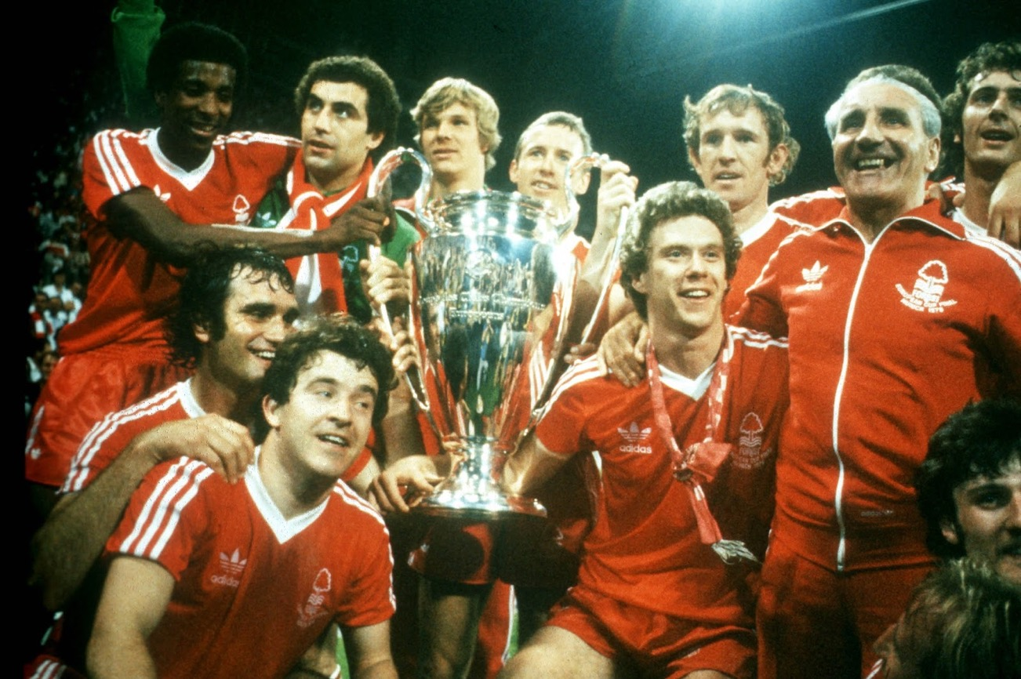
Question 3
What two years did Nottingham Forest win the European Cup?

Slide 5
Question 4
What sport has a position called ‘Fly Half’?

Slide 6
Question 5
What sport do you have to score in the ‘D’?

Slide 7
Question 6
How many points do you get for a ‘TRY’ in Rugby Union?

Slide 8
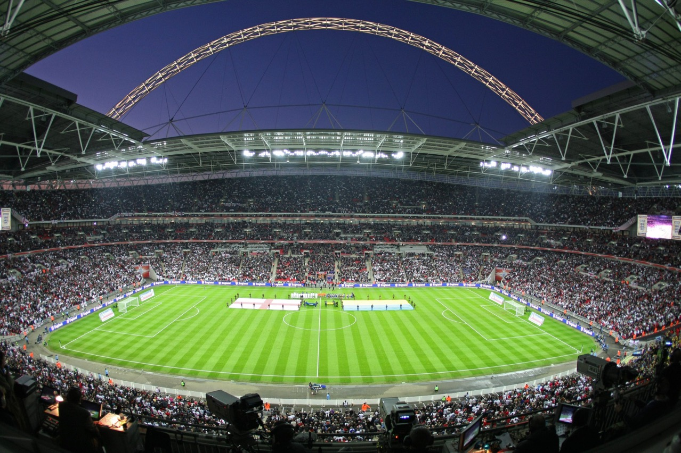
Question 7
What is the England football home ground called?

Slide 9
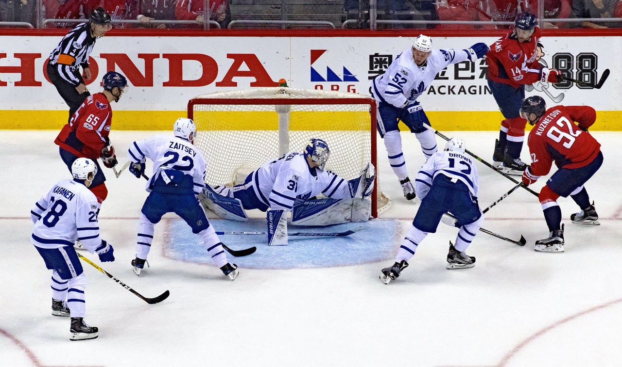
Question 8
What do you slap in Ice-Hockey ?

Slide 10
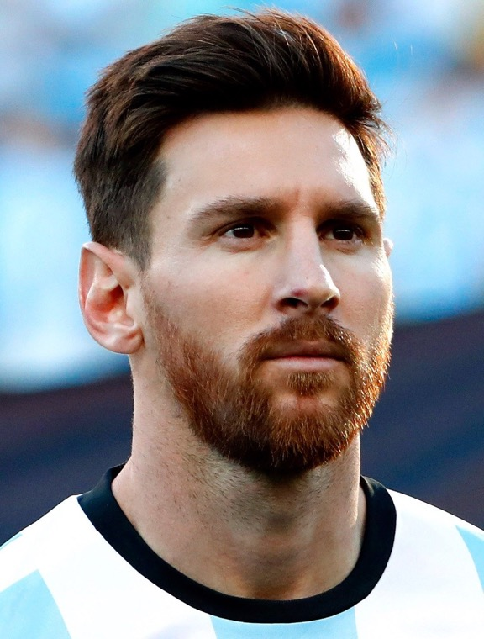
Question 9
Which country is Lionel Messi from ?

Slide 11
Question 10
What five colours make up the Olympic rings ?

Slide 12
Answers
1 1986 against England
2 2012
3 1979 Malmo and Hamburg 1980
4 Rugby
5 Hockey
6 5
7 Wembley
8 Puck
9 Argentina
10 Blue, Yellow, Black, Green, Red

