Slide 2
Learning Objective
Use commas
To separate items in a list:
To separate extra information in a sentence;
Between clauses;
To show direct speech after a clause;
After fronted adverbials.

Slide 3
Recap
Commas tell the reader to make a brief pause, not as long as the pause for a full stop.
They are a little bit more complicated than other punctuation marks because they have lots of uses.

Slide 4
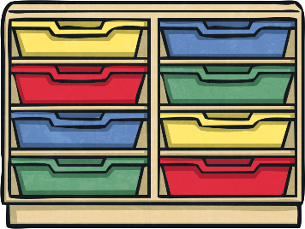
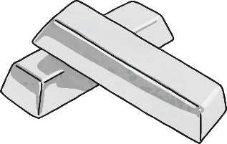



Starter
The antiques shop sells silver, paper, lanterns, drawers and vases
Can you make this sentence mean different things using commas?

Slide 5
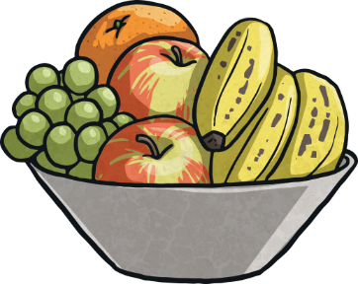
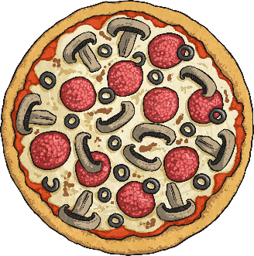
Introduction
Commas are used to separate items in lists, but ‘and’ is used instead of a comma for the last item.
In my fruit bowl, I have bananas, satsumas and kiwis.
Can you punctuate this list with commas?
My three favourite foods are fish pie stir fry and pizza.

Slide 6

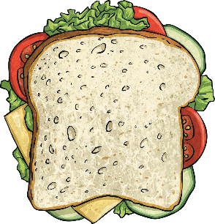
Introduction
Commas can be used like brackets to separate extra information from the main sentence. These are sometimes called embedded clauses.
The boy, who was only eight, won the award for best actor.
Notice that the sentence still makes sense if you don’t include the clause in the commas.
Can you separate the extra information in this sentence?
The sandwich which was the only one left was delicious.

Slide 7
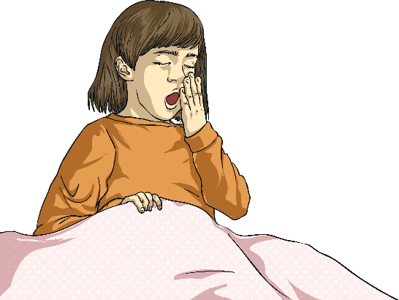

Introduction
Commas are used between clauses to break up long sentences. They are used before words like ‘and’, ‘but’, ‘so’, and ‘for’.
I was feeling really tired, so I got up and went to bed.
Can you break up this sentence using a comma?
Yesterday I went to the shops but today I stayed at home.

Slide 8

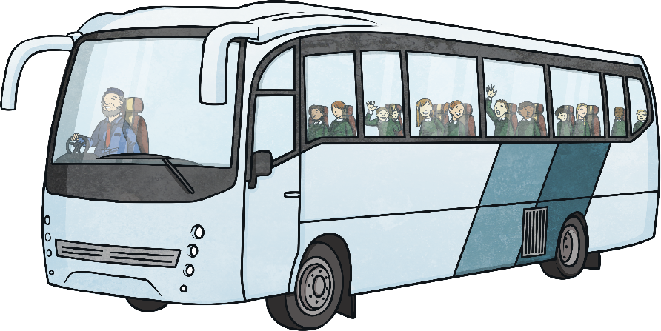
Introduction
Commas can be used before speech marks begin.
Tommy shouted, “Help me please, I’m stuck in here!”
Commas are also used after fronted adverbials.
Fortunately, the next bus came five minutes later.

Slide 9

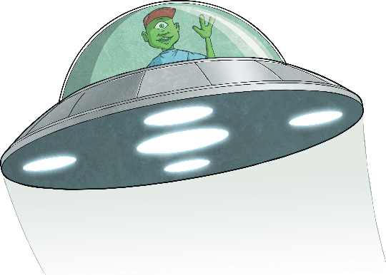
Activity
Complete the ‘Fix my Sentence’ activity.
For the first 5 questions, you will need to repair the incorrect sentences with commas.
After that, you will need to write or complete the sentences, remembering to use commas correctly.

Slide 10
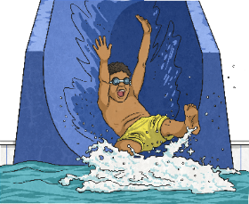
Plenary
Take it in turns to explain to your partner why each of these commas are in the sentences:
On Saturday, I’m going to the water park.
Michael said, “I’m not going.”
You can have your potatoes boiled, steamed, mashed or roasted.
I knew it was wrong, but I did it anyway.

