Slide 1
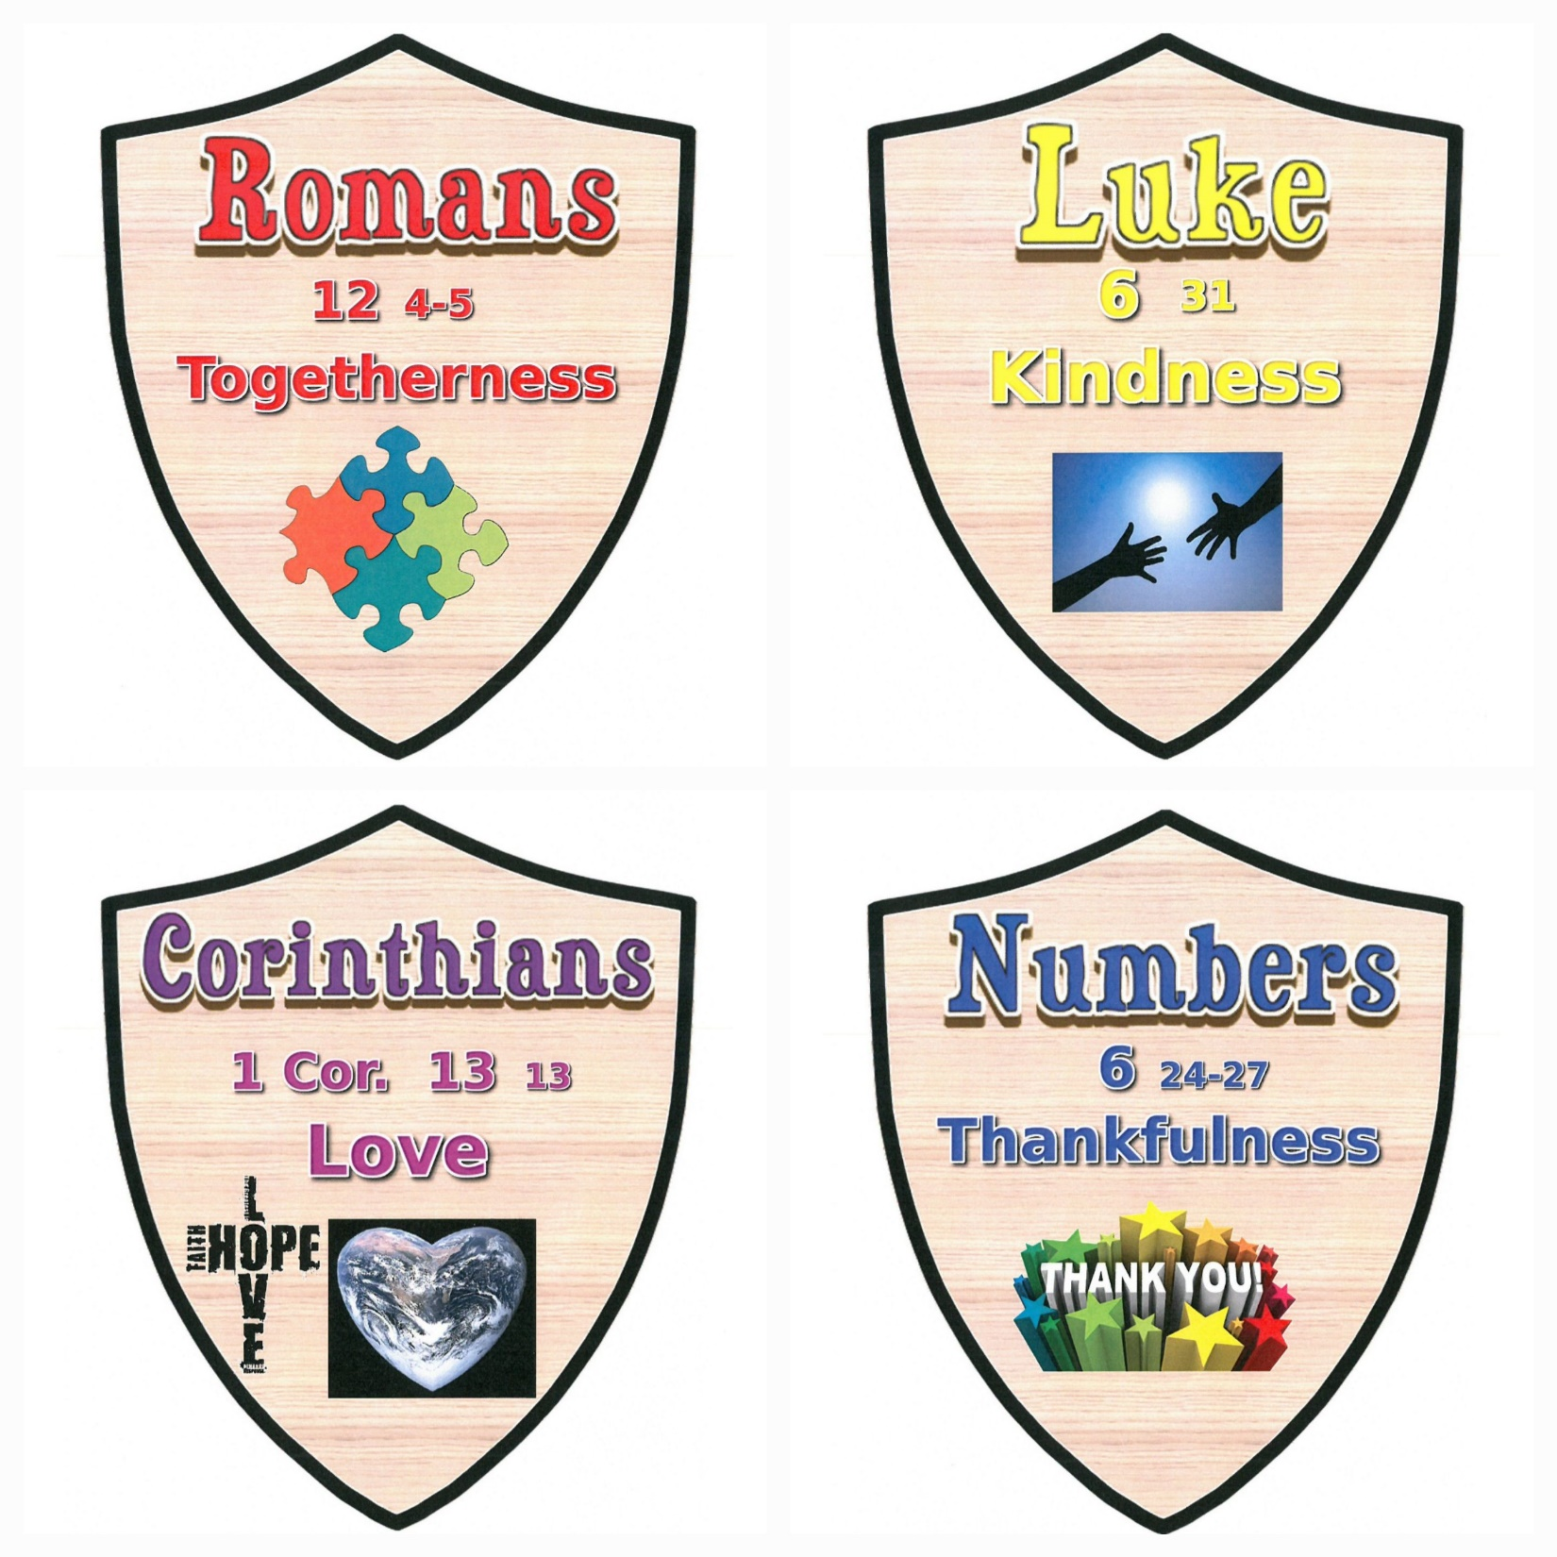
house captain QUIZ!

Slide 2
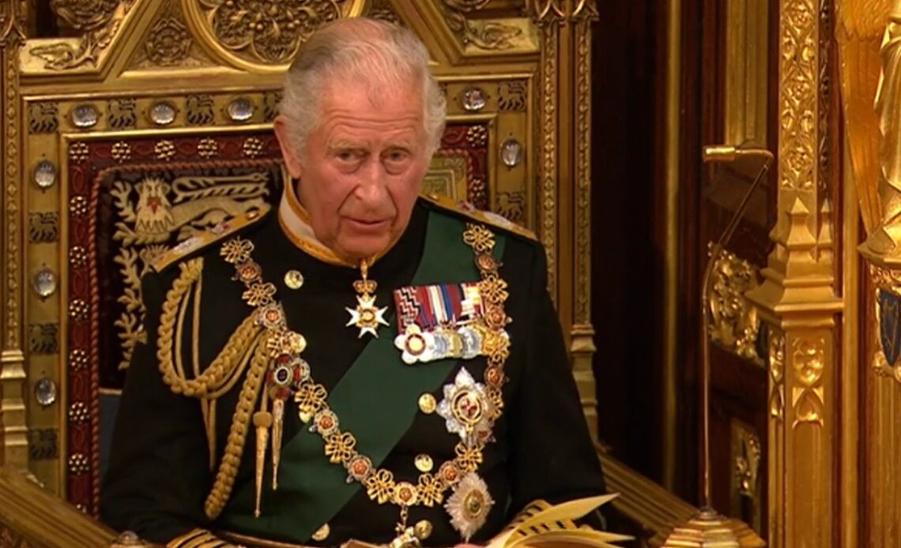
Question No.1
What year was king Charles III born?
1928
1938
1948

Slide 3
Question No.1
What year was king Charles III born?
1928
1938
1948

Slide 4
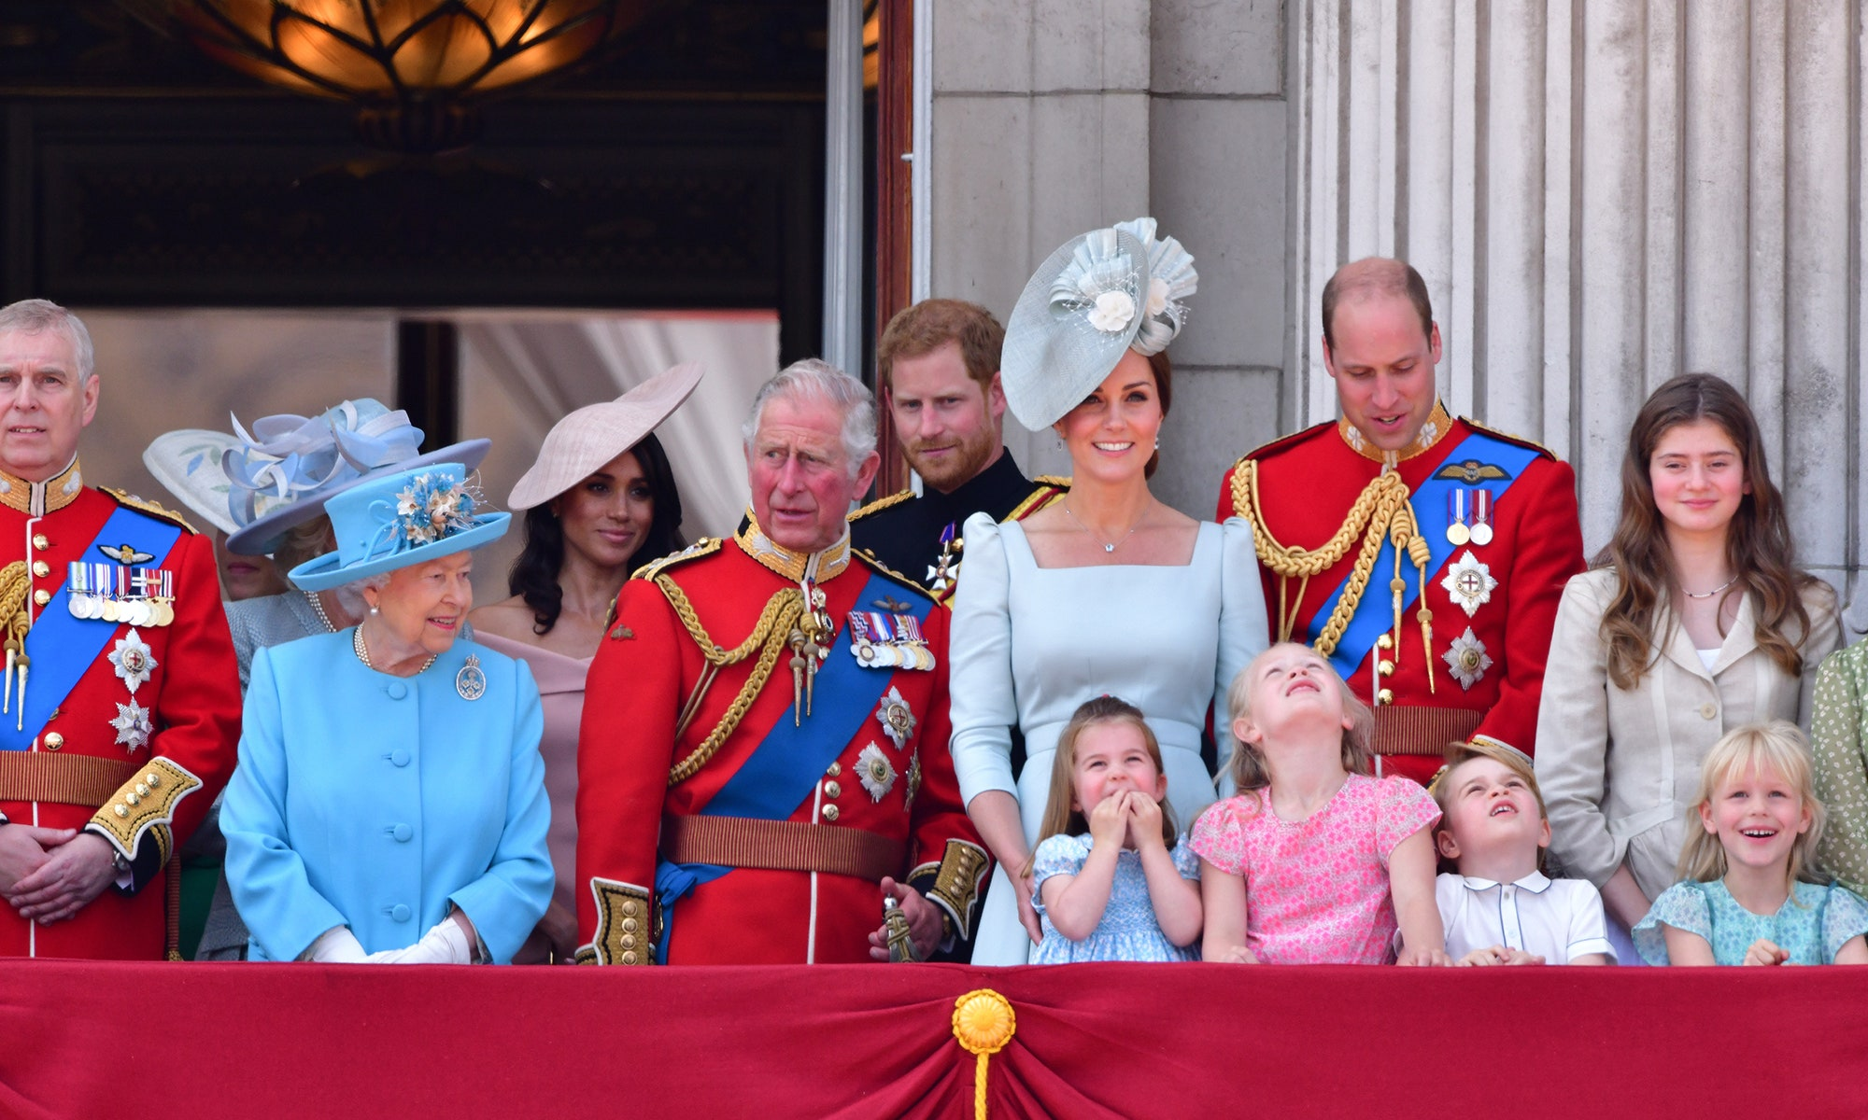
Question No.2
The royal family can sign autographs?
True
False

Slide 5
Question No.2
The royal family can sign autographs?
True
False

Slide 6
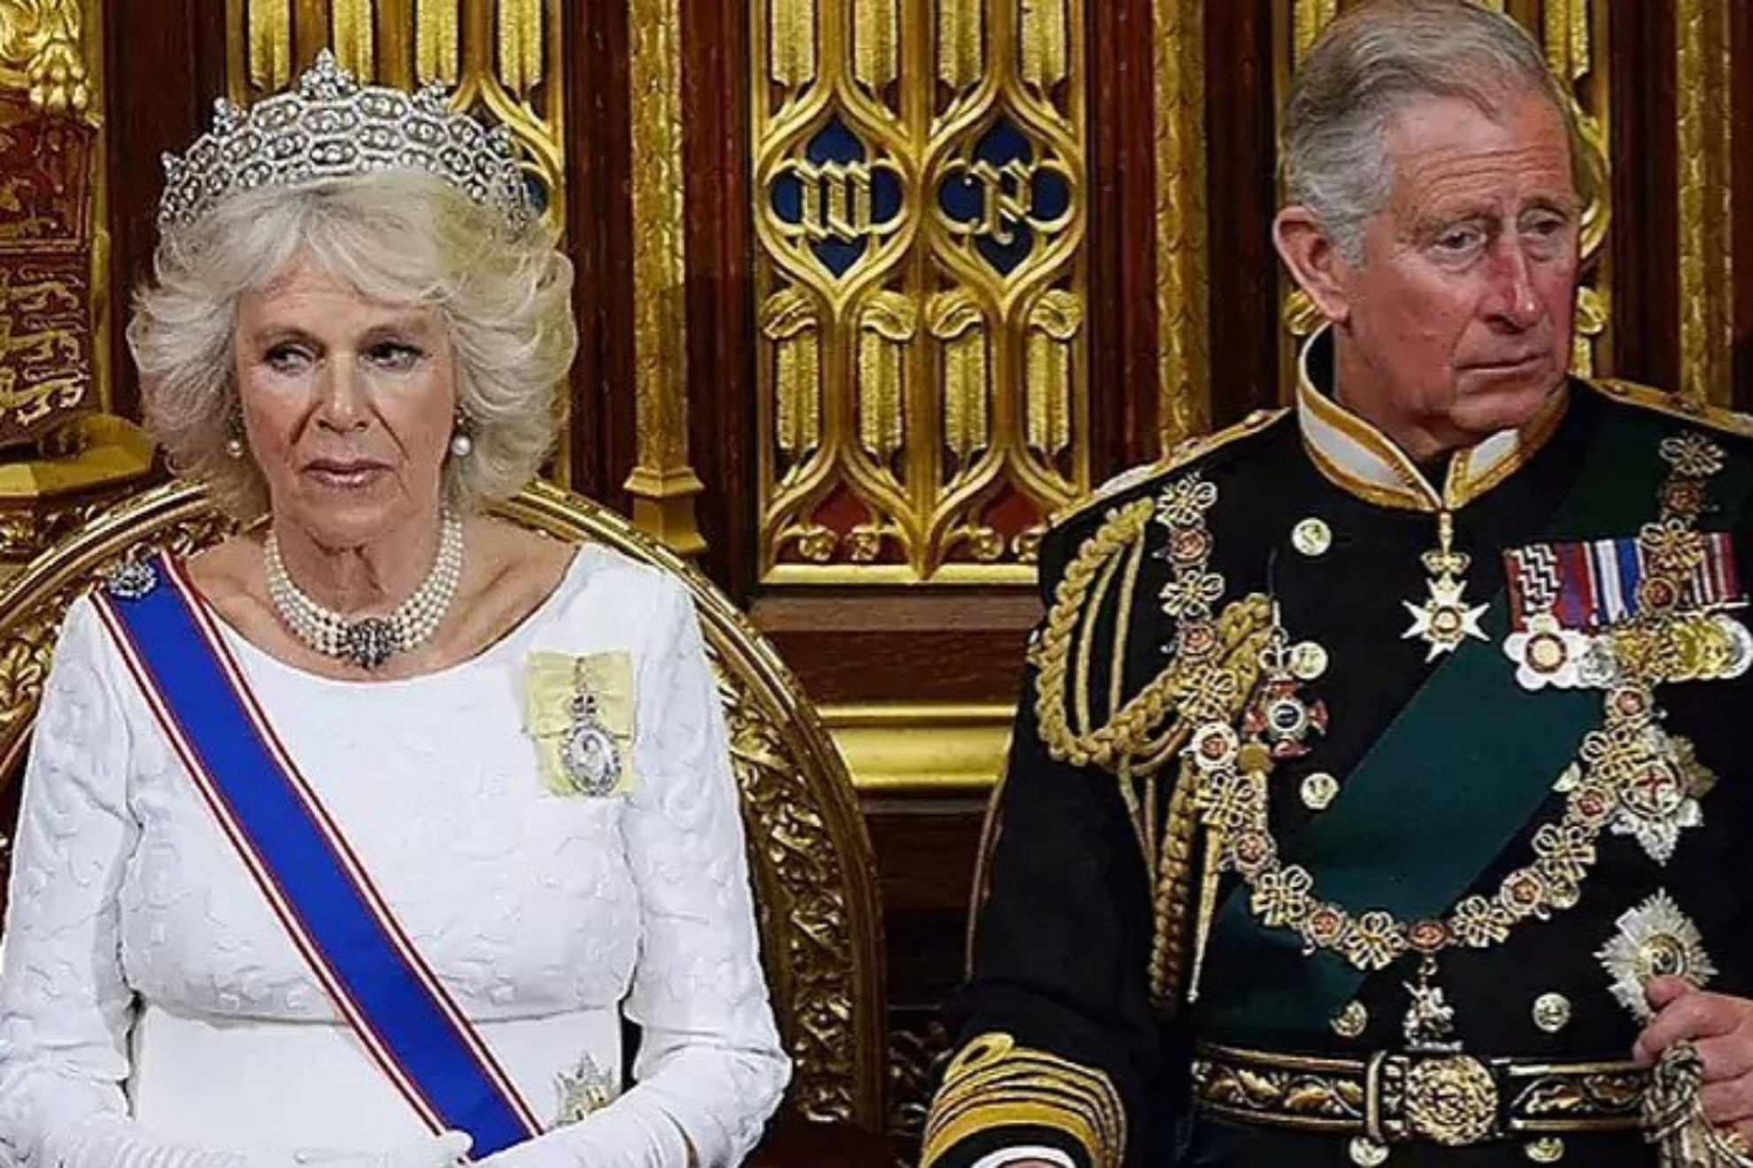
Question No.3
What is king Charles wife called ?
Camila
Anne

Slide 7
Question No.3
What is king Charles wife called ?
Camila
Anne

Slide 8
Question No. 1
When did World War 2 start?
March 1929
September 1939
July 1919

Slide 9
Question No.1
When did World War 2 start?
March 1929
September 1939
July 1919

Slide 10
Question No.2
How long did World War 2 last for?
4 years
6 years
9 years

Slide 11
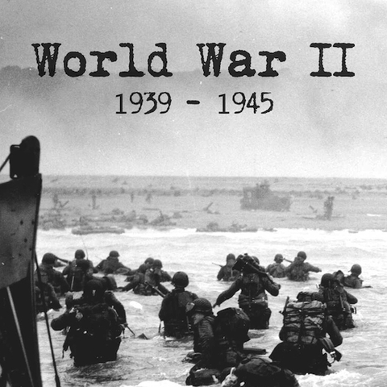
Question No.2
How long did World War 2 last for?
4 years
6 years
9 years

Slide 12
Question No.3
When is remembrance day each year?
11 O’clock on 11th of November (11.11.11)
12 O’clock on 12th December (12.12.12)

Slide 13
Question No.3
When is remembrance day each year?
11 O’clock on 11th of November (11.11.11)
12 O’clock on 12th December (12.12.12)

Slide 14
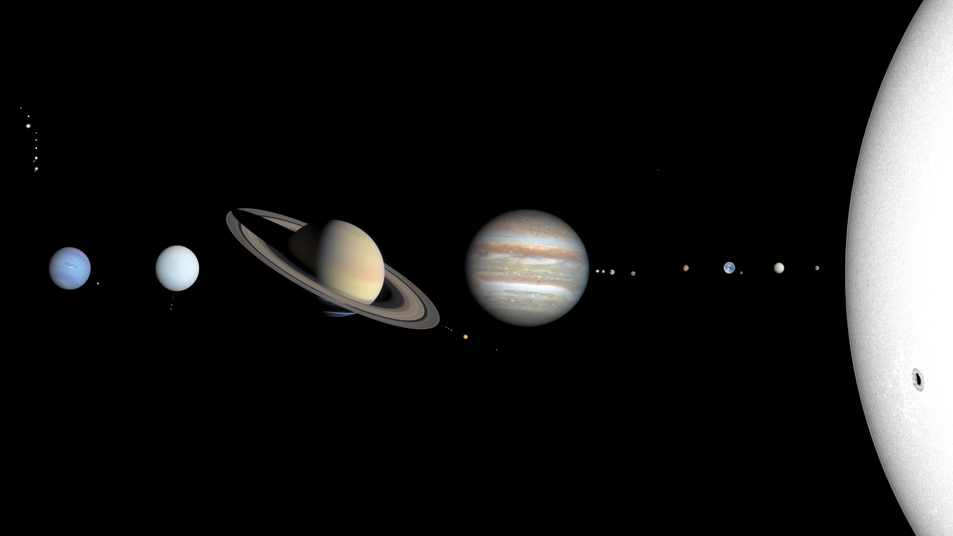
Question No.1
Which planet is closest to the sun?
Earth
Venus
Mercury

Slide 15
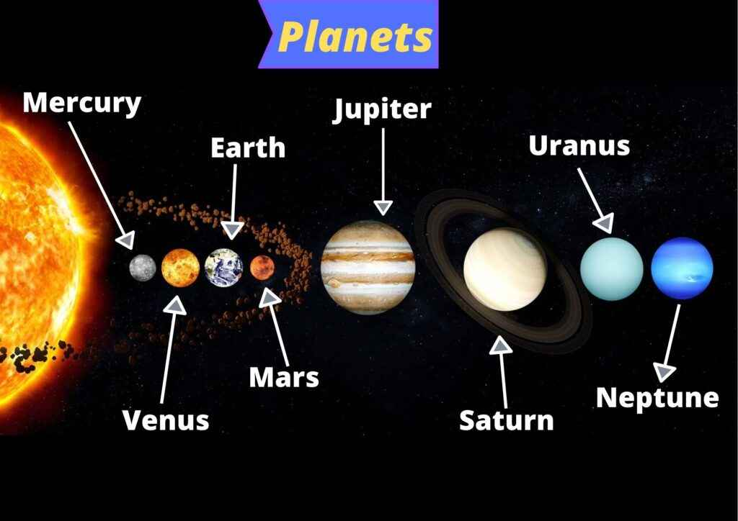
Question No.1
Which planet is closest to the sun?
Earth
Venus
Mercury

Slide 16
Question No.2
which is faster – the speed of light or sound?
Speed of sound
Speed of light

Slide 17
Question No.2
which is faster – the speed of light or sound?
Speed of sound
Speed of light

Slide 18
Question No.3
How high up, from the earth, is space? When does space begin?
62 miles up
500 miles up

Slide 19
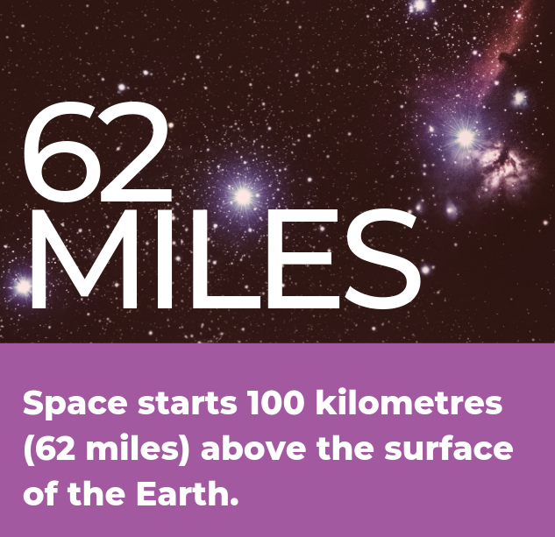
Question No.3
How high up, from the earth, is space? When does space begin?
62 miles up
500 miles up

Slide 20
Question No. 1
What is the SECOND largest country in the world? Land mass/area
Russia
Canada

Slide 21
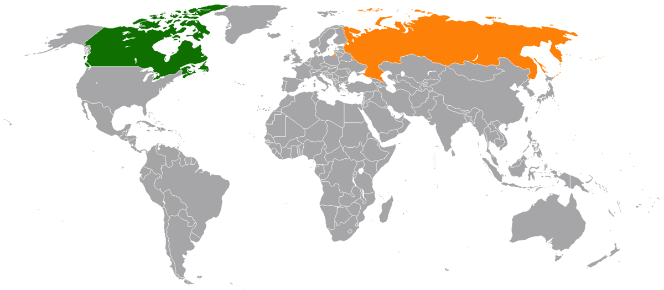
Question No.1
What is the SECOND largest country in the world? Land mass/area
Russia (first largest)
Canada (second largest)

Slide 22
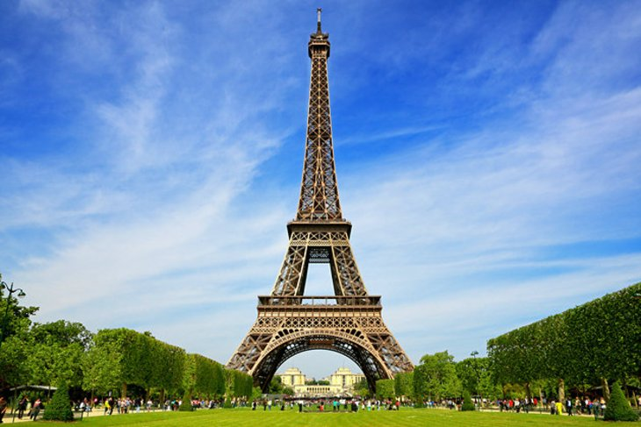
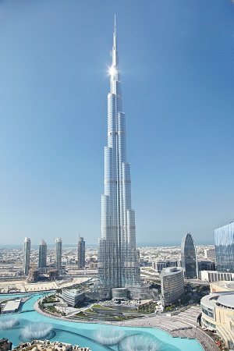
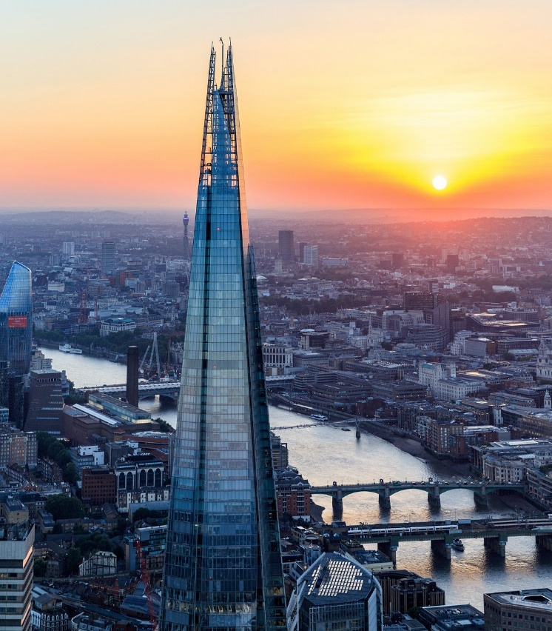
Question No.2
Name of the Tallest structure in the world?
Eiffel Tower, Paris, France
Burj Khalifa, Dubai
The Shard, London, England

Slide 23
Question No.2
Name of the Tallest structure in the world?
Eiffel Tower, Paris, France (330m to the tip)
Burj Khalifa, Dubai (830m to the tip)
The Shard, London, England (310m to the tip)

Slide 24
Question No.3
Which country has the highest population of people?
China
America

Slide 25
Question No.6
Which country has the highest population of people?
China (over 1 billion people)
1, 000, 000, 000
America (over 325 million)
325, 000, 000

Slide 26
That’s it well done everyone !

