Slide 1
Holly’s fabulous general knowledge quiz!
cool!

Slide 2
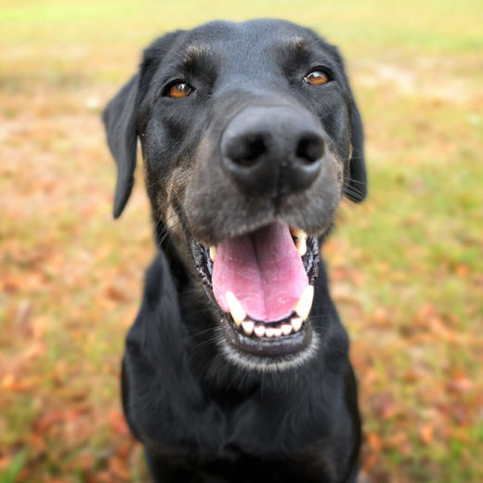
animals
How many permanent teeth do dogs have?
Out of all animals which has the biggest bite force?
Which large marine mammals are sometimes known as sea cow?

Slide 3
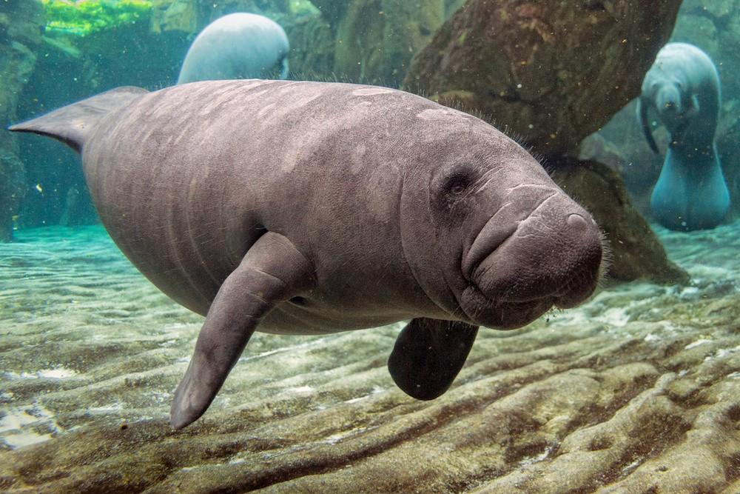
Answers to animals
42
hippopotamus
manatee

Slide 4
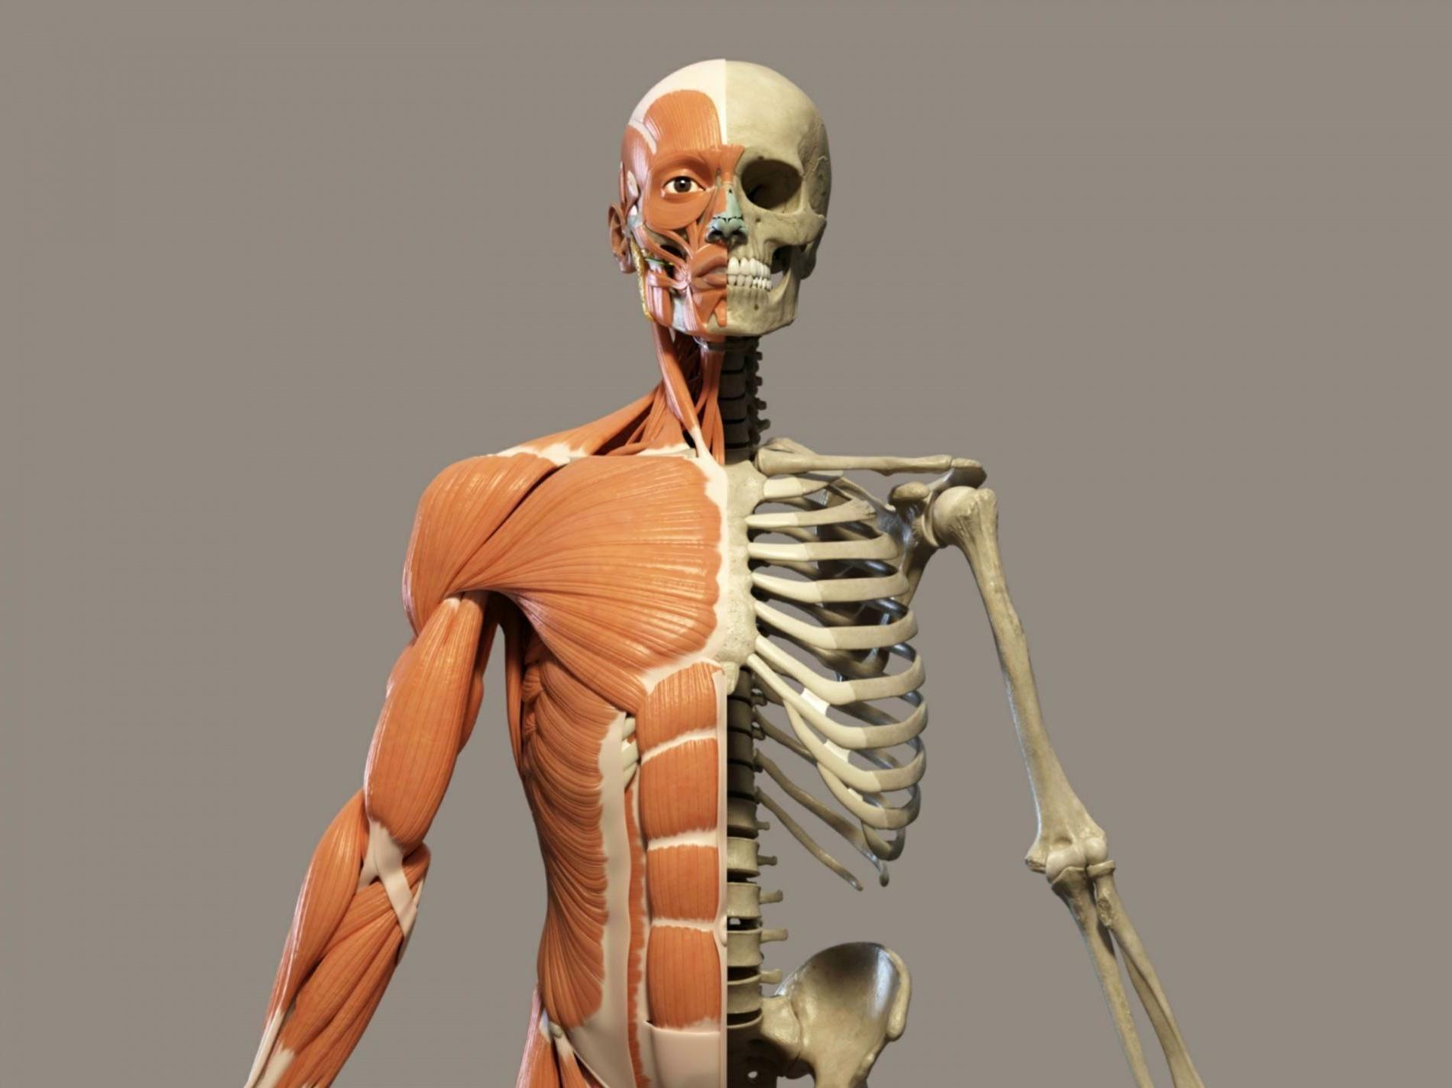
The human body!
What is the human body’s biggest organ?
Another name for the voice box is?
What is the name of the flow of blood through your heart and body?

Slide 5
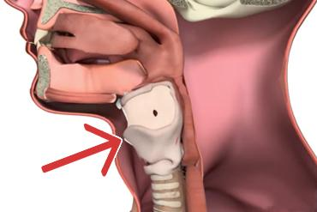
Answers to the human body
The skin
2. The larynx
3. Circulation

Slide 6
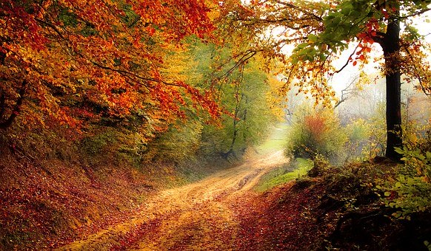
nature!
The love apple is the original name for?
How can you tell the age of a tree?
Which grain is used to make semolina?

Slide 7
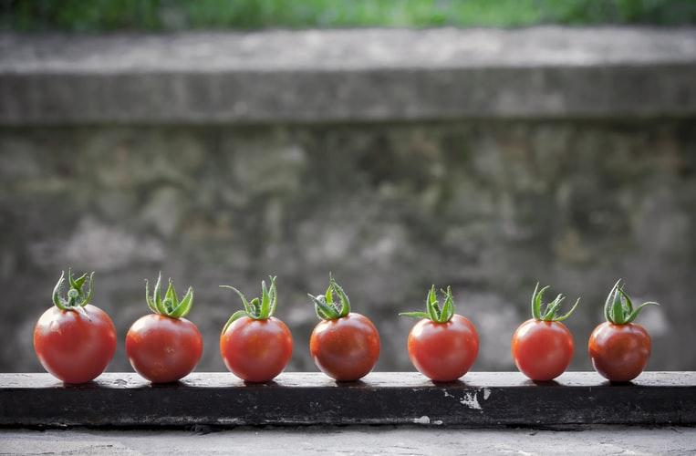
Answers to nature.
Tomato
The number of rings
Wheat

Slide 8
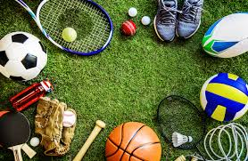
sport!
Which sport does Ronnie O’sullivan play ?
In which sport do teams compete to win the stanley cup?
In rugby union,who is england mens top try scorer?

Slide 9

Answers to sport.
Snooker
Ice hockey
Rory underwood

Slide 10

Thank you!
Thank You for doing my quiz!!!!!!!!!
Notes:
no

