Slide 1
Quiz (part 3)

Slide 2
Quick fire

Slide 3
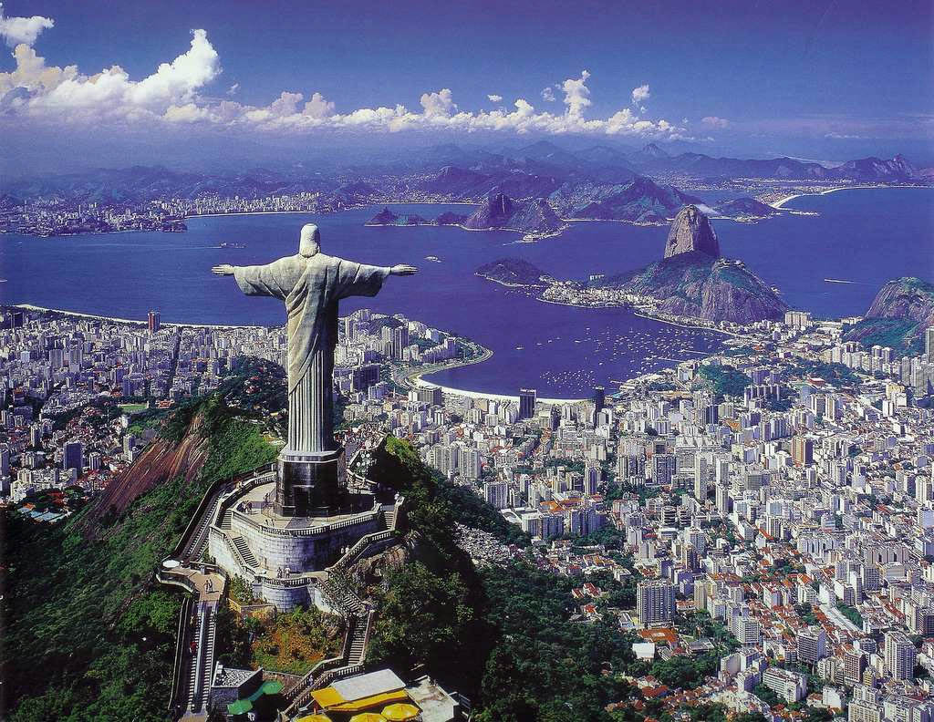
What is the third letter of the name of this city?

Slide 4
What fish is spelt out by the first letters of the names of these four countries

Slide 5
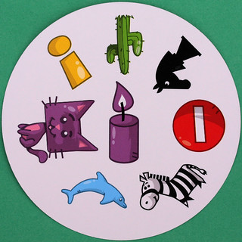
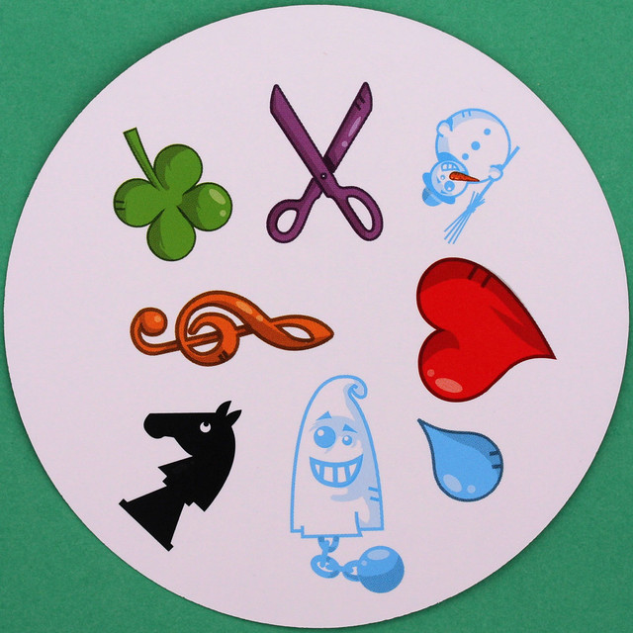
Which of these icons appears in both images?

Slide 6
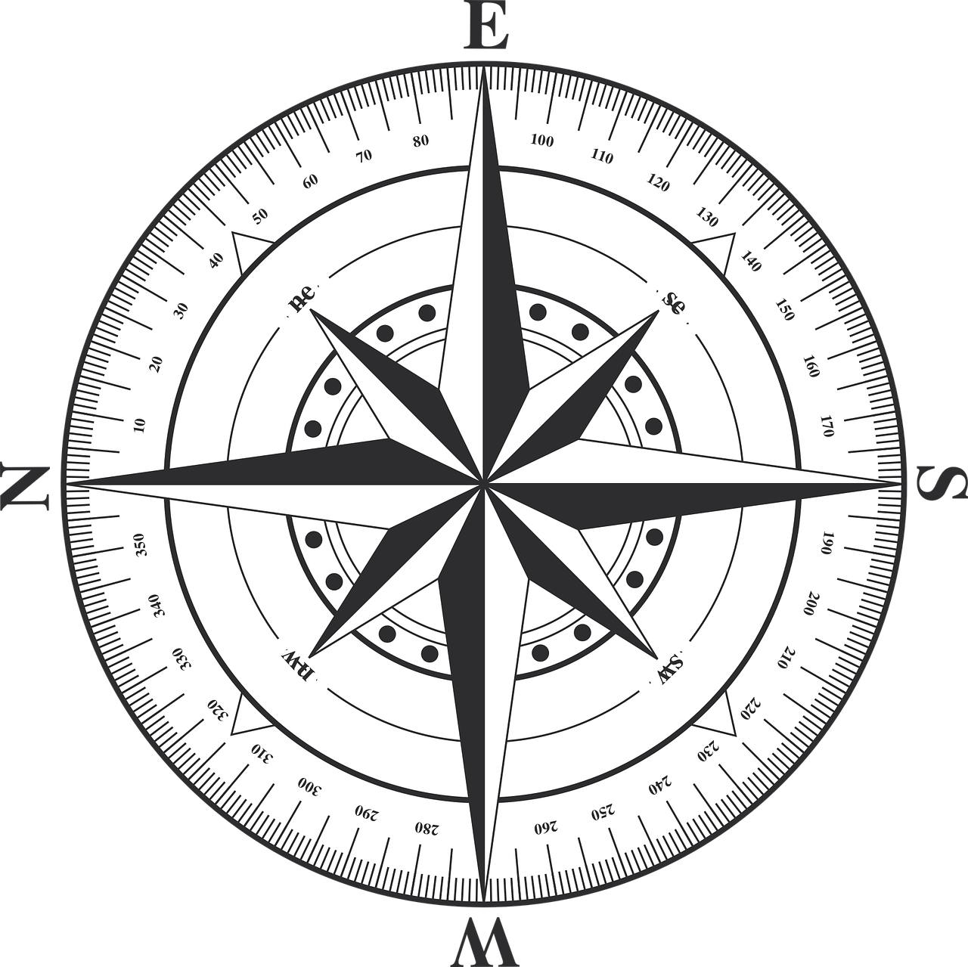
On this compass, what direction is opposite to 270 degrees from north?

Slide 7
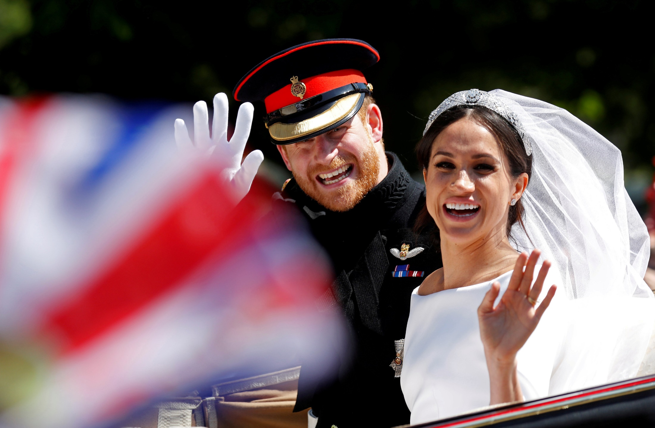
When this photo was taken, who was manager of the mens England football team?

Slide 8
What is the answer to this maths problem?
Total number of queens on the board at the start of a chess game
Number of pawns each player begins with in a chess game
x

Slide 9
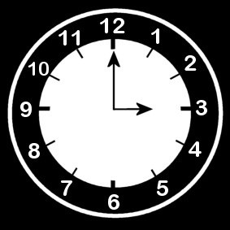
On this topsy turvy clock, what time would it be in 47 minuets?

Slide 10
This is the postcode of which British cathedral?
EC4M 8AD

Slide 11
SPECIALIST ROUND

Slide 12
THE SPECIALEST SUBJECT IS…
DISNEY FILMS

Slide 13
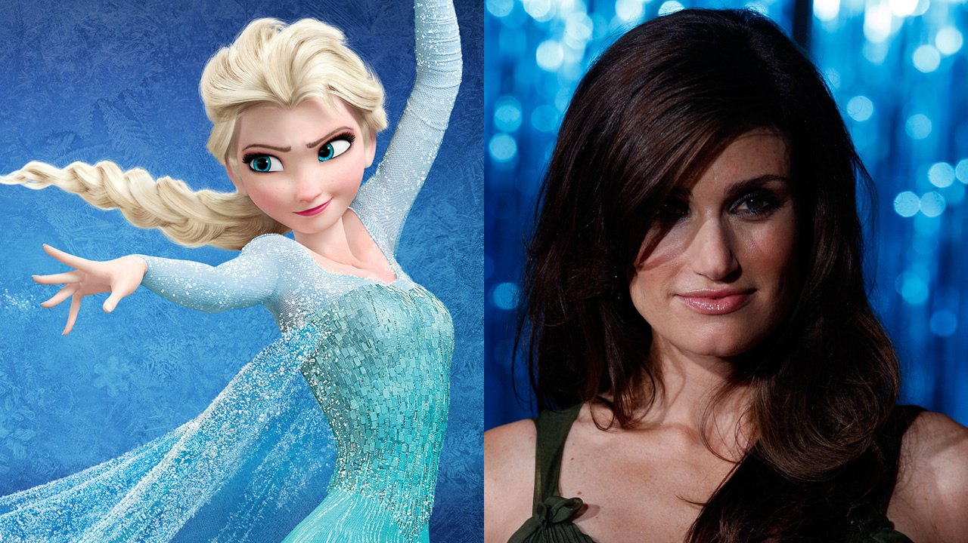
Which 2013 Disney feature is voiced by this actor?

Slide 14
Which of these is the correct spelling for this character?
Pinnochio
Pinochio
Pinocchio
Pinnocchio

Slide 15
Which Disney character could have written this dating profile?
Male
DOB: 1991
French servant looking for new flame. You’ll always be my guest?

Slide 16
How many of these songs feature in the 1964 film “Mary Poppins”?
A spoonful of sugar,
Bibbidi-bobbidi-boo,
Jolly Holliday,
Sister Suffragette,
Little April Shower,

Slide 17
The title of which film is split between two words in this sentence?
If they did not want to eat a salad, diners could choose the soup instead.

Slide 18
OBSERVATION

Slide 19
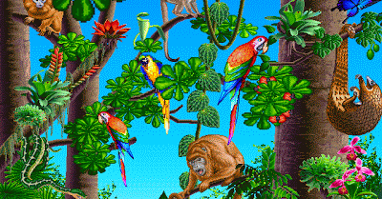
Lets see if you were paying attention

Slide 20
How many trees can be seen in the picture?

Slide 21
What bird is there three of?

Slide 22
How many snakes can be seen in the picture?

Slide 23
The only blue and purple creature in the picture is what animal?

Slide 24
MEMORY ROUND

Slide 25
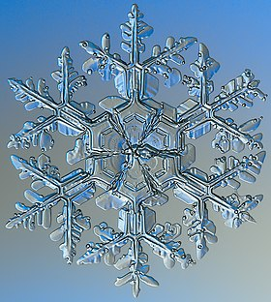

Slide 26
Turn over your piece of paper

Slide 27
Put these tiles in the order you had first seen them, draw arrows

Slide 28
FINAL ROUND

Slide 29
How many of these books were written by Philip Pullman?
Northern Lights,
Gormenghast,
The Magician’s Nephew,
The Silver Chair,
La Belle Sauvage,

Slide 30
How much did Sherlock Holmes pay for his cape?
BIRTHDAY CAKE £26.00
PIPE £22.00
CAPE £ ?
TOTAL £78.00

Slide 31
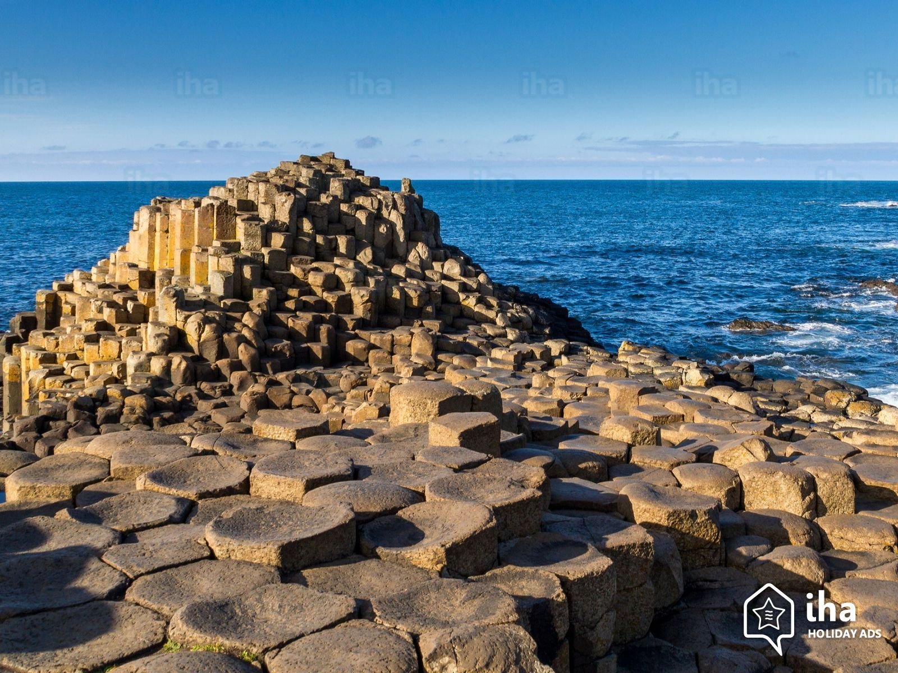
This cluster of columns is part of what northern Irish feature?

Slide 32
Which piece of Laboratory equipment completes this crossword?
B
B
N
R

Slide 33
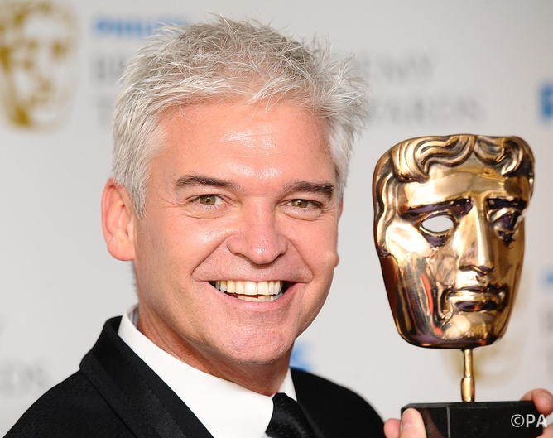
What is the fifth letter of the name of this celebrity?

Slide 34
What fashion accessory can be spelt by the letters represented by these keys?

Slide 35
Answers

Slide 36
RIO DE JANEIRO

Slide 37
Tuna

Slide 38
Knight

Slide 39
East

Slide 40
Gareth Southgate

Slide 41
16

Slide 42
03:47

Slide 43
ST. PAULS CATHEDRAL

Slide 44
Elsa

Slide 45
C

Slide 46
Lumiere

Slide 47
three

Slide 48
Aladdin

Slide 49
three

Slide 50
Parrot

Slide 51
one

Slide 52
Butterfly

Slide 54
two

Slide 55
£30

Slide 56
Giants Causeway

Slide 57
Bunsen burner

Slide 58
L

Slide 59
Bag

Slide 60
The End
Add up you’re scores
Out of 37

