Slide 1

quiz

Slide 2

music
What is the last word in the Adele song title “Someone like…”?
2. True or False, Reggae music was born in the United States?
3. Which American singer recorded the song “OMG”?
4. What kind of music is Taylor Swift famous for?
5. Circle Of Life is a song from which Disney musical?

Slide 3
history
Who built Chichinitzna?
2. What is the name of the monument that guards the Egyptian Pyramids?
3. Mount Vesuvius destroyed what Roman city in 79 AD?
4. What language was spoken in ancient Rome?
5. What is XII in Roman Numerals?

Slide 4
geography
1. What is Europe's tallest active volcano?
2. In what country is Mount Everest located?
3. What is the capital city of Spain?
4. What is the currency of Peru?
5. What is the stretch of water separating England and France?

Slide 5
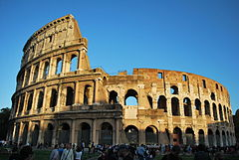
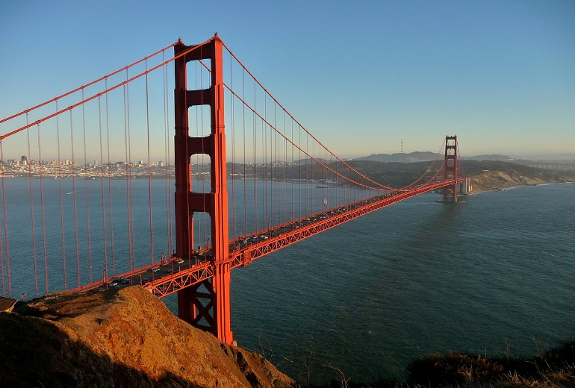
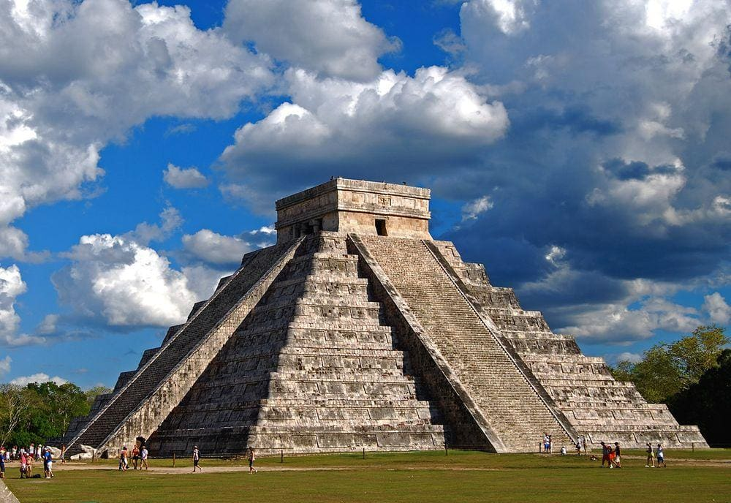
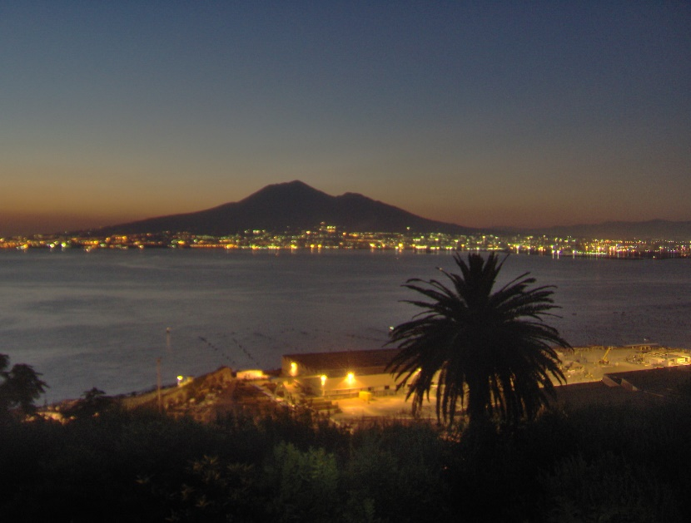
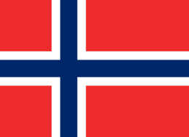
Picture
In what country would you find this?
In what city would you find this?
What happens if you clap at this structure?
This is the national flag of which country?
In what country would you find this?

Slide 6
Solar system
Order the planets from the sun? (not including Dwarf planets)
What was the first planet to have its rings discovered?
The solar system used to have a Dwarf Planet, name it?
What is the name of the Galaxy in which the Solar system is?
True or False, Neptune has the most Moons?

Slide 7
sport
How long does half time last in football?
What are the five colours of the Olympic Rings?
Which two teams compete in the University Boat Race?
How long is the London marathon, to the nearest mile?
How many players are there in a Rugby Union team?

Slide 8
Tv shows
What quiz show features a penny arcade machine?
What fruit does Sponge Bob Square Pants live in?
Who won Britain’s Got Talent 2019?
Who wants to be a millionaire is hosted by who?
What are the names of the Simpsons family?

Slide 9
Look at the pictures on the next slide, then answer the question on the slide after that

Slide 10
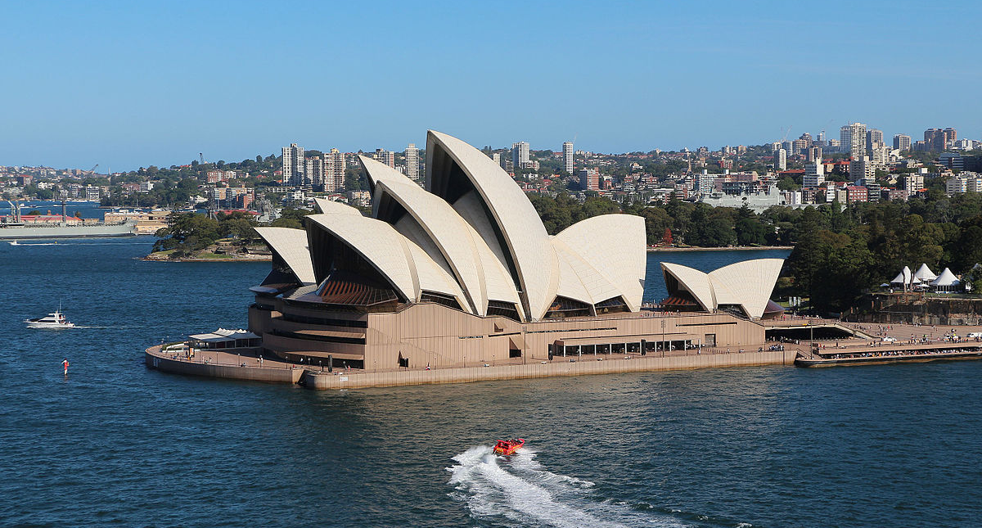
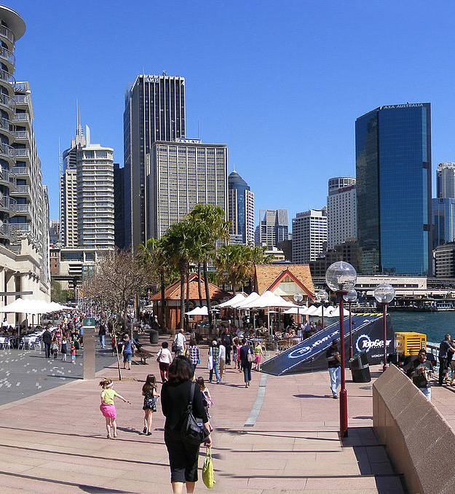
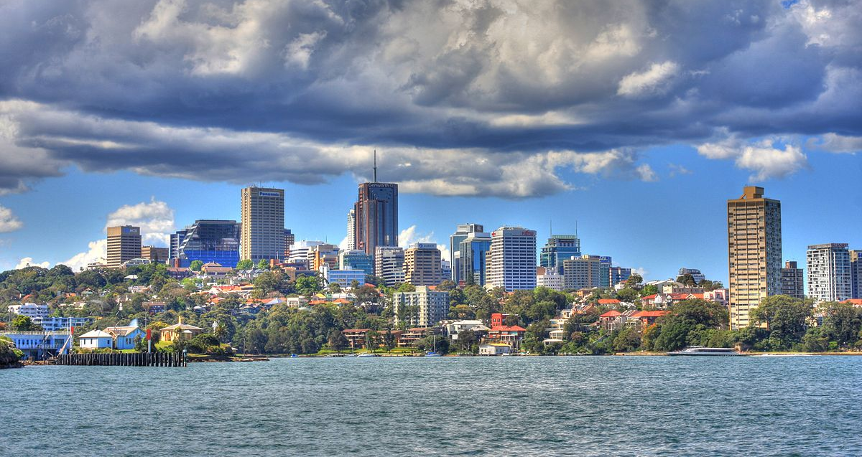

Slide 11
Where were those three photos taken?

Slide 12
General knowledge
In the Simpson's what primary colour is Marge’s hair?
What’s the “T” in T-Rex short for?
Dino is an abbreviation to what type of extinct creature?
What type of creature is a Skate?
What planet has its orbit between Venus and the Sun?

Slide 13
If a jewel is green it is a what?
What does "BBC” stand for?
What is the main ingredient of risotto?
How many protons are there in a hydrogen atom?
What does “NHS” stand for?

Slide 14
Music round
You
False, it was born in Jamaica
Camila Cabello
Country
Lion King
History round
Mayans
Sphinx
Pompeii
Latin
12
Geography round
Mount Etna
Nepal
Madrid
Sol
Chanel
Picture round
Italy
San Francisco
It claps back
Norway
Italy
Solar system
Mercury, Venus, Earth, Mars, Jupiter, Saturn, Uranus and Neptune
Saturn
Pluto
Milky Way
False, Jupiter has the most moons

Slide 15
Sport round
15 minutes
Blue, Black, Red, Yellow, Green
Oxford Cambridge
27 miles
15 players
Tv shows round
Tipping Point
Pineapple
Collin Thackery
Jeremy Clarkson
Homer, Marge, Bart, Lisa, Maggy
The three photos were taken in Sydney
General Knowledge
Blue
Tyrannosaurs
Dinosaur
Fish
Mercury
Emerald
British, Broadcasting corporation
Rice
One
National Health Service

