Slide 1
Quiz (part 2)

Slide 2
For this quiz, you will need:
Pencil
Paper
A brain

Slide 3
music
Louis Armstrong was famous for playing what jazz instrument?
“Dance with me Tonight” was a hit by which male pop star?
How many keys in total are there on a standard piano?
What is the only major piano scale to feature no sharps?
What Madonna music video was set in Venice?

Slide 4
Geography
The Crocodile River flows across what continent?
What is the currency of Chile?
Nevado Del Ruiz is a volcano in what country?
What is the capital of Russia?
What is the tallest building in the world?

Slide 5
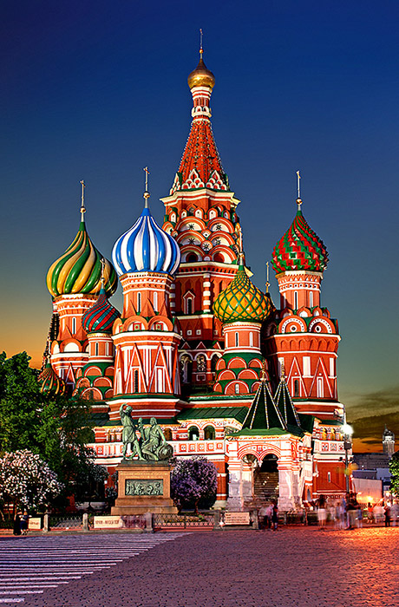
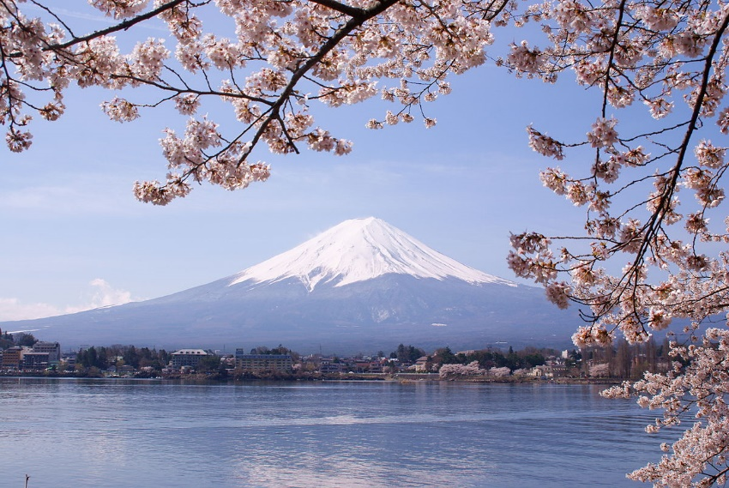
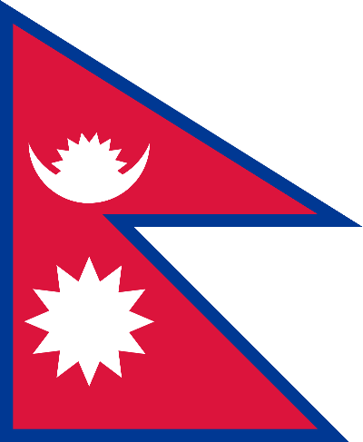
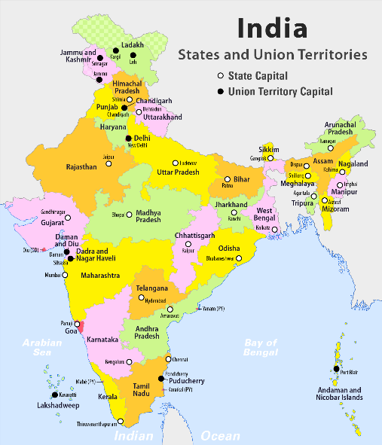
PICTURE
In which country would you find this?
What is the name of this mountain?
This is the flag of which country?
What nationality are people from this country?
This Photo by Unknown Author is licensed under CC BY-SA

Slide 6
Tv shows
Who hosts the tv quiz show Tenable?
On Who Wants to be a Millionaire, how many lifelines does each player have?
On Pointless what number does Pointless tower start from?
How many contestants take part in the first round of Mastermind?
How much money is the jackpot counter worth on tipping point?

Slide 7
History
What is the answer to I + X + XII in Roman numerals?
In what year was the Great Fire Of London?
What are Egyptian letters called?
Who was on the throne when George VI was born?
How many general elections did Thatcher win as Tory leader?

Slide 8
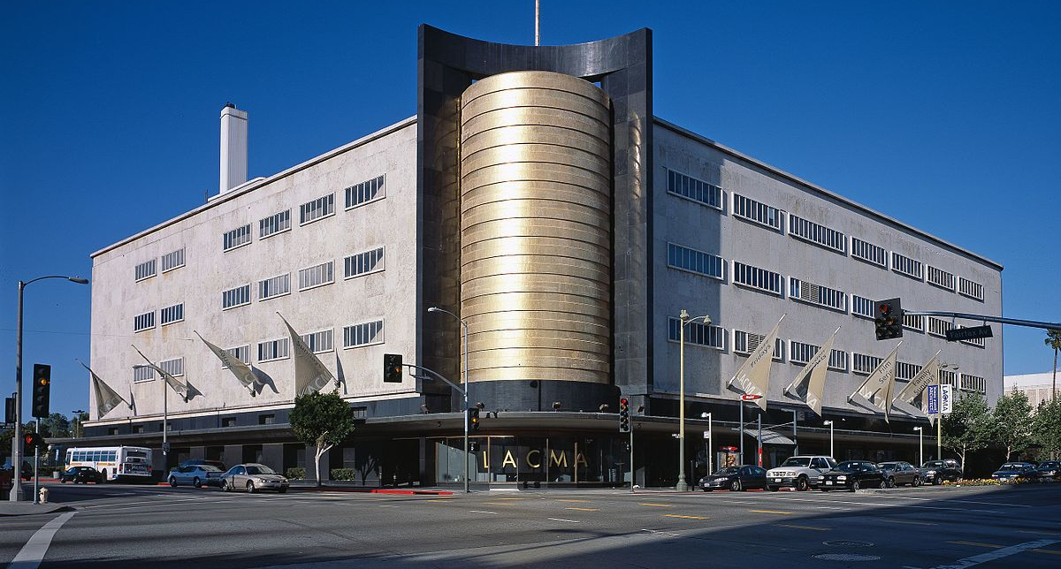
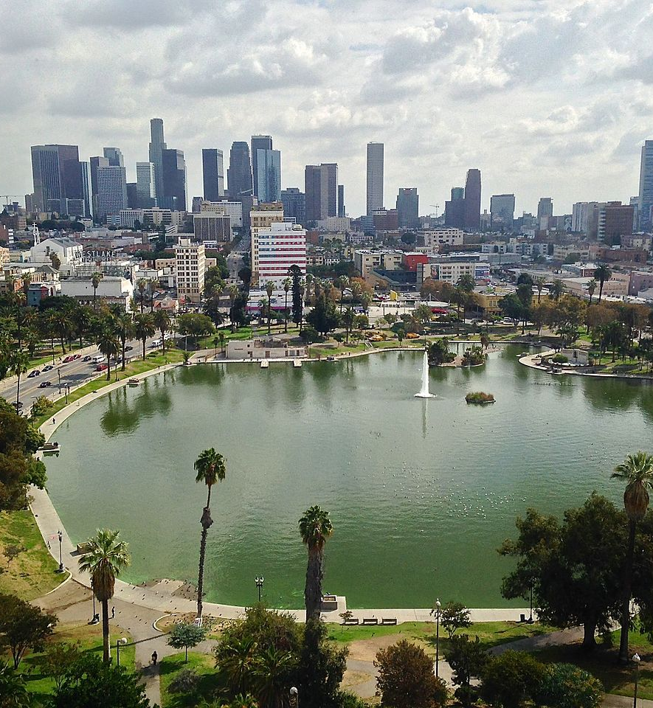
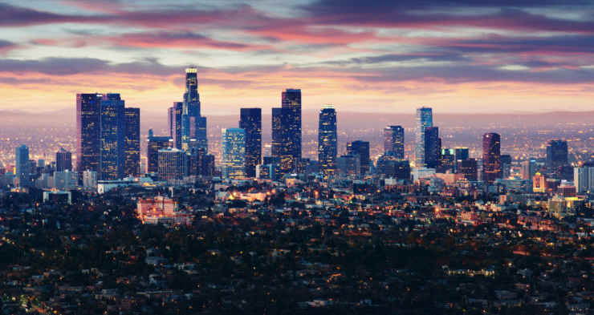

Slide 9
Where were those photos taken?

Slide 10
sport & leisure
True or False, cycling events are held in a velodrome?
What fruit is dried to make raisins?
The silver fern is the symbol of what national rugby team?
What is the highest score you can get in 10 Pin Bowling

Slide 11
General knowledge
What was the first Space Shuttle to ever take off?
What is the currency of Japan
What is the smallest country in the world?
Which Super Hero is named a notorious web slinger?
The city of Mumbai is in which country?

Slide 12
In what decade was John Major Prime Minister?
Kylie Minogue is what nationality?
What primary colour gives its name to a species of shark?
How many people go on a double date?
Bacon jam contains the meat of which farm animal?

Slide 13
What German car company was formally known as B,F,W?
According to the 2011 Beyoncé hit “Girls run the…” what?
What two word phrase is the correct way to address a Duke?
Which of the blood groups come first in alphabetical order?
Full Proof Cooking is a book by which former TV baking judge?

Slide 14
What Roald Dahl character has magic powers?
What is the tallest waterfall in the world?
How many girls are there in the Famous Five?

Slide 15
ANSWERS
Trumpet
Olly Murs
88
C major
Like a Virgin

Slide 16
Africa
Peso
Columbia
Moscow
Burj Khalifa

Slide 17
Russia
Mount Fuji
Nepal
Indian

Slide 18
Warwick Davis
Four
100
Four
£10,000

Slide 19
XXIII
1666
Hieroglyphics
Victoria
Three

Slide 20
Los Angeles

Slide 21
True
Grapes
New Zealand
300

Slide 22
Columbia
Yen
Vatican city
Spiderman
india

Slide 23
90s
Australian
Blue
Four
pig

Slide 24
BMW
World
Your grace
A
Mary Berry

Slide 25
Matilda
Angel falls
3

Slide 26
The end

