Slide 1
Harry’s Quiz
Part 5

Slide 2

Welcome to my new quiz!
you will need:
A pencil
A ruler
A fast working brain (if you have one)

Slide 3
QUICK FIRE

Slide 4
In this round its 5 points for each correct answer and ten seconds to answer, any arguing with your judicator will result In point loss. Here is your first question.

Slide 5


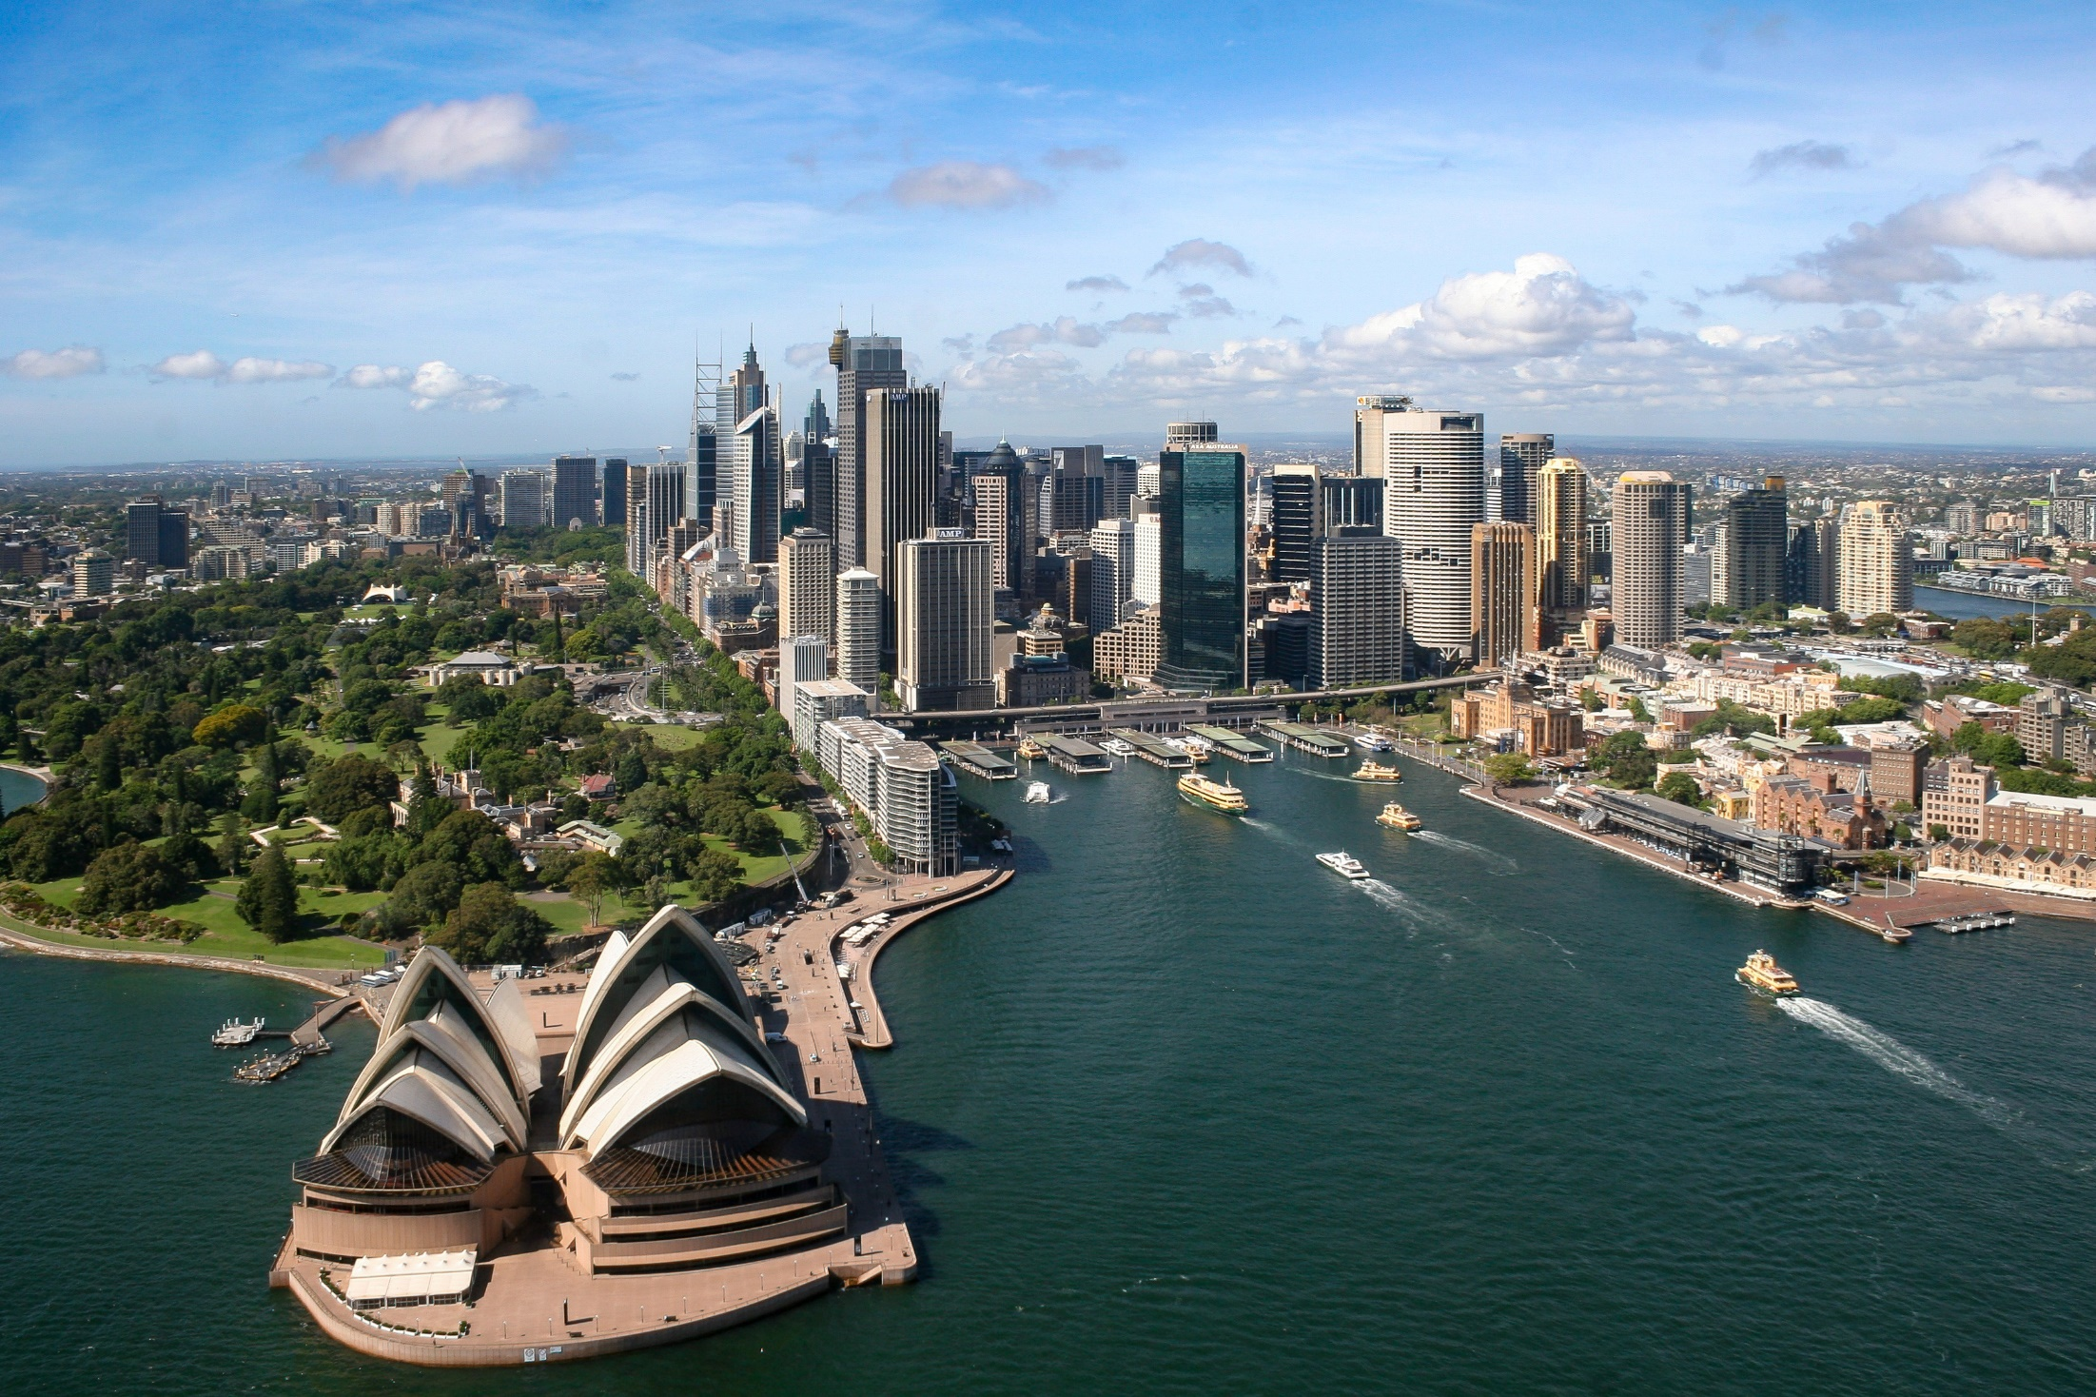

What is the second letter in the name of this city?

Slide 6
Which dog breed completes this crossword?
G
S
D
N

Slide 7
This is an anagram of which tall tourist attraction? (in England)
DLOYNO NEY

Slide 8

What is the price of the honey now it is in the sale?
£25
50% OFF

Slide 9
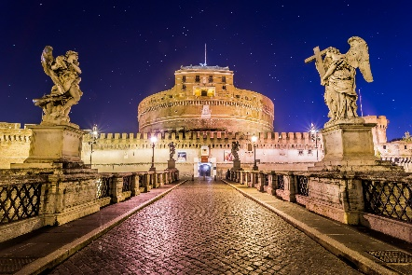
Where did I write this postcard?
I’m having a great
Time here, and
Tomorrow I’m visiting the Trevi Fountain

Slide 10
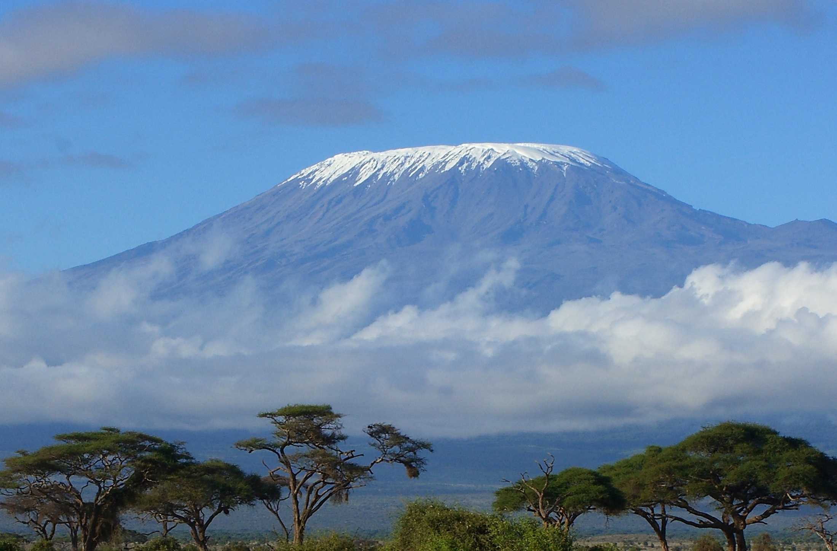
This mountain is In which national park?

Slide 11
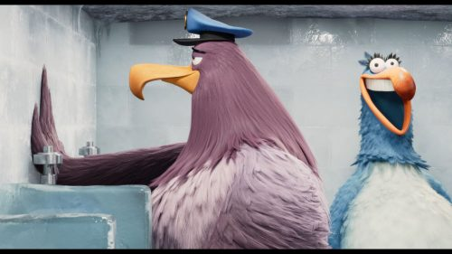
This is a scene in what film?

Slide 12
SPECIALAIST ROUND

Slide 13
In this round, there will be a series of questions based on one subject, each one you get right will score you 5 points, but remember you only have ten seconds to answer each question…

Slide 14
But before we move on, lets find out what the specialist subject is.
The specialist subject is…
CITIES

Slide 15
This is an anagram of which London landmark?
PMIREILA WRA SUEMUM

Slide 16
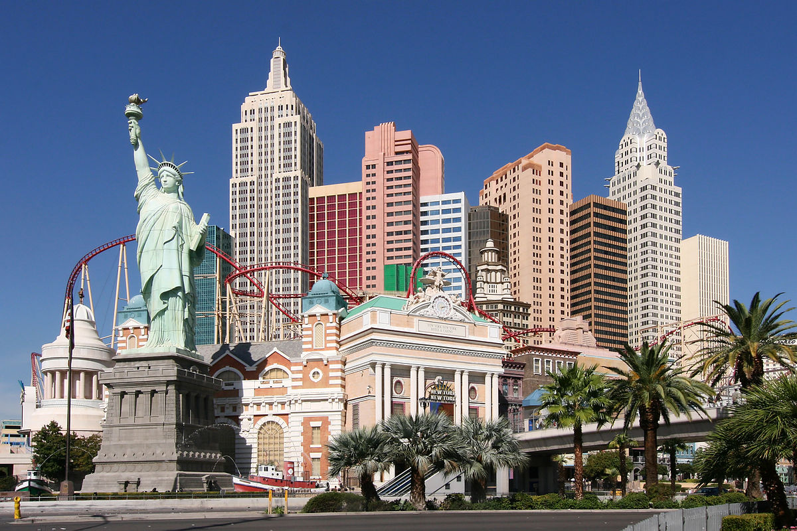
In what city would you find this rollercoaster?

Slide 17
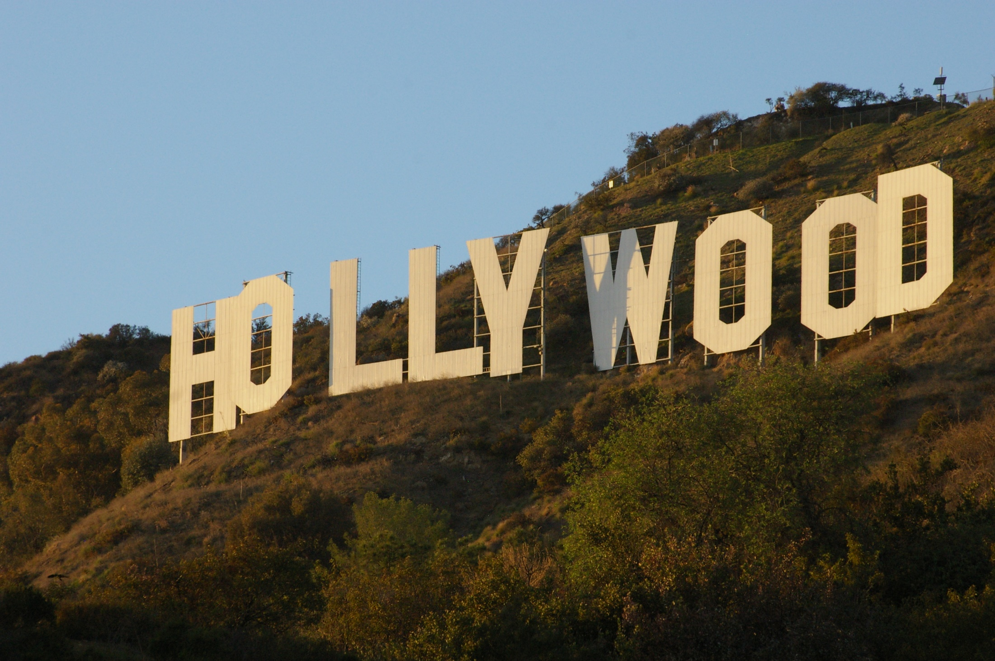
Before the removal of four letters what did this sign say?

Slide 18
What English city is the only one beginning with “y”

Slide 19
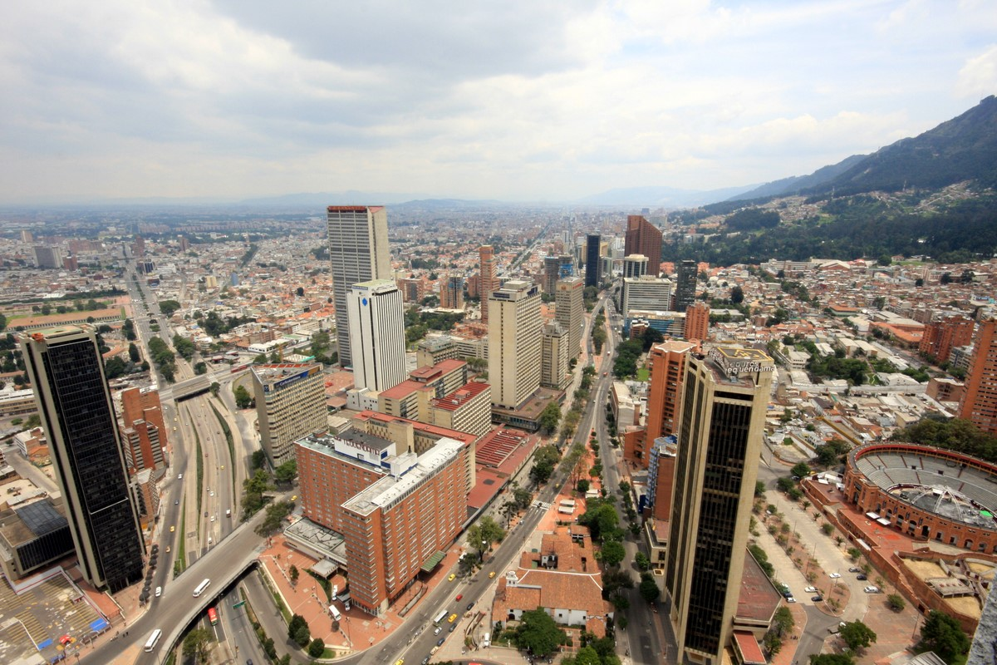
This is the capital of which country?

Slide 20
OBSERVATION

Slide 21
In this round I will show you an image, you have 10 seconds to study the image before it disappears. Then I will ask you a series of questions each worth 5 points, all you need to do is remember what you saw.

Slide 22
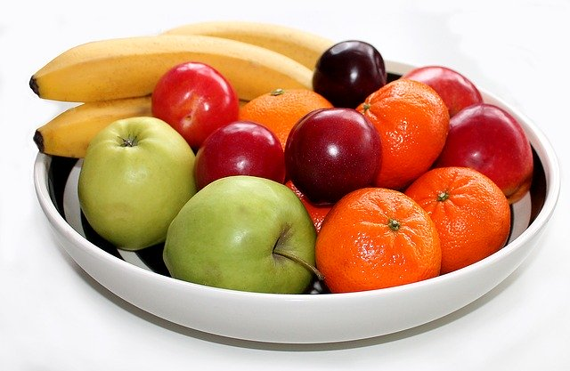
Lets see if you were paying attention

Slide 23
How many bananas are in the fruit bowl?
What colour are the apples?
How many pieces of fruit are red?
What two colours make up the colour of the bowl?
If three pieces of fruit were eaten, how many would you be able to see?

Slide 24
MEMORY ROUND

Slide 25
In this round I will give you a series of animal pictures in a certain order you have 20 seconds to study the order, you will have to number them. Then I will show you the same animals in a different order, your job is to put them in the order that you first saw them
Lets play

Slide 26
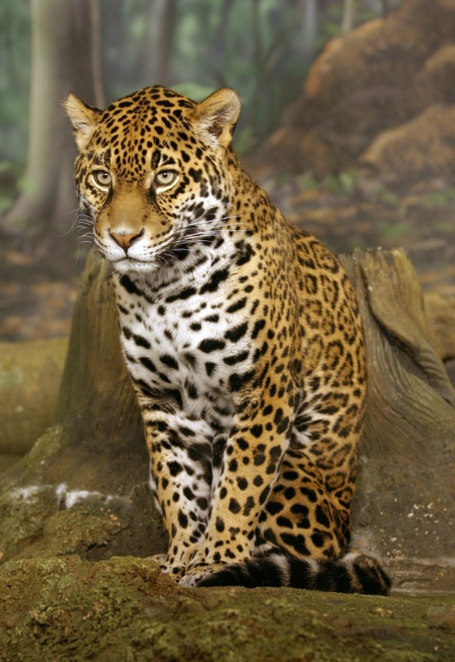
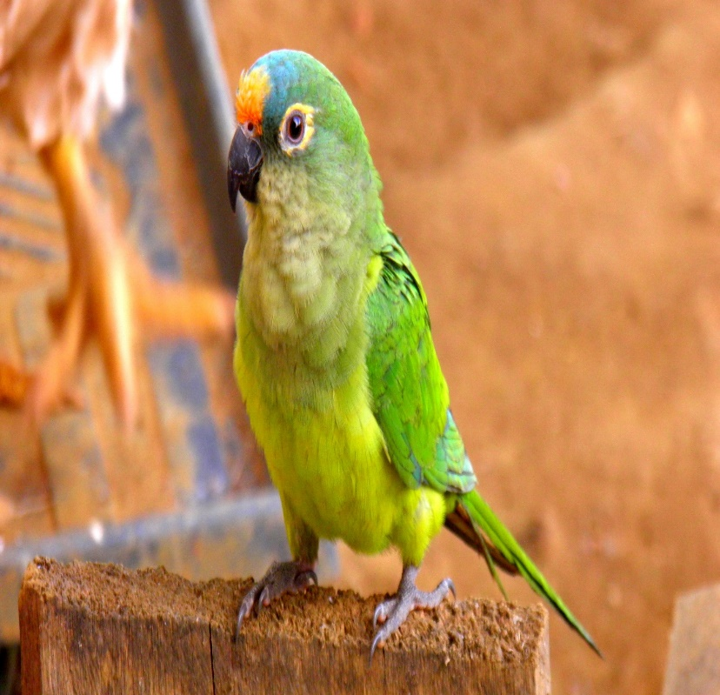
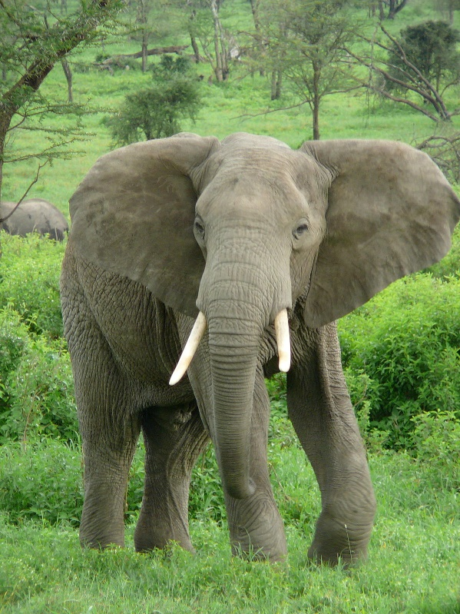
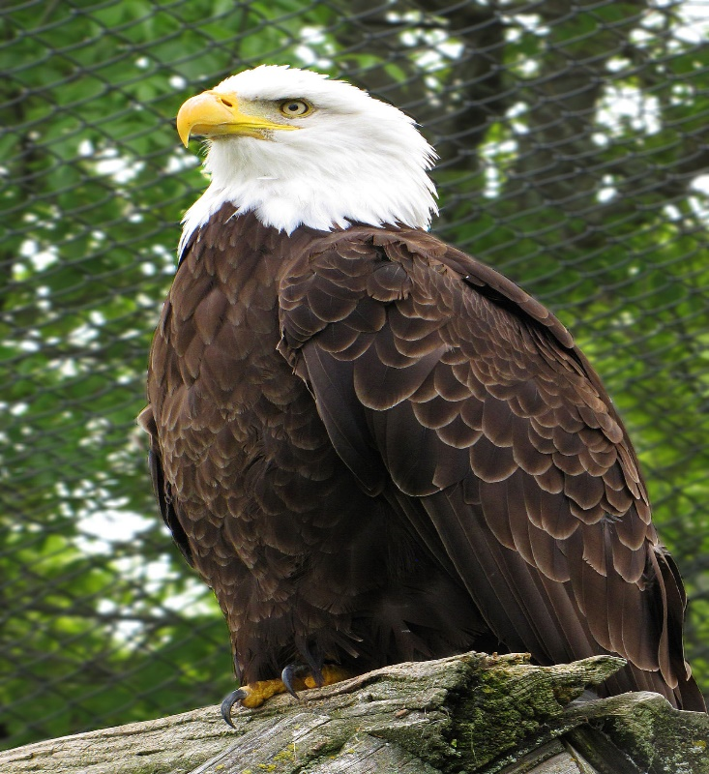
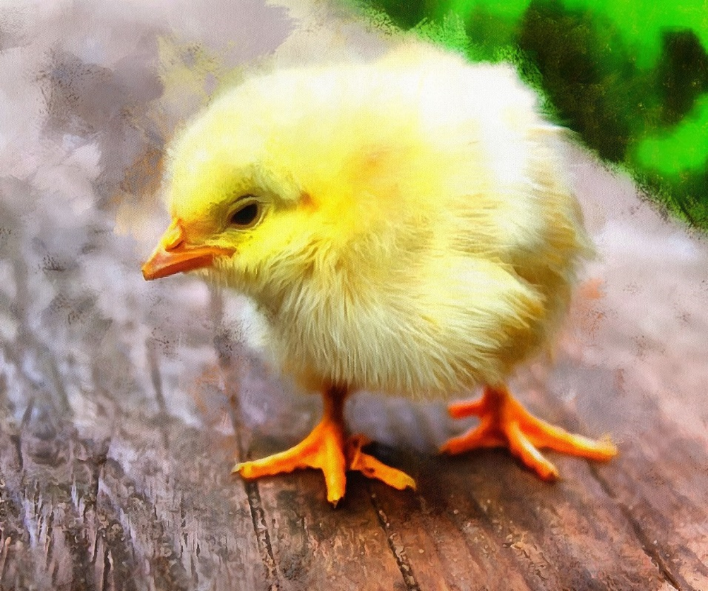

Slide 27
You now have 30 seconds to put the tiles in the order you first saw them.

Slide 28
Time up!

Slide 29
MULTIPLE CHOICE

Slide 30
In this round I will ask you a series of multiple choice questions, each one you get right scores you 10 points, you have just five seconds to answer each question and there’s no conferring, here is your first one…

Slide 31

Which of these is the correct name for this Mammal?
Lion
Jaguar
Tiger
Leopard

Slide 32
Which of these is an example of an oxymoron?
Total Recall
Last Action Hero
Red Heart
True Lies

Slide 33

Which point on this compass is opposite to 180 degrees from north?
A
D
B
C

Slide 34
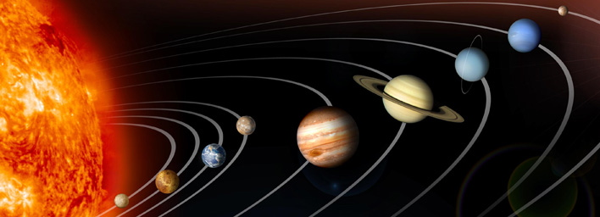
On this image of the solar system, which planet is four away from Saturn and six away from Neptune?
C
B
D
A

Slide 35
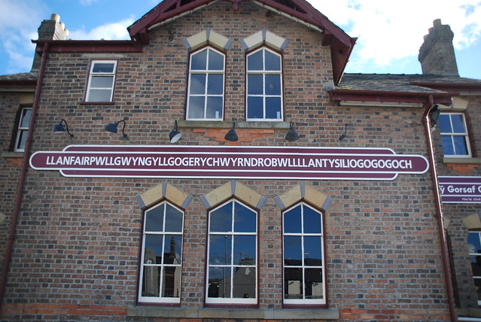
In what country of the UK, would you find this sign?
Wales
England
Scotland
Ireland

Slide 36


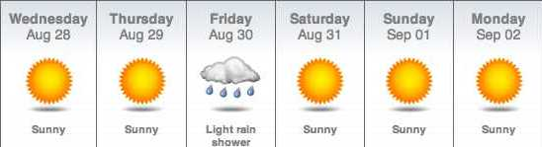

A
B
C
D
According to this forecast for new York in late November, What will the weather be like on thanksgiving day?

Slide 37
BONUS ROUND

Slide 38
In this round, I will ask you five questions, they will we very hard, but each right answer is worth 20 points, so there is a massive 100 points to play for, so to get the maximum points you all need to perform well. Good luck!

Slide 39
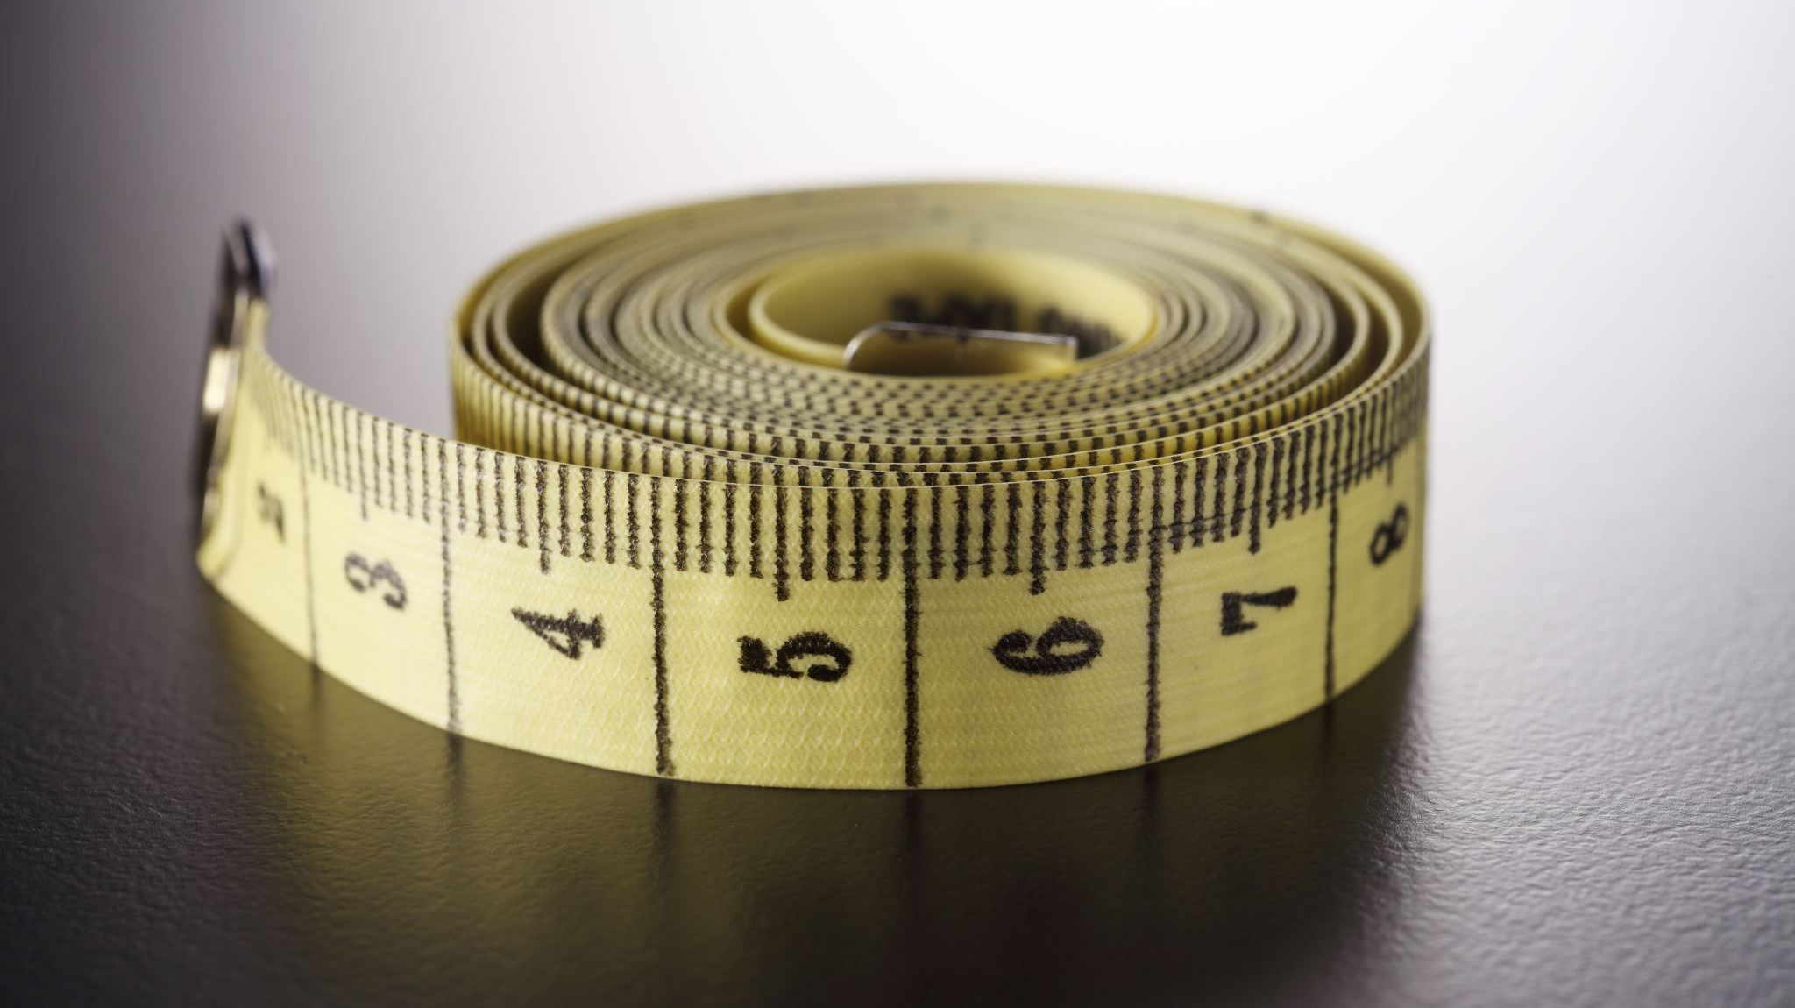
What unit of measurement is equal to this diagram?
X 220
= 1 YARD

Slide 40

How much did I pay for the toy car?
CAKE £23.99
TOY CAR £?
COFFEE £4.95
TOTAL: £49.93

Slide 41
This is an anagram of which former politician?
NAN DIWDEOMCEB

Slide 42
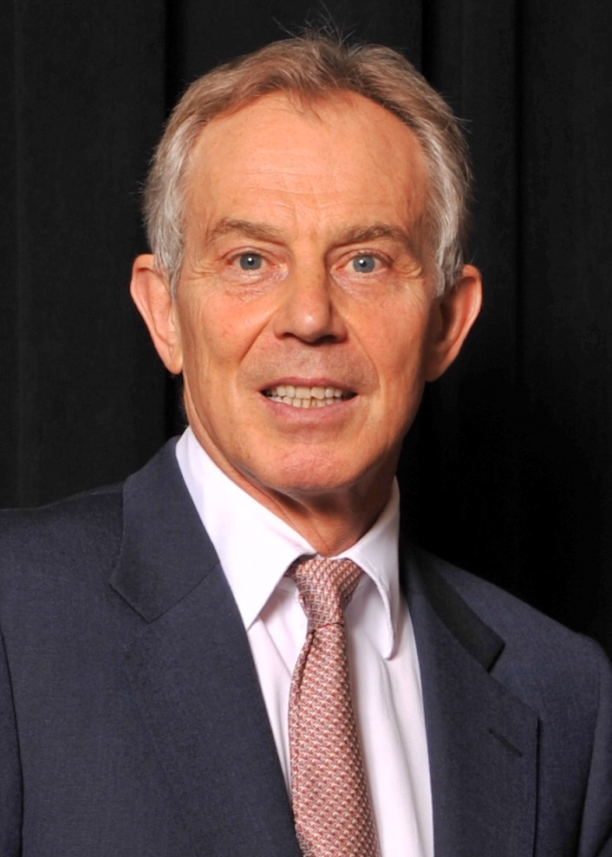
In what year was this politician elected as labour leader?

Slide 43
This is an anagram of which country?
LBEJMU

Slide 44
FINAL ROUND

Slide 45
In this round, there will be a series of questions, this time each one is worth 10 points, you have ten seconds to answer each question, and there is no conferring.
Here is your first one…

Slide 46
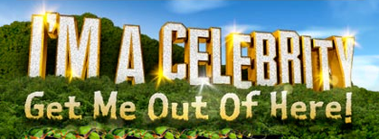
What five words are missing in the name of this reality TV show
?

Slide 47
What is the answer to this maths problem?
Total number of strings on four ukuleles
How many eyes Kevin the minion has

Slide 48
My journey is 245 miles long and this diagram shows one fifth of it, how does this diagram show?
? MILES

Slide 49
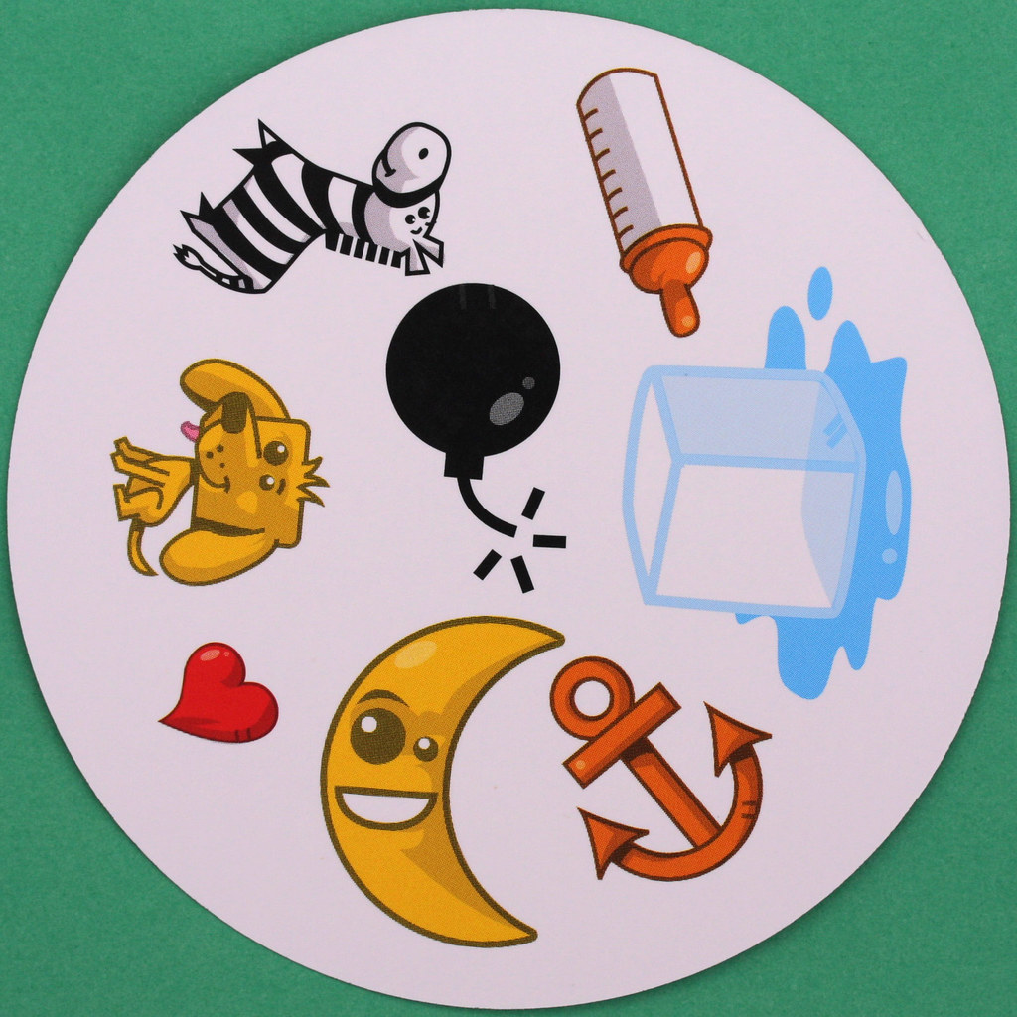
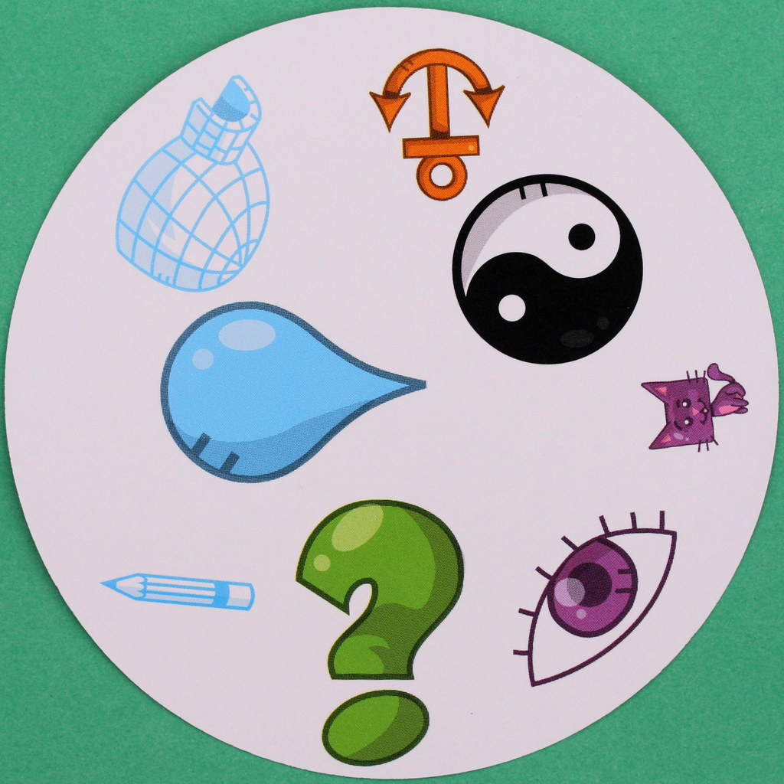
Which of these icons appears in both images?

Slide 50
This is an anagram of which fast food restaurant?
BTEL ACOL

Slide 51
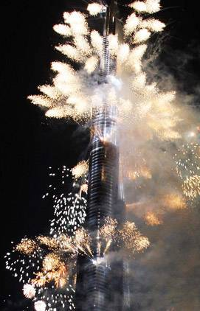
In what year was this celebration held?

Slide 52
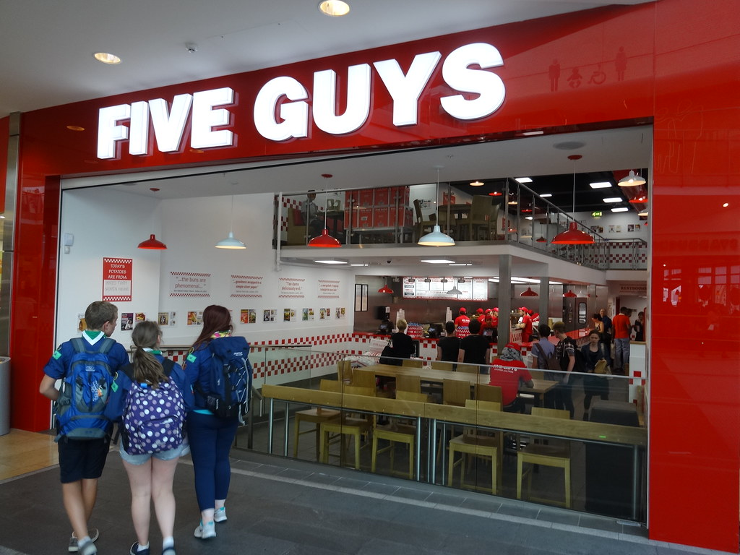
Name three milkshakes that this fast food restaurant sells?

Slide 53
That’s the end of the quiz, lets reveal the answers…

Slide 54
ANSWERS

Slide 55
What is the second letter in the name of this city?
SYDNEY

Slide 56
Which dog breed completes this crossword?
G
S
H
E
P
H
E
R
D
R
M
A
N

Slide 57
This is an anagram of which tall tourist attraction? (in England)
DLOYNO NEY
LONDON EYE

Slide 58
What is the price of the honey now it is in the sale?
£12.50
£25
50% OFF

Slide 59
Where did I write this postcard?
I’m having a great
Time in Rome, and
Tomorrow I’m visiting the Trevi Fountain

Slide 60
This mountain is In which national park?

Slide 61
This is a scene in what film?
ANGRY BIRDS 2

Slide 62
Remember, 5 points for each correct answer in that round

Slide 63
This is an anagram of which London landmark?
PMIREILA WRA SUEMUM
IMPERIAL WAR MUSEUM

Slide 64
In what city would you find this rollercoaster?
LAS VEGAS
THE ROLLERCOASTER IS LOCATED IN THE NEW YORK NEW YORK HOTEL

Slide 65

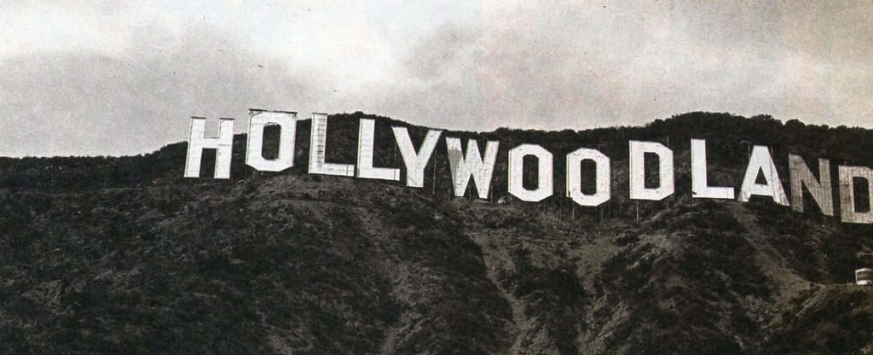
Before the removal of four letters what did this sign say?

Slide 66
What English city is the only one beginning with “y”
YORK

Slide 67
This is the capital of which country?
COLOMBIA
THE CITY IS CALLED BOGOTA

Slide 68
Remember, 5 points for each correct answer in that round

Slide 69
How many bananas are in the fruit bowl? 3
What colour are the apples? GREEN
How many pieces of fruit are red? 5
What two colours make up the colour of the bowl? BLACK AND WHITE
If three pieces of fruit were eaten, how many would you be able to see? 13

Slide 70
Remember, 5 points for each correct answer in that round

Slide 72
Remember, each tile you put in the right place scores you 5 points in that round

Slide 73
Which of these is the correct name for this Mammal?
Lion
Jaguar
Tiger
Leopard

Slide 74
Which of these is an example of an oxymoron?
Total Recall
Last Action Hero
Red Heart
True Lies

Slide 75
Which point on this compass is opposite to 180 degrees from north?
B

Slide 76
On this image of the solar system, which planet is four away from Saturn and six away from Neptune?
C
B
D
A

Slide 77
In what country of the UK, would you find this sign?
Wales
England
Scotland
Ireland

Slide 78
A
B
C
D
According to this forecast for new York in late November, What will the weather be like on thanksgiving day?
Thanksgiving day is always on a Thursday

Slide 79
Remember, 10 points for each correct answer in that round

Slide 80
What unit of measurement is equal to this diagram?
FERLONG
X 220

Slide 81
How much did I pay for the toy car?
CAKE £23.99
TOY CAR £20.99
COFFEE £4.95
TOTAL: £49.93

Slide 82
This is an anagram of which former politician?
NAN DIWDEOMCEB
ANN WIDDECOMBE

Slide 83
In what year was this politician elected as labour leader?
1953

Slide 84
This is an anagram of which country?
LBEJMU
BELJUM

Slide 85
Remember, 20 points for each correct answer in that round

Slide 86
What five words are missing in the name of this reality TV show
?

Slide 87
What is the answer to this maths problem?
Total number of strings on four ukuleles= 16
How many eyes Kevin the minion has= 1
16

Slide 88
My journey is 245 miles long and this diagram shows one fifth of it, how does this diagram show?
49 MILES

Slide 89
Which of these icons appears in both images?

Slide 90
This is an anagram of which fast food restaurant?
BTEL ACOL
TACO BELL

Slide 91
In what year was this celebration held?
2010

Slide 92
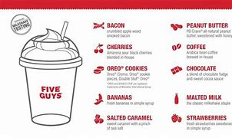
Name three milkshakes that this fast food restaurant sells?

Slide 93
Remember, 10 points for each correct answer in that round

Slide 94
Add up your scores
0/340

Slide 95

Hope you got good scores and enjoyed part five of my quiz, time to say good by good luck next time

