Slide 1
Quiz(part 4)

Slide 2
You will need:
A pencil
A ruler (optional)
A fast working brain

Slide 3
QUICK FIRE

Slide 4
In this round you will get a selection of questions each one you get right will score you one point. Here are the rules:
Read the question
Click anywhere
Once the timer finished, click the space bar
Do the same for all the questions

Slide 5



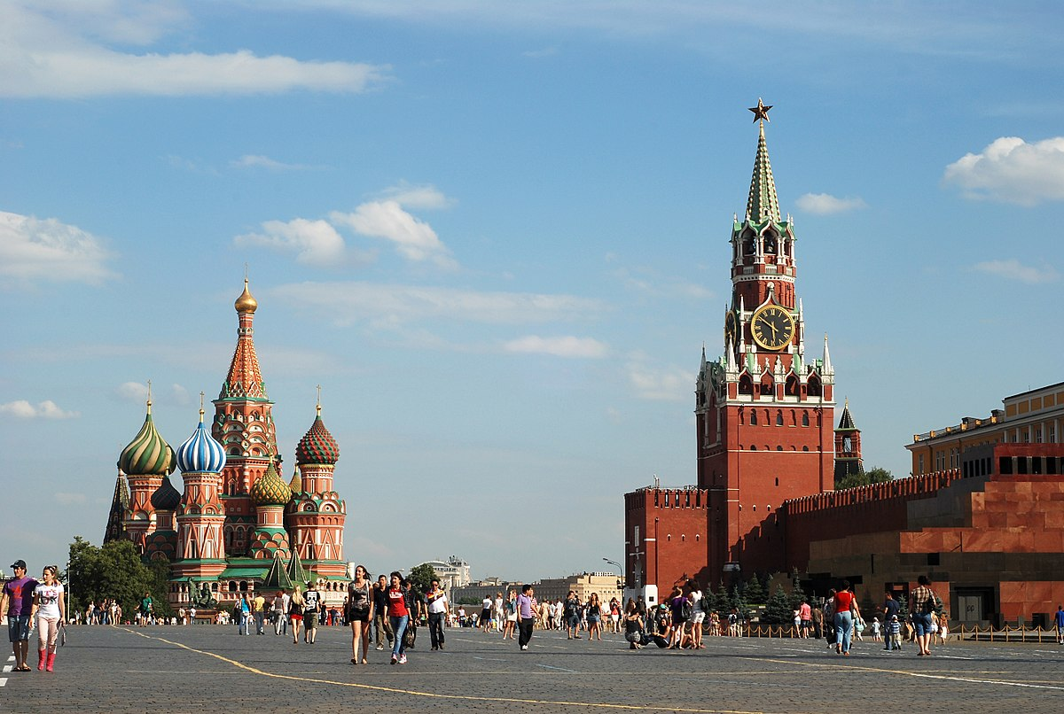

What is the fifth letter in the name of this city?

Slide 6
Which UK national park completes this crossword?
B
B
S
N

Slide 7
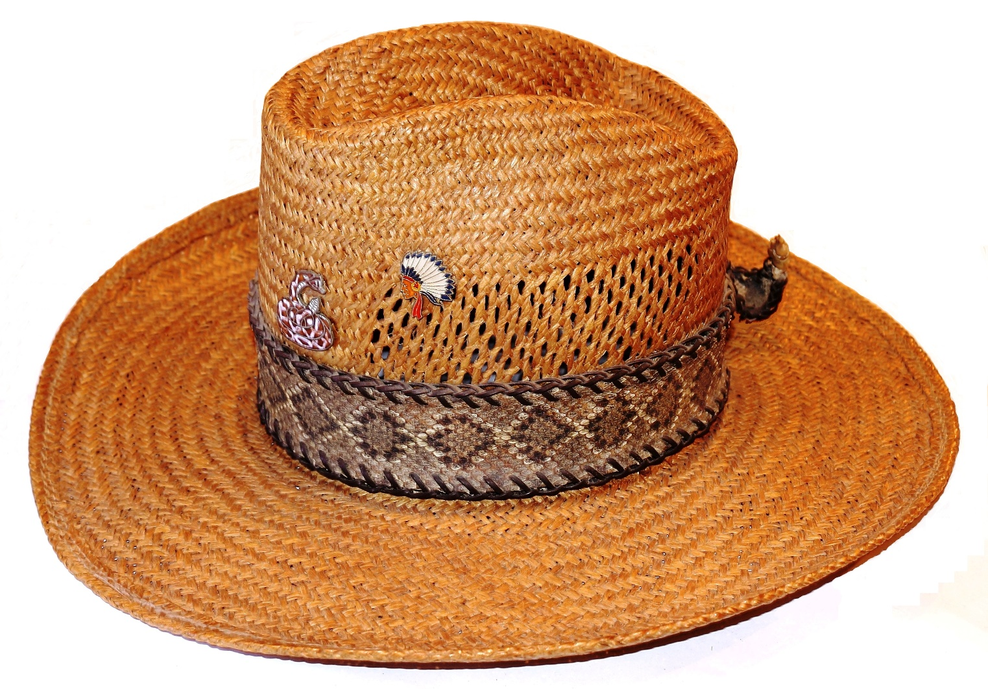
What is the price of this hat now it is in the sale?
£80
20% OFF

Slide 8
What fashion accessory is split between two words in this conversation (your clue is bad grammar)?
Harry said “My favourite band is Abba.” “good for you,” said Noah. “The best band is The Beatles.”

Slide 9
This is an anagram of which country?
MULAIBOC

Slide 10
What is the answer to this maths problem?
TOTAL NUMBER OF PEOPLE ON A GAME OF GUESS WHO
HOW MANY BOOKS ARE IN THE WISHING CHAIR COLLECTION

Slide 11
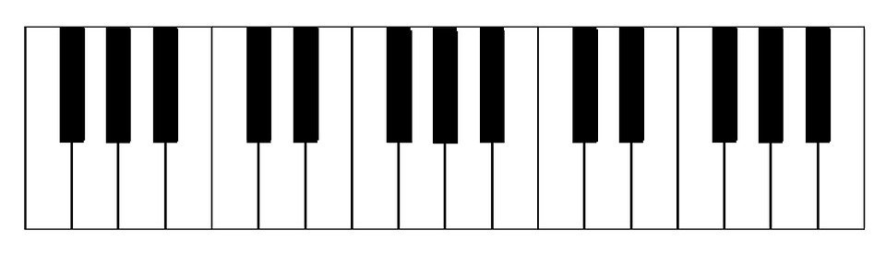
Which vegetable can be spelt using these letters?

Slide 12
SPECIALIST ROUND

Slide 13
In this round (similar to the quick fire round) you will get a selection of questions based on one subject each one you get right will score you one point. Here are the rules:
Read the question
Click anywhere
Once the timer has finished, click the space bar
Do the same for all the questions

Slide 14
The specialist subject is…
QUIZ SHOWS

Slide 15
How much is this drop worth in the standard quiz show “Tipping Point” if each counter is worth double its normal value?
X 2

Slide 16

Which of these is the host for this TV show
Bradly Walsh
Ben Shepard
Jeremy Clarkson
Warwick Davies

Slide 17
W
What 2000’s quiz show completes this crossword?
L
K
T

Slide 18
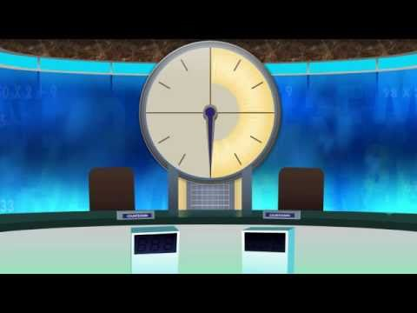
How long does this clock last for before it stops?

Slide 19
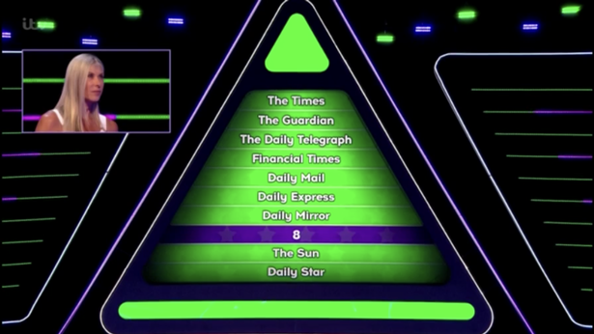
In what quiz show was this picture taken

Slide 20

What is the word missing in the name of this game show?
?

Slide 21
OBSERVATION

Slide 22
In this round I will show you an image, when you get on the next slide double click, once the timer has finished, I will ask a series of questions on the picture, all you need to do is remember what you saw.

Slide 23




Slide 24
How many starfish can be seen in the picture?

Slide 25
How many sea shells can be seen on the sea floor?

Slide 26
How many pieces of coral are in colour?

Slide 27
How many fish can be seen in in the picture?

Slide 28
MULTIPLE CHOICE

Slide 29
In this round I will give you a series of multiple choice questions each worth one point, after reading it, you click anywhere, then you have 5 seconds to answer until you hear a ring when the timer has finished, after the timer finishes click the space bar.

Slide 30
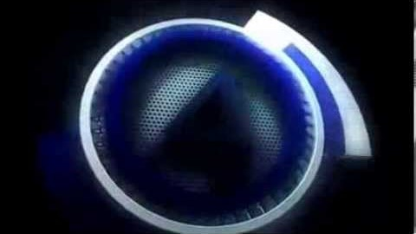
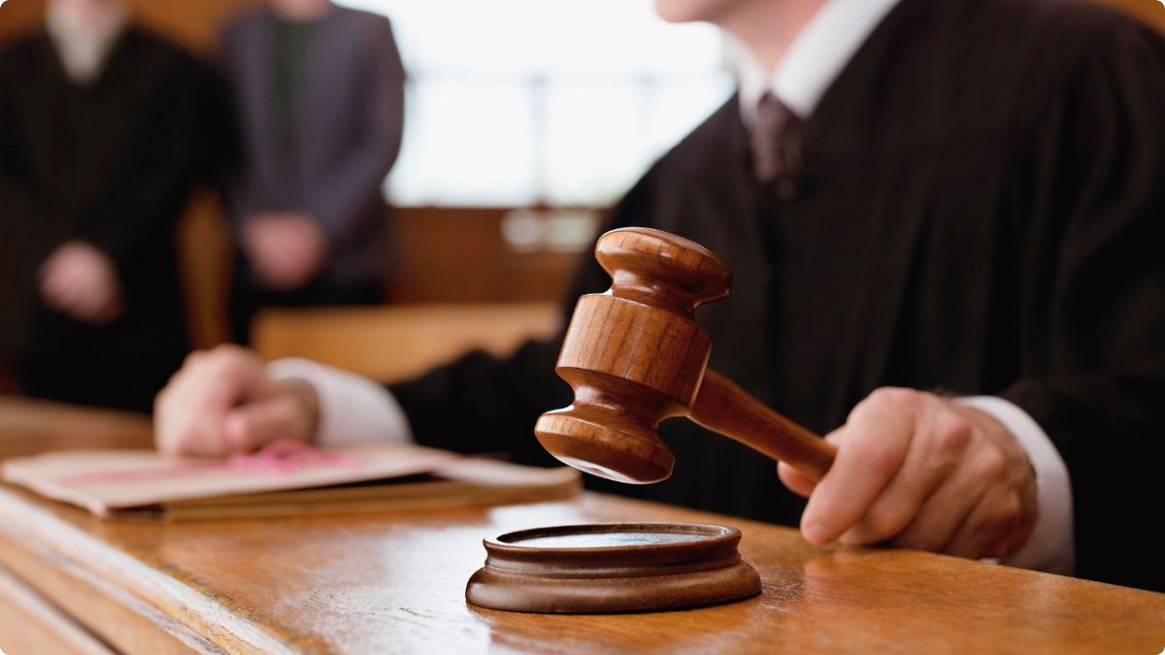
Which of these is the correct way to address a male judge
Your Grace
Your Honour
My Man

Slide 31
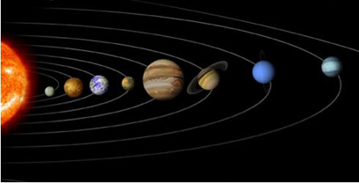
On this image of the solar system, which planet is five away from Saturn and four away from Jupiter?
A
B
C
D

Slide 32

Which point on this compass is directly opposite 315 degrees?
A
B
D
C

Slide 33
Which of these British monarchs featured on the worlds first adhesive postage stamp?
William IV
Victoria
Edward VII
Edward VIII

Slide 34
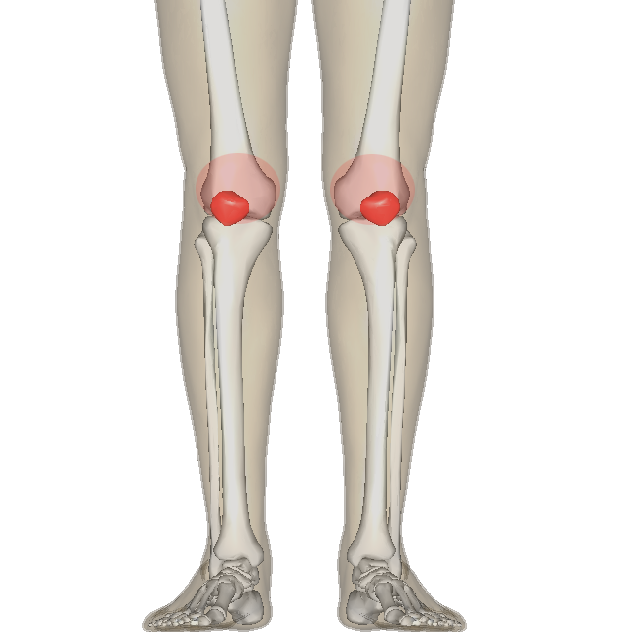
Which of these is an anagram of the highlighted bone?
EMU RUSH
LATE PAL
CARAMEL TAPS
CALL VICE

Slide 35
Which of these is not a type of hat?
Non la
Kepi
Cloche
Moccasin

Slide 36
MEMORY ROUND

Slide 37
In this round you have 10 seconds to study a selection of road signs, then you will have 20 seconds to put the tiles into the order that you first saw them, you will need To write down what each sign is. Each one you put in the right place will score you five points.

Slide 38
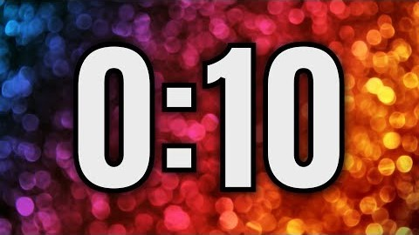






Slide 39


Slide 40
BONUS ROUND

Slide 41
In this round, there will be 5 questions, these questions will be BARKINGLY HARD, much harder than the rest, but each correct answer is worth 20 points, so there is a Whopping 100 points to play for. But to get them you need to perform very well.

Slide 42
Because these questions will be very hard there is not a time limit, but you do need to answer at some point, Lets play the Bonus round

Slide 43
Which first name links these famous people?
Ride (astronaut)
Field (actor)
Gunnell (athlete)

Slide 44
Which of these singers shares their initials with the person who became editor-in-chief of American Vogue in 1998?
Amy Winehouse
Diana Ross
Celine Dion

Slide 45


Which fashion designer could have written this social media post?
Clapham Veg
Punk fashion selling out on London’s Kings Road #TooFastToLive#TooYoungToDie
McMalc Likes this

Slide 46
When used in relation to wine, what does the “V” stand for in this abbreviation?
ABV

Slide 47
Brass is an alloy of copper and which other metal?
Zinc
Tin
Nickel
Gold

Slide 48
FINAL ROUND

Slide 49
In this round its five points for each correct answer, and then exactly like the quick fire round you get ten seconds two answer?

Slide 50

Jurassic Park
The good dinosaur
The land before land
Jurassic World
Which of these films featuring dinosaurs was released first?

Slide 51
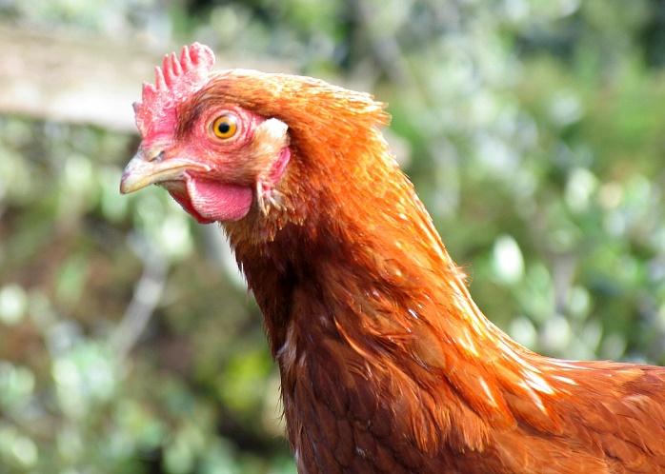
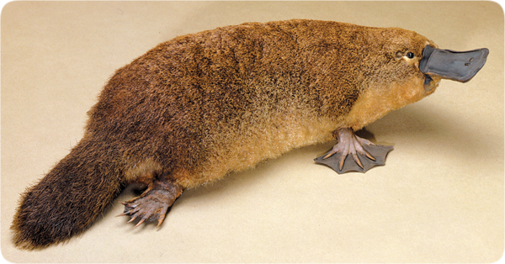
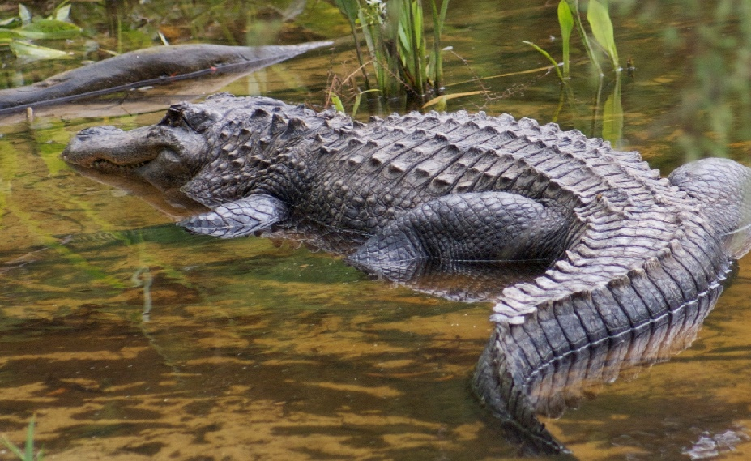
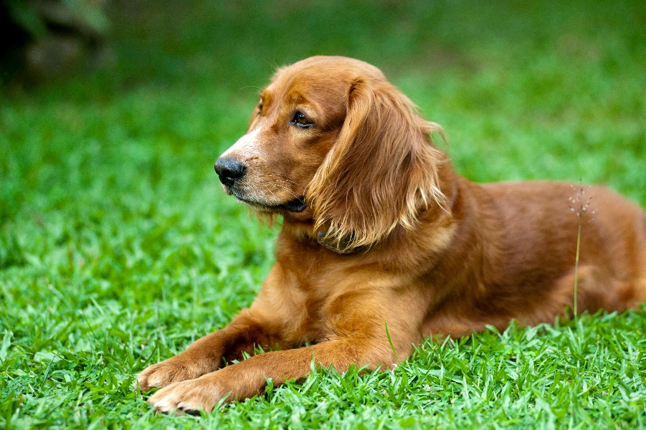
The females of how many of these species lay eggs

Slide 52





How much did Winnie-The-Pooh pay for the honey?
BBCF Prime
CONDENSED MILK £5.30
HONEY
BALOONS £4.70
TOTAL £33.00

Slide 53
This is an anagram of which breakfast (it could include different types of cereal food?
RIEGDORP

Slide 54
Which word in this film title is a pronoun?
Honey, I shrunk the children.

Slide 55
ANSWERS

Slide 56
What is the fifth letter in the name of this city?
Moscow

Slide 57
Which UK national park completes this crossword?
B
R
E
B
E
A
C
O
N
S
O
N

Slide 58
What is the price of this hat now it is in the sale?
£64
£80
20% OFF

Slide 59
What fashion accessory is split between two words in this conversation (your clue is bad grammar)?
Harry said “My favourite band is Abba.” “good for you,” said Noah. “The best band is The Beatles.”

Slide 60
This is an anagram of which country?
UOCLMIBA
COLUMBIA

Slide 61
What is the answer to this maths problem?
TOTAL NUMBER OF PEOPLE ON A GAME OF GUESS WHO
HOW MANY BOOKS ARE IN THE WISHING CHAIR COLLECTION
8

Slide 62
Which vegetable can be spelt using these letters?
CABBAGE

Slide 63
ADD UP YOUR SCORES, EACH ONE YOU GET CORRECT SCORES YOU ONE POINT.

Slide 64
How much is this drop worth in the standard quiz show “Tipping Point” if each counter is worth double its normal value?
X 2
£700

Slide 65
Which of these is the host for this TV show
Bradly Walsh
Ben Shepard
Jeremy Clarkson
Warwick Davies

Slide 66
W
E
What 2000’s quiz show completes this crossword?
A
L
I
N
K
E
S
T

Slide 67
How long does this clock last for before it stops?
30SECONDS

Slide 68

In what quiz show was this picture taken

Slide 69
What is the word missing in the name of this game show?
?

Slide 70
ADD UP YOUR SCORES, EACH ONE YOU GET CORRECT SCORES YOU ONE POINT.

Slide 71
How many starfish can be seen in the picture?
Three

Slide 72
How many sea shells can bee seen on the sea floor?
Five

Slide 73
How many pieces of coral are in colour?
Four

Slide 74
How many fish can be seen in in the picture?
Five

Slide 75
ADD UP YOUR SCORES, EACH ONE YOU GET CORRECT SCORES YOU ONE POINT.

Slide 76
Which of these is the correct way to address a male judge
Your Grace
Your Honour
My Man

Slide 77
On this image of the solar system, which planet is five away from Saturn and four away from Jupiter?
A
B
C
D

Slide 78
Which point on this compass is directly opposite 315 degrees?
B

Slide 79
Which of these British monarchs featured on the worlds first adhesive postage stamp?
William IV
Victoria
Edward VII
Edward VIII

Slide 80
Which of these is an anagram of the highlighted bone?
EMU RUSH
LATE PAL
CARAMEL TAPS
CALL VICE

Slide 81
Which of these is not a type of hat?
Non la
Kepi
Cloche
Moccasin

Slide 82
ADD UP YOUR SCORES, EACH ONE YOU GET CORRECT SCORES YOU ONE POINT.

Slide 84
ADD UP YOUR SCORES, EACH TILE YOU PLACE IN THE RIGHT PLACE WILL SCORE YOU FIVE POINTS.

Slide 85
Which first name links these famous people?
Sally Ride (astronaut)
Sally Field (actor)
Sally Gunnell (athlete)

Slide 86
Which of these singers shares their initials with the person who became editor-in-chief of American Vogue in 1998?
Amy Winehouse
Diana Ross
Celine Dion

Slide 87
Which fashion designer could have written this social media post?
Vivienne
Westwood
Clapham Veg
Punk fashion selling out on London’s Kings Road #TooFastToLive#TooYoungToDie
McMalc Likes this

Slide 88
When used in relation to wine, what does the “V” stand for in this abbreviation?
Volume
ABV

Slide 89
Brass is an alloy of copper and which other metal?
Zinc
Tin
Nickel
Gold

Slide 90
ADD UP YOUR SCORES, EACH ONE YOU GET CORRECT SCORES YOU TWENTY POINTS.

Slide 91
Jurassic Park
The good dinosaur
The land before land
Jurassic World
Which of these films featuring dinosaurs was released first?

Slide 92
The females of how many of these species lay eggs

Slide 93
How much did Winnie-The-Pooh pay for the honey?
BBCF Prime
CONDENSED MILK £5.30
HONEY £23.00
BALOONS £4.70
TOTAL £33.00

Slide 94
This is an anagram of which breakfast (it could include different types of cereal food?
PORRIDGE
RIEGDORP

Slide 95
Which word in this film title is a pronoun?
Honey, I shrunk the children.

Slide 96
ADD UP YOUR SCORES, EACH ONE YOU GET CORRECT SCORES YOU FIVE POINTS.

Slide 97
THE END
Add up your total score.
?/148

