Slide 1
thekeysupport.com/leaders
The Equality Act 2010
Staff briefing
Notes:
In advance:
Adapt the yellow highlighted text on slides 15 and 16
Add photos of your SENCO and inclusion lead on slide 15
Familiarise yourself with your school policy on inclusion
On the day: make sure you have a copy of the facilitator notes, either printed or open on a separate device
Welcome staff to this briefing on The Equality Act
Let staff know there will be interactivity throughout the session, with discussion points and activities

Slide 2

Learning objectives
Today, we’ll learn…
What the Equality Act 2010 is
What the 9 protected characteristics are
What the different types of discrimination are
What our duties to protected individuals are
Notes:
Run through the learning objectives with staff
Tell staff there will be a quick assessment at the end of the briefing to assess their understanding or that you’ll email them a link to the digital quiz
Reassure staff that you’ll give them a handout and make the slides available after the session – so they don’t need to take notes

Slide 3

What is the Equality Act 2010?
The act is a law that protects everyone from discrimination
This includes pupils, parents and staff
It covers the protected characteristics
Notes:
Explain that:
The Equality Act 2010 protects people from discrimination in the workplace and in wider society. It sets out the different ways in which it’s unlawful to treat someone
As a school you have a duty to protect your pupils – that means prospective, current, and former – as well anyone else who uses the school, including staff, parents and other members of the community
The act is based on protected characteristics, which you’ll cover in the following slides
Tell staff what can happen if you don’t comply with the act
For example, it can:
Cause distress for the person or people affected
Damage the inclusive and welcoming culture in your school
Share this example:
The Urswick School in East London repeatedly sent a Black pupil with afro-textured hair home because her hair was “too big”. This pupil ended up having to leave the school as she was constantly in trouble for wearing her hair in its natural state. The pupil’s family took legal action and the school’s diocese had to make an out of court settlement (https://www.bbc.co.uk/news/newsbeat-45521094)

Slide 4
What are the 9 protected characteristics?
Sexual orientation
Gender reassignment
Age
Pregnancy and maternity
Religion or belief
Race
Disability
Marriage and civil partnership
Sex
Notes:
Ask staff to call out the 9 protected characteristics
Reveal the 9 protected characteristics
Ask individuals to internally reflect on which characteristics they have, and think about how the act protects them

Slide 5

Question time
Which protected characteristics don’t apply to pupils in school?
Notes:
Ask your staff which protected characteristics don’t apply to pupils in school – you could ask staff to raise their hand or call out the answers

Slide 6
Exceptions for pupils
Sexual orientation
Gender reassignment
Age
Pregnancy and maternity
Religion or belief
Race
Disability
Marriage and civil partnership
Sex
Notes:
Explain that:
Age: a person’s age is a protected characteristic in relation to employment, but this doesn’t apply to pupils in schools. Schools can admit and organise children by age groups and treat pupils in ways appropriate to their age and stage of development, even in the case of pupils over the age of 18
Marriage and civil partnership: this characteristic only applies to staff, as it only protects people in the context of employment and not education

Slide 7
Exceptions for schools
Sexual orientation
Gender reassignment
Age
Pregnancy and maternity
Religion or belief
Race
Disability
Marriage and civil partnership
Sex
Notes:
Explain that there are also exceptions for schools:
Single-sex schools aren't discriminating by refusing to admit pupils of the opposite sex
Schools with a religious nature can give preferential treatment to children of their own faith when it comes to admissions and provision of extra-curricular services. For example, a Jewish school can provide pastoral care from a rabbi and not from any other faiths

Slide 8




The act protects people from discrimination
Direct discrimination
Treating someone with a protected characteristic less favourably than others.​
Indirect discrimination
Putting rules or arrangements in place that apply to everyone, that put someone with a protected characteristic at an unfair disadvantage.​
Harassment
Unwanted behaviour linked to a protected characteristic that violates someone’s dignity or creates an offensive environment for them.​
Victimisation
Treating someone unfairly because they’ve complained about discrimination or harassment.​
Notes:
Explain the 4 types of discrimination:
Direct discrimination is when you treat someone with a protected characteristic less favourably than others.​
Example: making a lesbian pupil change separately because she makes the other girls feel ‘uncomfortable’
Indirect discrimination is when you put rules or arrangements in place that apply to everyone, that put someone with a protected characteristic at an unfair disadvantage
Example: having a school uniform policy that doesn’t allow for any headwear could indirectly discriminate against Muslim girls who wear head coverings
Harassment is unwanted behaviour linked to a protected characteristic that violates someone’s dignity or creates an intimidating, hostile, degrading, humiliating or offensive environment for them
Example: making fun of the voice of a deaf colleague
Victimisation is treating someone unfairly because they’ve complained about discrimination or harassment
Example: 44

Slide 9

Perceptive and associative discrimination
Perception
Treating someone worse because of a characteristic which you think a person has, even if you are mistaken
Association
Treating a someone worse because they are associated with someone who has a protected characteristic
Notes:
Explain that someone doesn’t need to have a protected characteristic to be discriminated against:
Discrimination by perception is when you treat someone worse because of a characteristic you think they have, even if they don’t have it
Example: a heterosexual male pupil signed up for dance club instead of football. The PE teacher made homophobic comments about the pupil for wanting to do dance. The teacher discriminated against the pupil because he thought the pupil is gay
Discrimination by association is when you treat someone worse because they are associated with a person who has a protected characteristic. This could be a member of their family, a friend, or anyone they have a relationship with
Example: a cis pupil ran a campaign to make school uniforms unisex to support her non-binary friend. When the pupil asked the school for a reference for her university application, the school declined as she was seen as disruptive. The school discriminated against the pupil because she was associated with her non-binary friend

Slide 10
Disability discrimination
We must treat pupils with disabilities more favourably than those who don’t have disabilities
To do this we must make reasonable adjustments
We will provide auxiliary aids or services to remove any disadvantages that the pupil faces
Notes:
Explain that disability discrimination is different to other protected characteristics:
With the other characteristics, the duty is to treat everyone the same. For example, a Muslim pupil and a Jewish pupil should be given the same treatment
However, with disability, schools may, and often must, treat pupils with disabilities more favourably, so that the pupils can access a comparable experience
This is the duty to make reasonable adjustments, and provide auxiliary aids or services
For example:
Rearranging the timetable so that a pupil with limited mobility has time to get to their lessons
Providing speech-to-text software for pupils with dyslexia or loss of dexterity
Making sure that all school trips are accessible to pupils in wheelchairs
Remind staff that disability discrimination extends to everyone – such as, parents, staff and visitors – not just pupils
Source:
https://www.legislation.gov.uk/ukpga/2010/15/section/20
https://www.gov.uk/government/publications/equality-act-2010-advice-for-schools

Slide 11
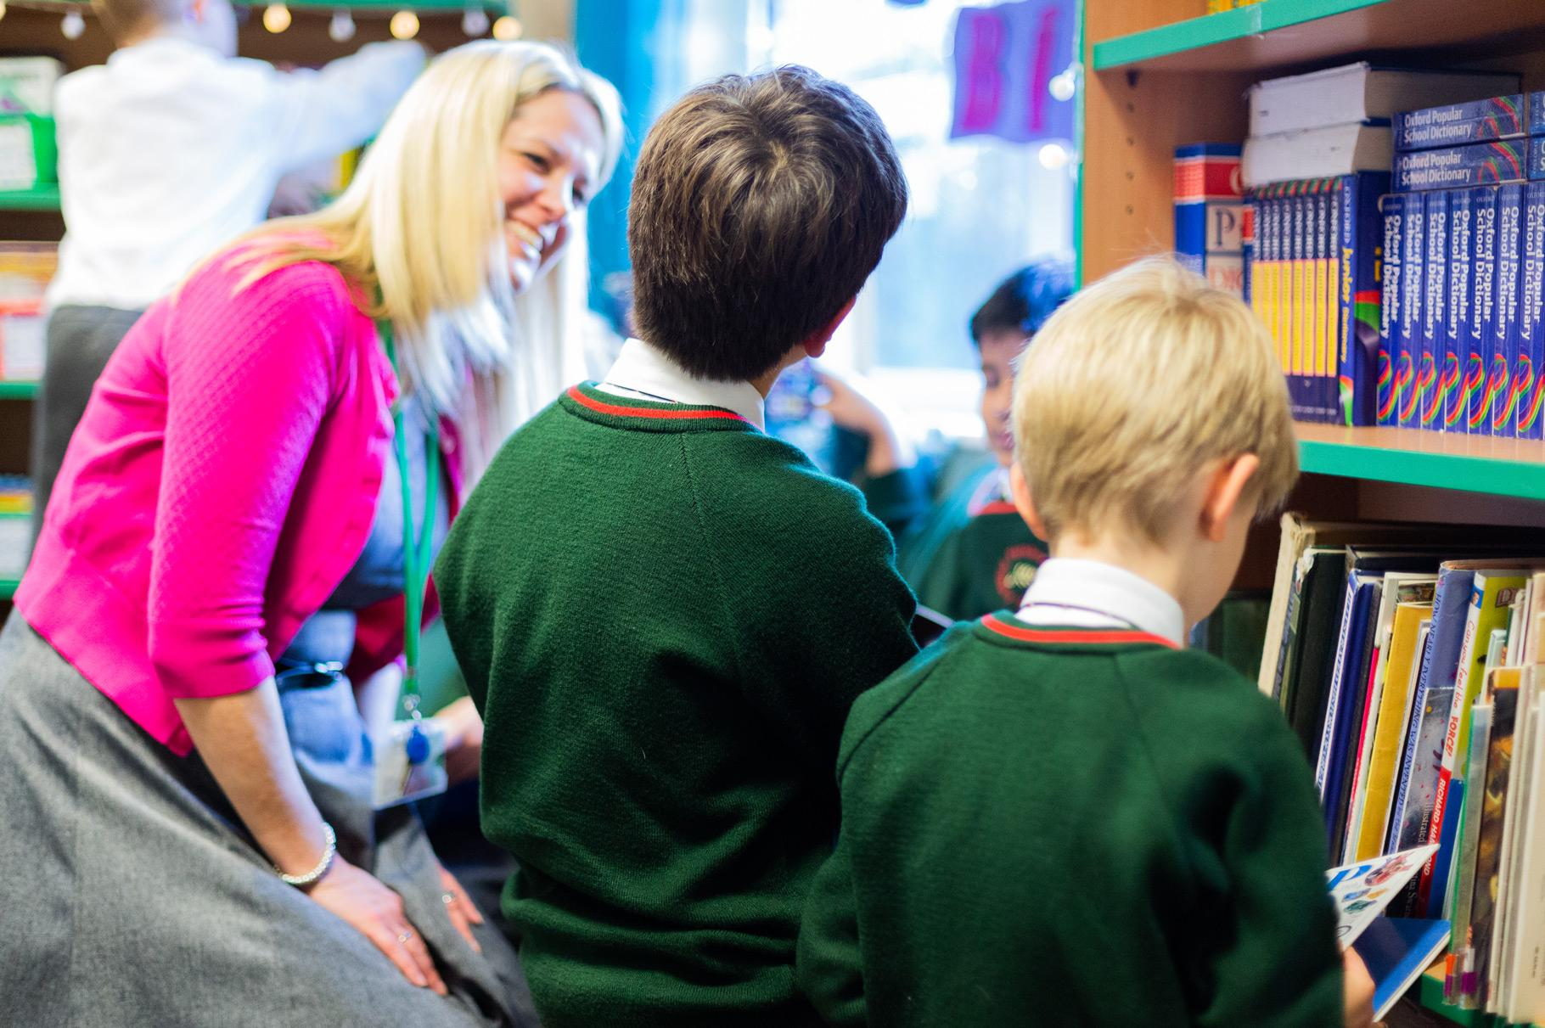

Positive action
We can take targeted action to tackle disadvantage experienced by groups of pupils with protected characteristics
For example, extra reading sessions for boys on free school meals
Notes:
Explain:
That positive action means we can take targeted action to address the disadvantages experienced by a specific group of pupils
Example: if we find that boys on free school meals have the lowest levels of reading enjoyment in the school, we could put in place interventions specifically aimed at tackling this disadvantage. This wouldn’t count as discrimination against girls, because it’s a proportionate way to achieve a specific goal

Slide 12




What we expect from our staff
Make sure all pupils have everything that they need to be confident and thrive
Be welcoming to
all, and celebrate
difference
Remove any barriers stopping pupils from fully enjoying their life at school
Consider equality when making everyday decisions
Notes:
[You can adapt this slide according to your school’s ethos, vision and values if you want to.]
Explain what your expectations are from your staff. For example:
That you expect all staff to promote equality and inclusion at all times
Remember that the duty extends towards colleagues, parents and school visitors, not just pupils

Slide 13
Key takeaways
Remember …
The Equality Act protects people on the basis of 9 protected characteristics
Pupils, staff, parents and the wider community are protected under the act
There are different kinds of discrimination
You must make reasonable adjustments for those with disabilities
Let’s work together to create an inclusive and welcoming environment for all
Notes:
Recap the key messages from the briefing
Take any final questions
Explain that you’d now like staff to complete a quick quiz to check their understanding. Share the paper ‘assessment’ sheets, and give staff 5 minutes to complete the questions, or ask them to complete the assessment in their own time and return it to you. Alternatively, tell staff you’ll email them a link to the digital quiz
Share the handout ‘Intro to the Equality Act’ for staff to refer back to. If you’re delivering this session remotely, tell them you’ll email it to them afterwards
Let staff know that you’ll share the slides afterwards
Thank staff for their time

Slide 14
Sources
Equality Act 2010, The Key Leaders
https://schoolleaders.thekeysupport.com/uid/8b88fe25-472a-4a5d-a94d-f29efc59d1b1/
Equality Act 2010: reasonable adjustments, The Key Leaders
https://schoolleaders.thekeysupport.com/uid/adf19382-e706-49dd-a618-b6e5eb2ebf85/
Equality Act 2010 https://www.legislation.gov.uk/ukpga/2010/15/contents
What equality law means for you as an education provider: schools, Equality and Human Rights Commission https://www.equalityhumanrights.com/en/publication-download/what-equality-law-means-you-education-provider-schools
Equality Act 2010: what teachers need to know and what schools need to do, Council for Disabled Children https://councilfordisabledchildren.org.uk/resources/all-aresources/filter/inclusion-send/disabled-children-and-equality-act-2010-what-teachers
Positive action, Equality and Human Rights Commission
https://www.equalityhumanrights.com/en/advice-and-guidance/positive-action

