Slide 1
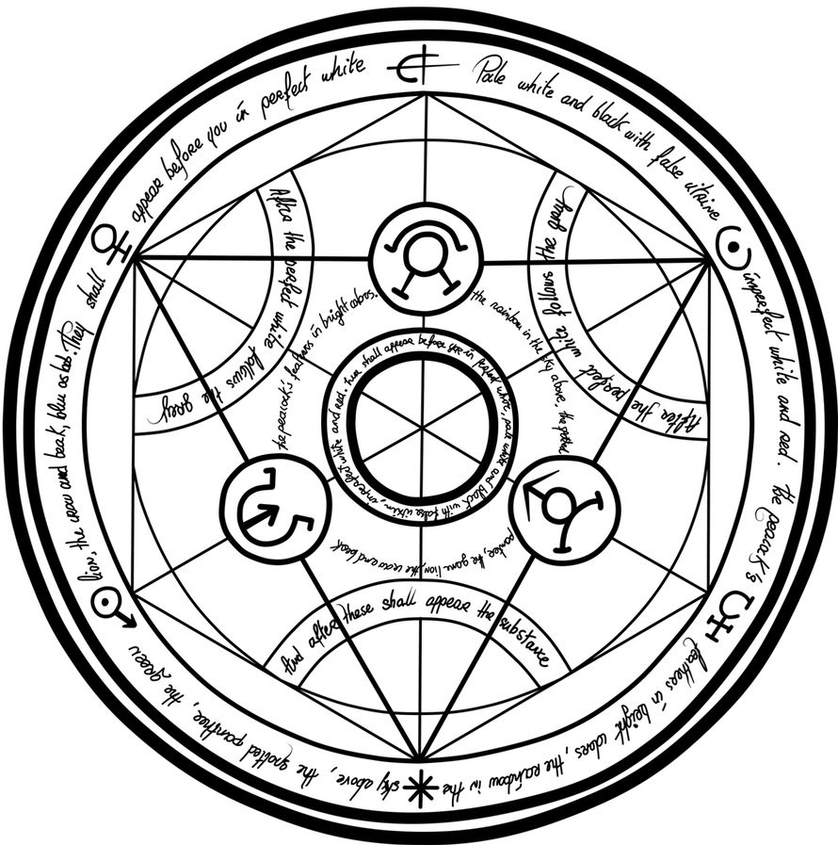

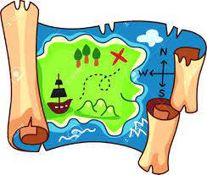
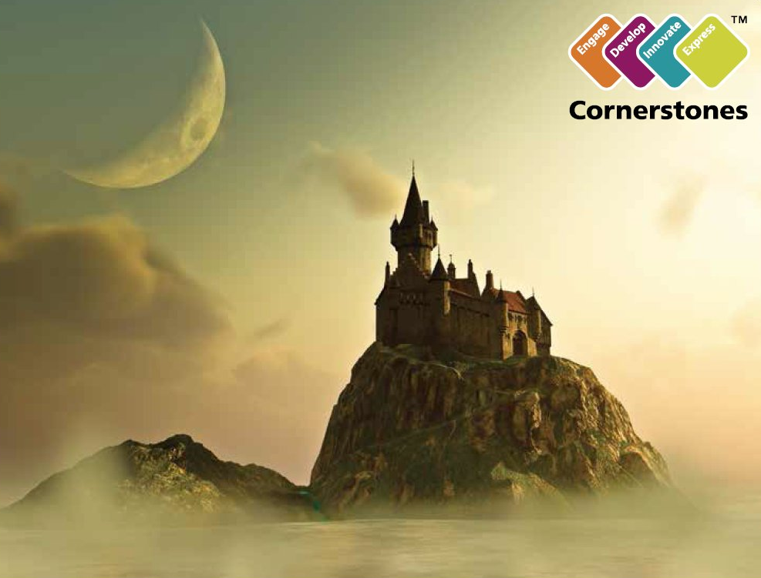
LO – We are discussing information relating to the new topic ‘Alchemy Island’ and addressing key misconceptions.
Lesson 1
Starter – What is Alchemy Island? Discuss with a partner and jot down your ideas.

Slide 2
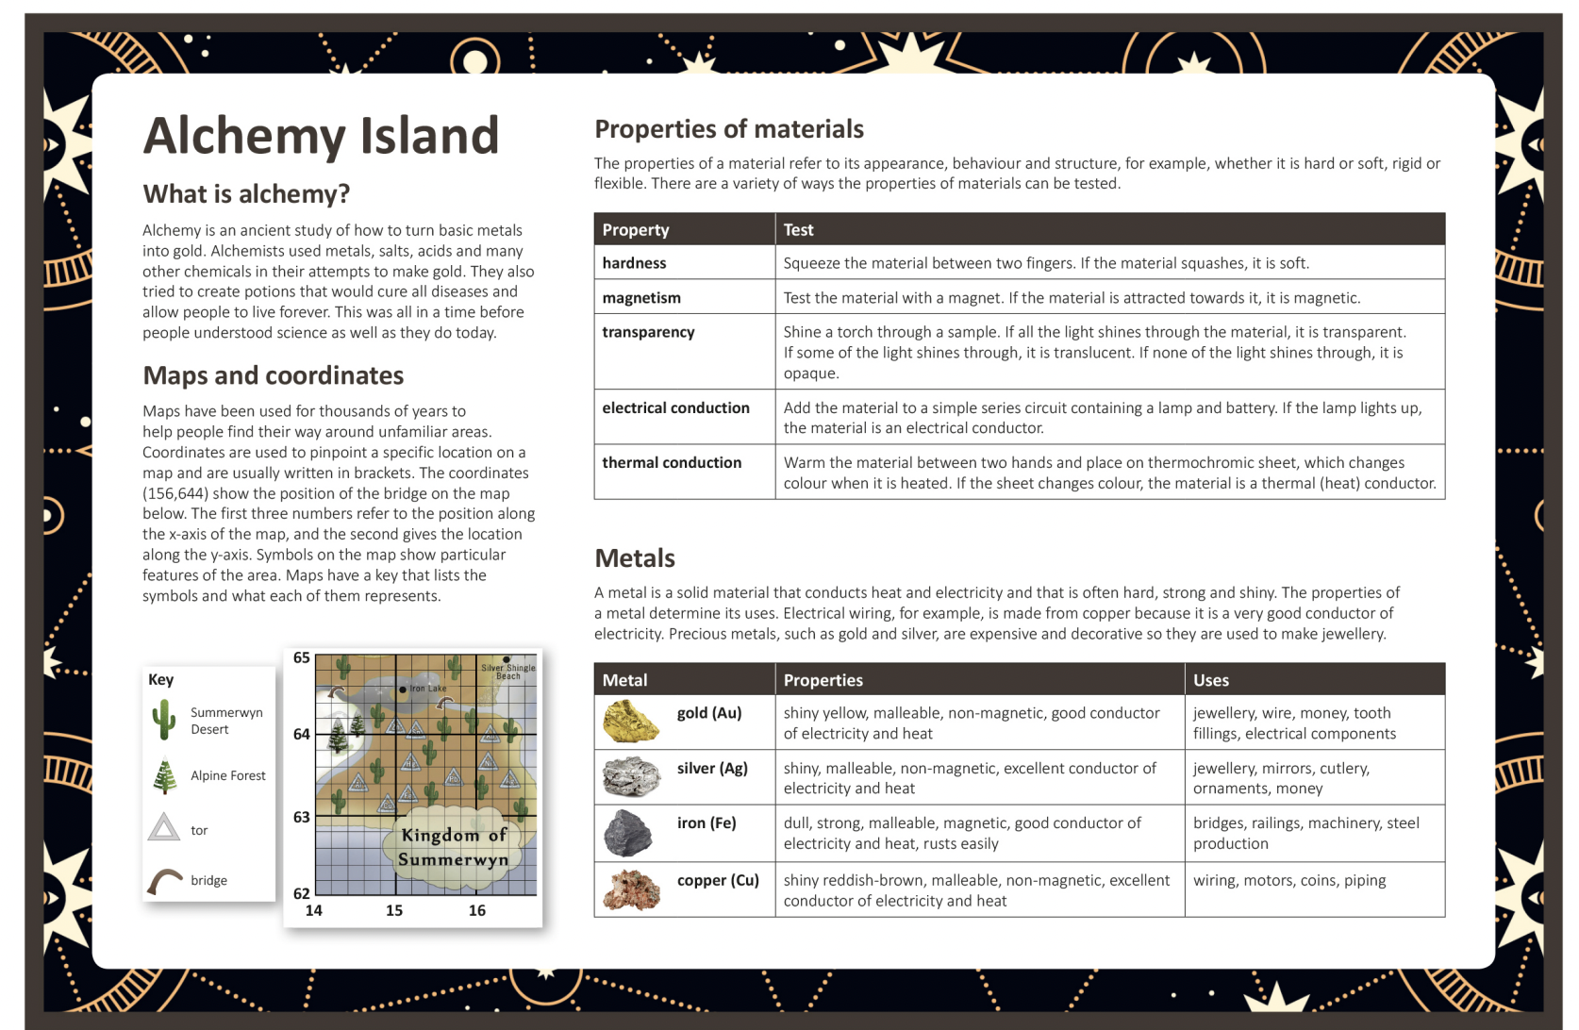

Slide 3
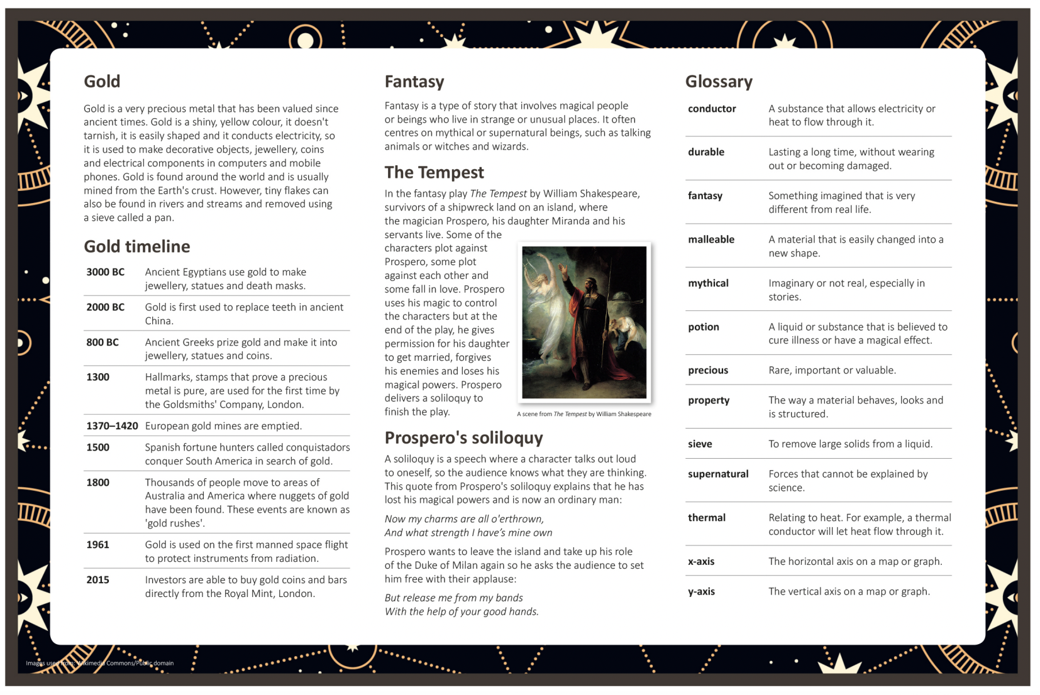

Slide 4
LO – We are writing a fantasy narrative about a quest for gold.
Lesson 2
Cold write lesson – Your task is to create a short story independently about a character on a quest for gold. This is a one-off task, which we are going to use to improve our writing over the next few weeks.
Try your best!!!

Slide 5
LO – We are feature spotting the beginning of a fantasy narrative.
Lesson 3
Starter – Discuss with a partner: what do you expect to see in a fantasy narrative? What would hook you into reading a fantasy story?

Slide 6
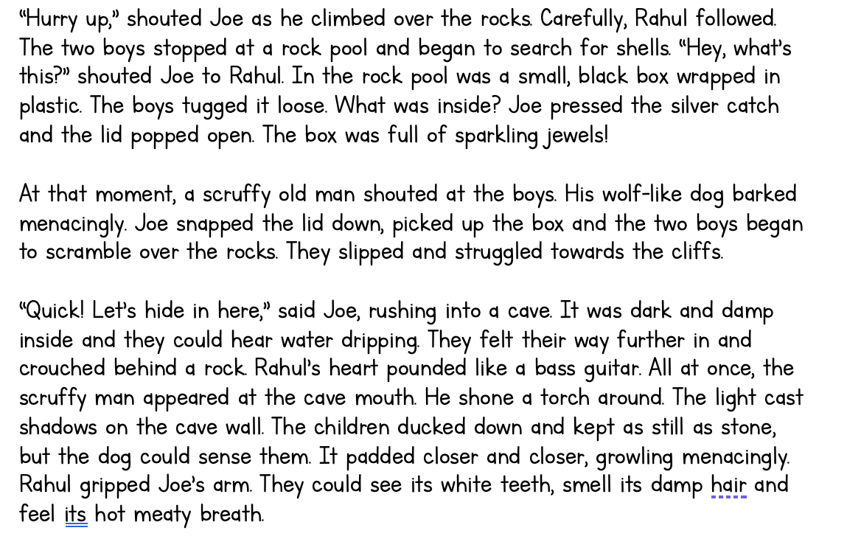

Slide 7
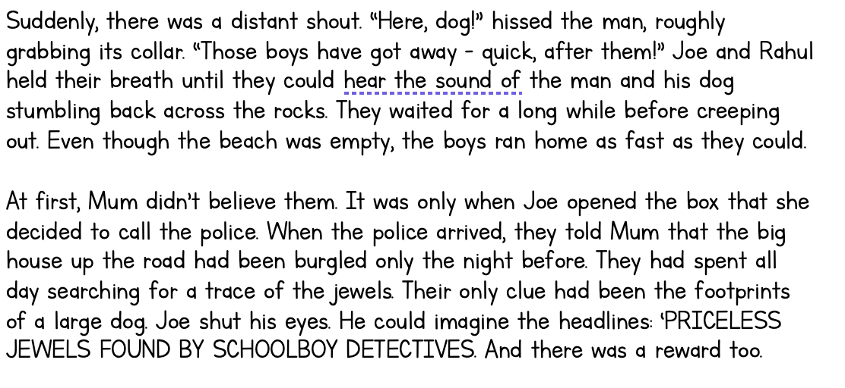

Slide 8
Feature-spotting task
Find examples of the following in the text:
Clear story structure (opening, build up, dilemma, resolution, ending)
Description using expanded noun phrases
Main characters
Similes
Rhetorical questions
Speech
Finished? Write your own toolkit for a successful fantasy story…

Slide 9
LO – We are creating a toolkit for suspense.
Lesson 4
Starter – Why is suspense important in a fantasy story?

Slide 10
Where can we find examples of:
Showing, not telling
Short, snappy sentences
Speech moving actions on
Empty words
Threatening noises
Questions to make the reader think
Rahul gripped Joe’s arm.
None in this paragraph.
“Quick! Let’s hide in here.”
It
Growling menacingly
None in this paragraph.

Slide 11
Today’s tasks:
Bronze – Find at least three examples of suspense in the text.
Silver – Create a toolkit of suspense strategies, including the ones we discussed as a class. Include examples of each of your strategies.
Gold – Can you turn basic ‘telling’ sentences into ‘showing’ ones?
‘Joe was scared.’ -> ‘Joe froze, as the hair on his neck stood up.’
‘Zara was sad.’ ->
‘Jonah felt shy.’ ->
‘Tom was angry.’ ->
‘He was frightened.’ ->
‘Remi was nervous.’ ->

Slide 12
LO – We are creating a setting description of a fantasy landscape.
Lesson 5

Slide 13
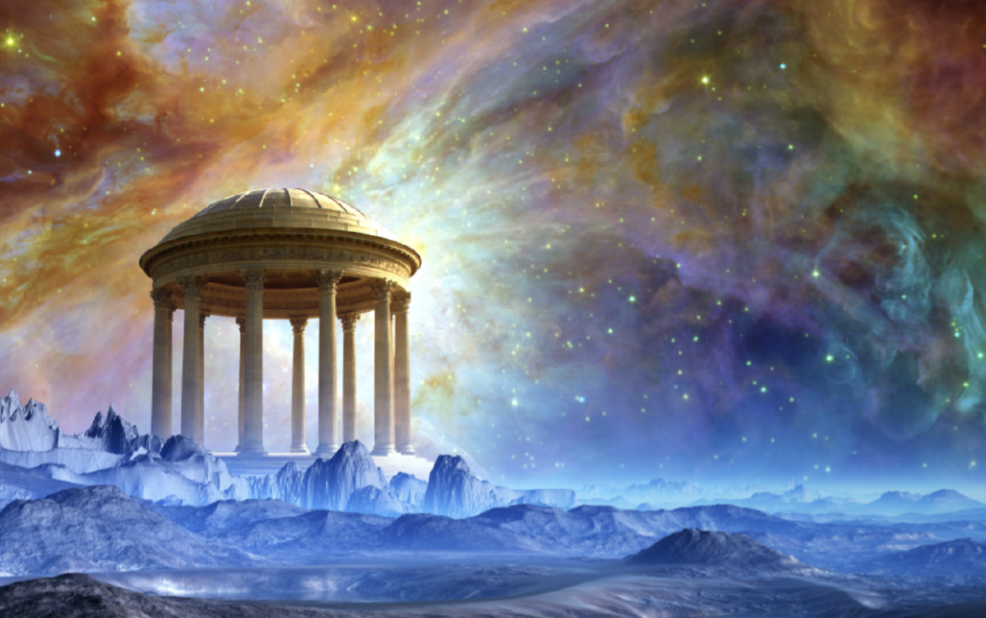
What adjectives describe this?

Slide 14
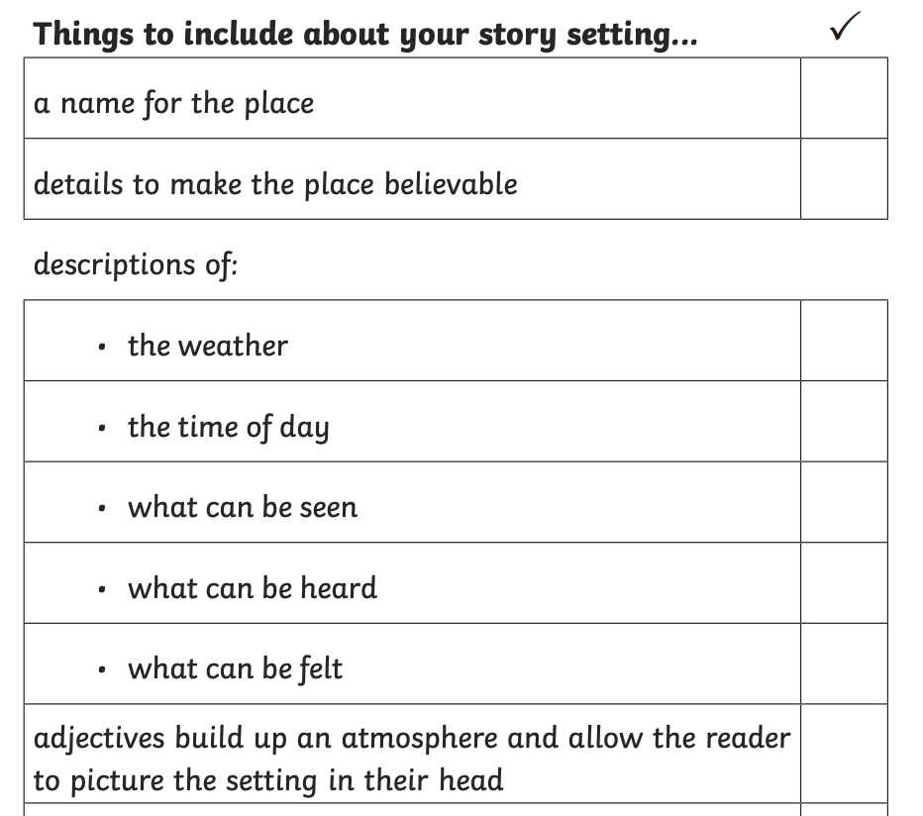
Class example:
Expanded noun phrases, similes, metaphors, exciting adjectives

Slide 15
LO – We are purple polishing our cold writes with a partner and identifying areas for improvement.
Lesson 6
Read through your cold write with a partner. Together, use purple pen to edit your work. Use a red pen to redo sections.

