Slide 1
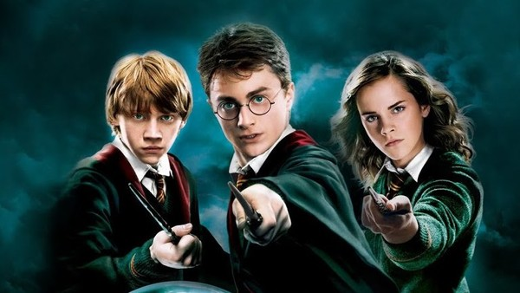
HARRY POTTER
QUIZ
BY DARCY!

Slide 2
Questions
1.Which of the Harry Potter cast is Mad Eye Moody’s son in real life?
2.How many times did Hermione turn the time turner?
3.What is Ron’s rat called?
4.Who was Hermione’s date to the Yule Ball?
5.What was the name of the tree Harry and Ron crashed their car into?

Slide 3
6.What is the Dursley’s address?
7.What flavours are Bertie Botts beans? Name 3
8.What animal represents Hufflepuff house?
9.Who is Harry Potter’s Godfather?
10.Which subject has a different teacher every year?

Slide 4
11. Name Harry’s parents!
12. What was the name of Harry’s owl?
13 .What is Draco Malfoy’s dad called?
14. Why did Dobby the house elf appear at Harry’s home?
15. What spell would you use to light the tip of your wand?
16. Name the killing curse!
17. What’s Harry’s wand made of?

Slide 5
18. Who was Harry’s first crush?
19. What is Harry’s Patronus?
20. What position did Harry play at Quidditch?

Slide 6
ANSWERS!!!
1. Bill
2.3
3.Scabbers
4.Victor Krum
5.Womping Willow
6.4 pirivet drive , Surry
7.Banana, black pepper, blueberry,booger,candyfloss, cherry, cinnamon, dirt, earthworm, earwax, grass, green apple, marshmellow, rotten egg, sausage, lemon, soap, tutti-frutt, vomit and watermelon.

Slide 7
ANSWERS
8. Badger
9. Sirius Black
10. Defence agaist the dark arts
11. Lily and James Potter
12.Hedwig
13. Lucius Malfoy
14.He came to warn Harry about the reopen of chamber of secrets

Slide 8
ANSWER
15. Lumos
16. Avada kedavra
17. Holly and a phoenix feather core
18. Cho Chang
19. A stag
20. Seeker

Slide 9
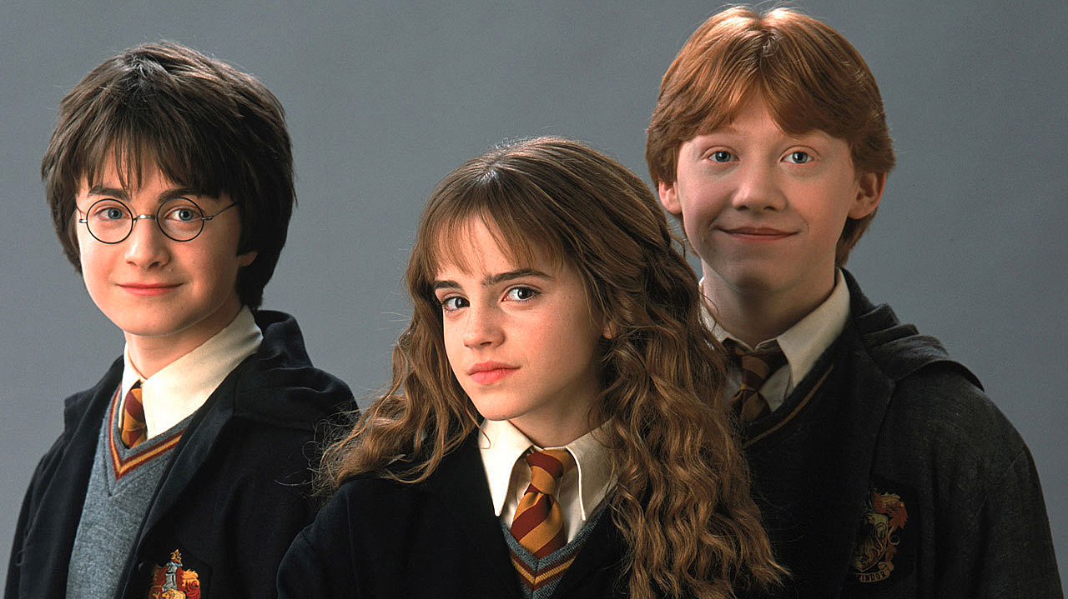
THANK YOU FOR DOING THIS QUIZ!!!

