Slide 1
Harry/Brians movie quiz
Contents: Harry potter
Star wars
marvel cinematic universe

Slide 2
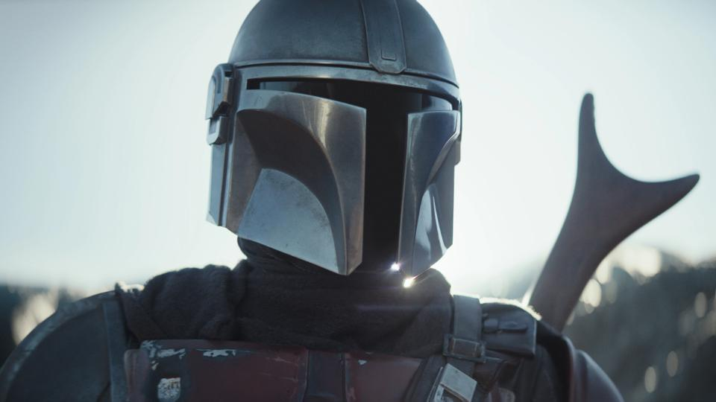
star wars

Slide 3
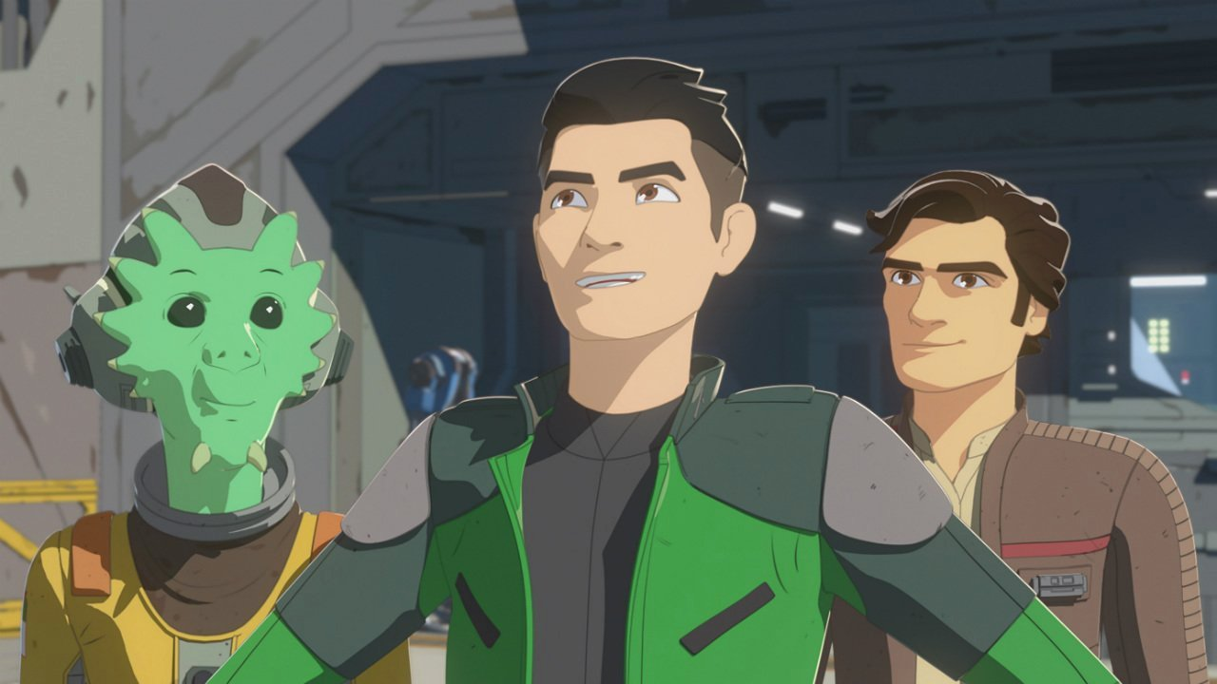
What TV show is this-

Slide 4
What is the name of the 501s commander

Slide 5
what is the name of the order that destroyed the jedi order

Slide 6
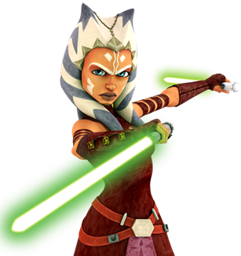
Who is this-

Slide 7
What is the capital of the republic

Slide 8
MARVEL CINEMATIC UNIVERSE

Slide 9
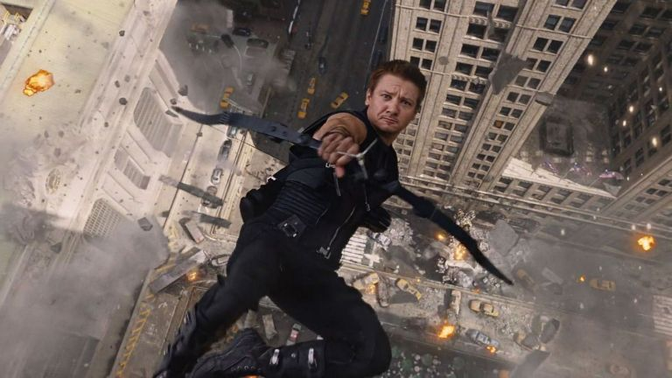
What is this marvel characters real name. (codename: Hawkeye)

Slide 10
What is the first name of Black Panthers actor

Slide 11
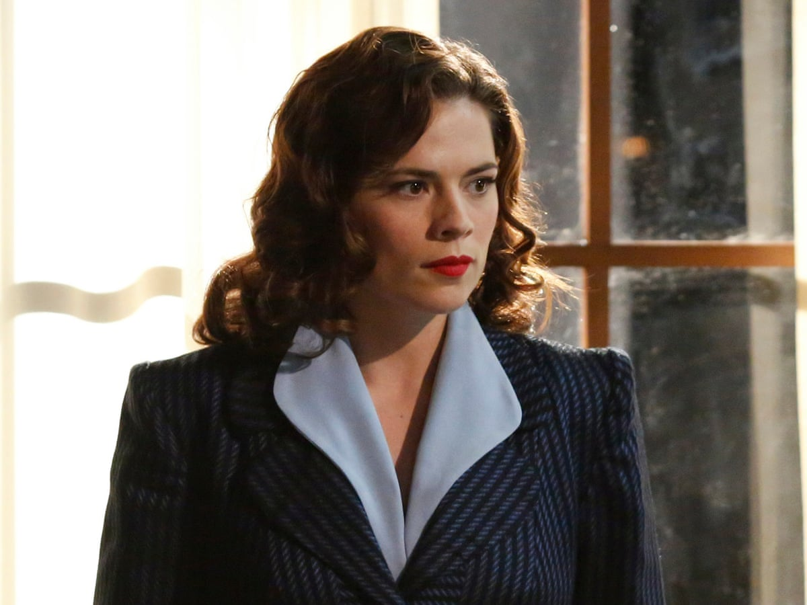
Who is this-

Slide 12
What is the name of the person who made marvel

Slide 13
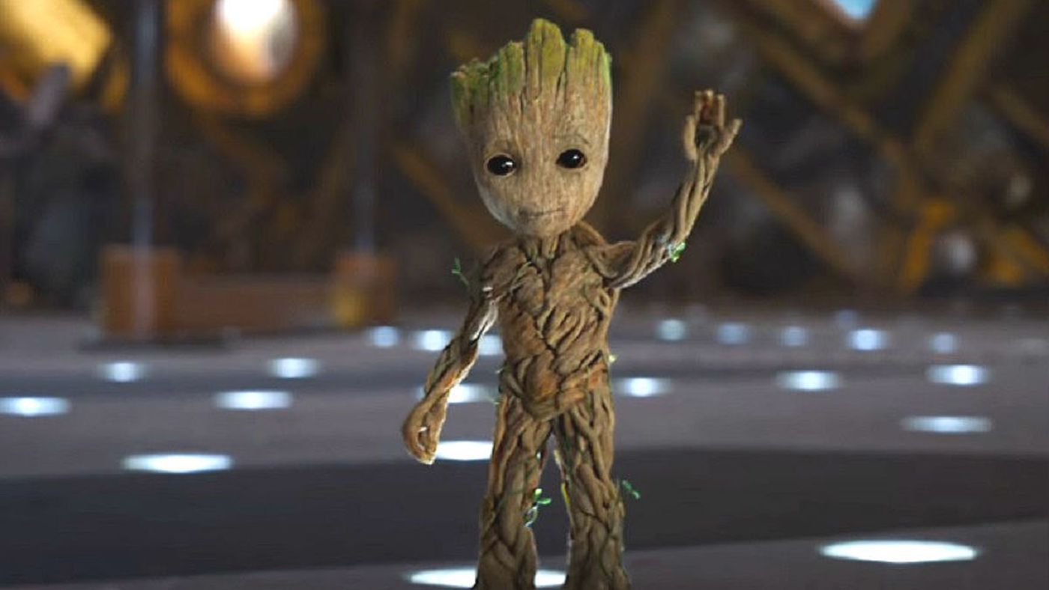
Who is this-

Slide 14
Harry potter

Slide 15
Who is Harrys best friend

Slide 16
Finish this sentence: “You’re a -

Slide 17
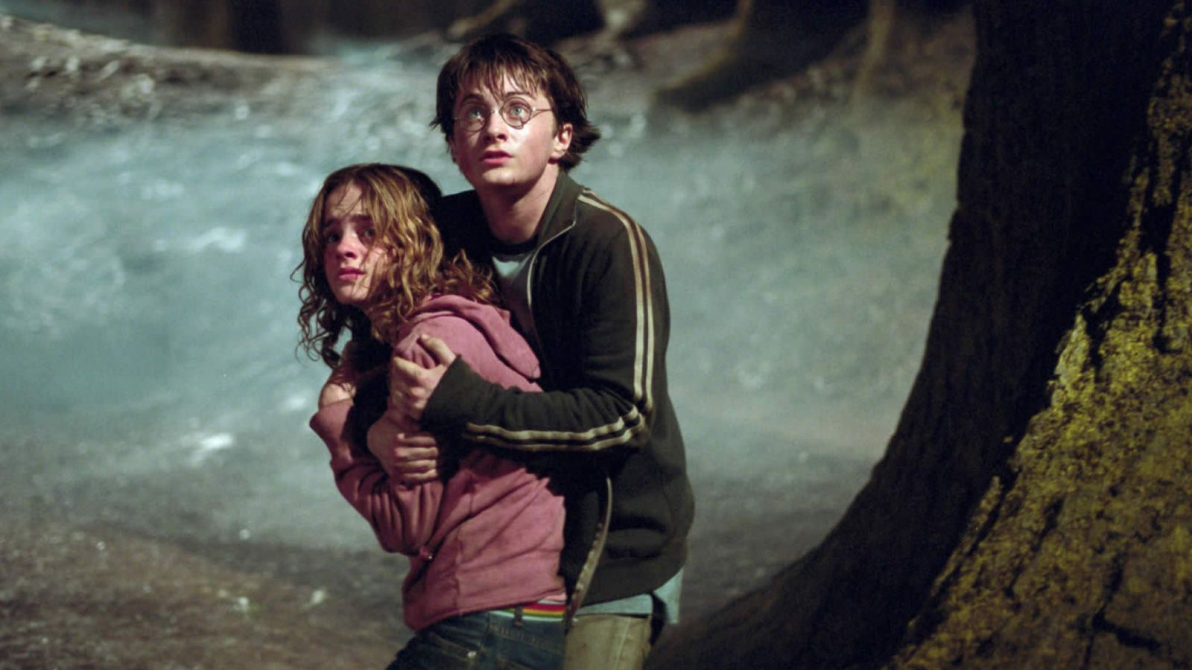
What film is this in-

Slide 18
How many books are there

Slide 19
What is the name of Harrys god farther

Slide 20
THANK YOU FOR DOING MY QUIZ
Next quiz, Harry/ Brians Gaming Quiz

