Slide 1




Year 1 - Autumn - Block 4
Place Value (within 20)

Slide 2
Circle the odd one out and explain why.
11 12 13 14
15 61 17 18

Slide 3

Mr Monaghan says,
Will Mr Monaghan say 11?
Explain how you know.
I am going to count to 20
I will start at 8

Slide 4

Teddy says,
Do you agree?
Explain your answer.
I can make all the numbers from eleven to twenty using the digits 1 – 9
1
2
3
4
5
6
7
8
9

Slide 5
Game
Use two sets of number cards.
One set with numerals 1–20, one set with words 1–20
Play in groups of 3 or 4
Take it in turns to pick a numeral card and a word card. Say the number on each card out loud. If they match you win the pair, if they don’t you put them back.

Slide 6


How many ways can you complete the part-whole model to show numbers up to 20, using the Base 10 equipment – you do not have to use it all.

Slide 7

Alex makes a part-whole model.
She says,
Explain her mistake.
What is her number?
There are 8 tens and 1 one.

Slide 8

Mo says,
How old is Mo?
How old is his sister?
I am one year older than my sister.
My sister is one year older than my brother.
My brother is 13

Slide 9
Use number cards 11 – 20
How many different ways can you complete the boxes?
is 1 more than
11
12
13
14
15
16
17
18
19
20

Slide 10


Teddy thinks of a number.
1 more than his number is 11
What is his number? Prove it.
Rosie thinks of a number.
1 less than her number is 15
What is her number? Prove it.
?
?

Slide 11
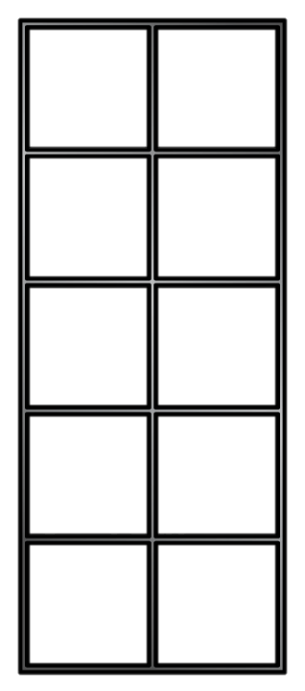


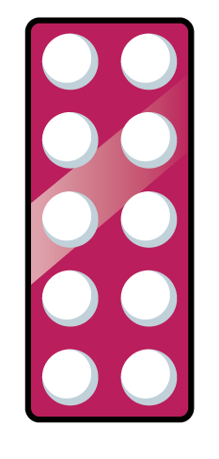





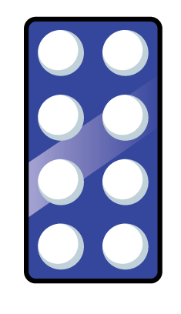


Which image is the odd one out?
Why?

Slide 12
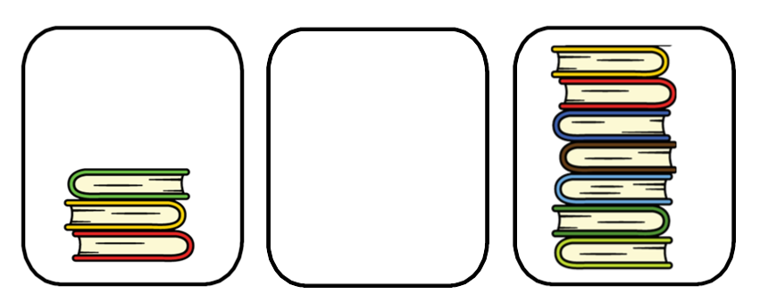

How many books can go in the empty box?
Compare with your partners- have you drawn the same amount of books?
How many possibilities are there?
Is it possible to have 3 or 7 books in the middle pile?
Least
Most

Slide 13


Dora has three jars of sweets.
A $=$ 12 B $=$ ____ C $=$ 17
She says,
How many sweets could be in B?
A has the least sweets.
C has the most sweets.

Slide 14
Fill the gaps:
______ is more than 15 but less than 20
______ is less than eighteen but more than twelve.
What numbers could go in the gaps?
Explain your answer.

Slide 15

All of the eggs are placed into baskets.
How many different ways can you make it correct?
Greatest Least

Slide 16






Alex orders the groups of objects from smallest to greatest.
Teddy says,
Do you agree with Teddy?
Has Alex done anything else wrong?
This is the incorrect order because there are more apples than chew bars.

Slide 17
Complete the image and match the numerals to the correct picture.
Order the numbers in each group from smallest to largest.
Order all of the numbers from smallest to largest.
11, 17, 19
14, 12, 5

Slide 18

Mr Monaghan says,
What could his number be?
My number is greater than 8 but less than 15

